Slide 1
Nervous System, Endocrine System, Reflexes, and the Brain
Oh my

Slide 2
Any questions from the reading?

Slide 3
The Nervous System
Nervous
system
Peripheral
Central
(brain and
spinal cord)
Autonomic
(self-regulated actions of the body)
Somatic
(voluntary movements of
skeletal muscles)
Sympathetic
(arousing)
Parasympathetic
(calming)

Slide 4
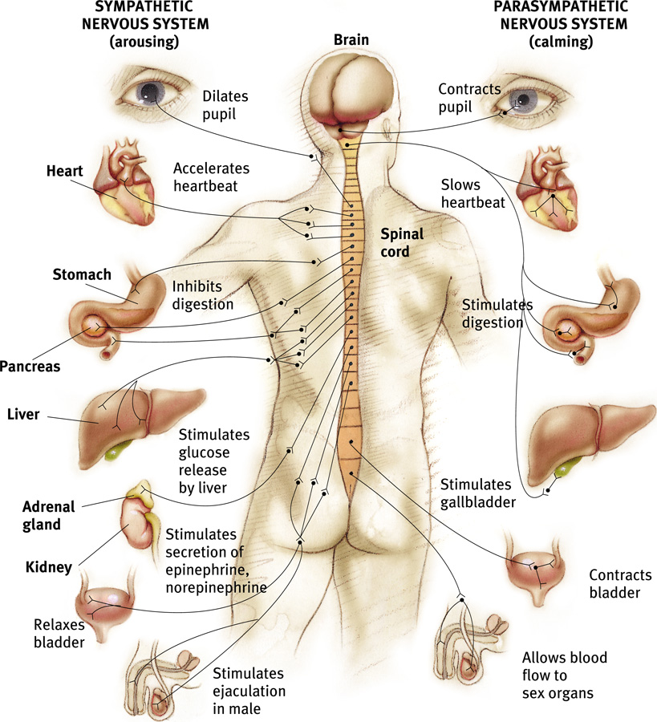
Autonomic Nervous System (ANS)
Sympathetic NS “Arouses”
(fight-or-flight)
Parasympathetic NS “Calms”
(rest and digest)

Slide 5
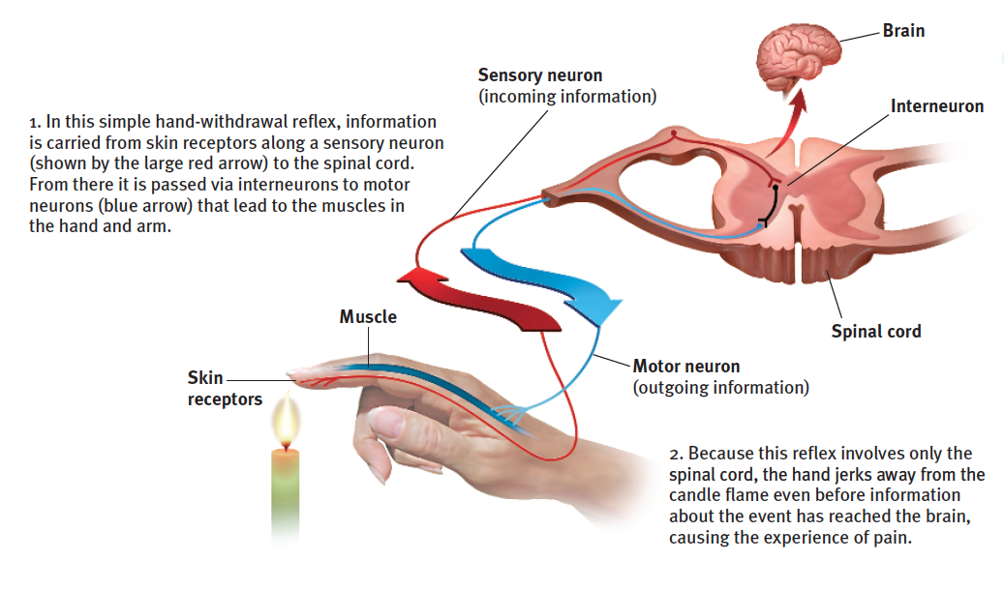
The Central Nervous System
Reflex = A simple, automatic, inborn response to a sensory stimulus

Slide 6
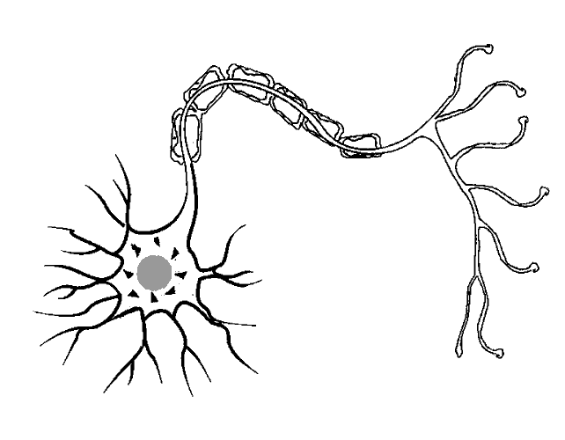
Kinds of Neurons
Sensory Neurons carry incoming information from the sense receptors to the CNS.
Motor Neurons carry outgoing information from the CNS to muscles and glands.
Interneurons relay messages between sensory and motor neurons.
Interneuron Neuron (Unipolar)
Sensory Neuron
(Bipolar)
Motor Neuron
(Multipolar)

Slide 7
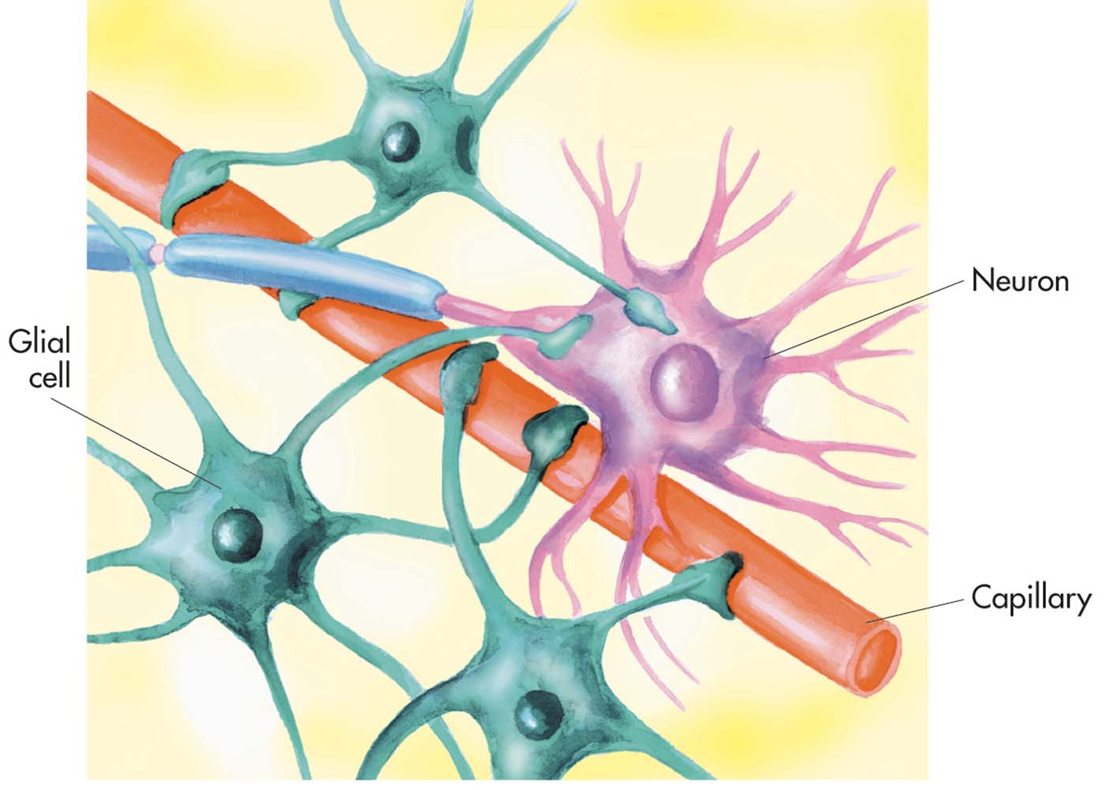
Types of Glial Cells
Glial cells = cells that support to neurons
Astrocytes = nutrition
Oligodendrocytes and Schwann cells provide myelin sheath
Astrocytes

Slide 8
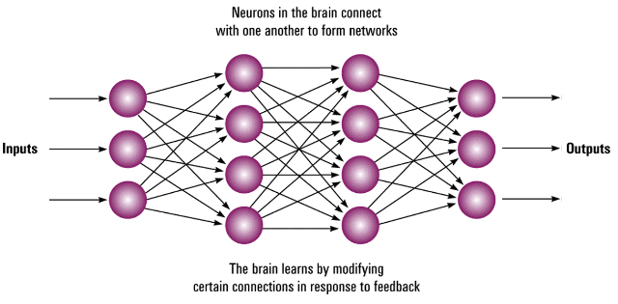
The Nervous System
Neural Networks
Interconnected neural cells
With experience, networks come stronger
“Muscle memory”
Neurons in the brain
connect with one
another to form networks
Inputs
Outputs
The brain learns by modifying
certain connections in
response to feedback

Slide 9
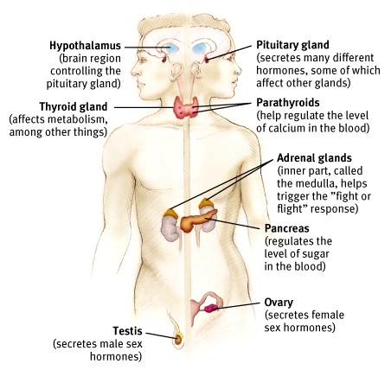
The Endocrine System
Endocrine System
The body’s “slow” chemical communication system
Consists of glands that secrete hormones into the bloodstream

Slide 10
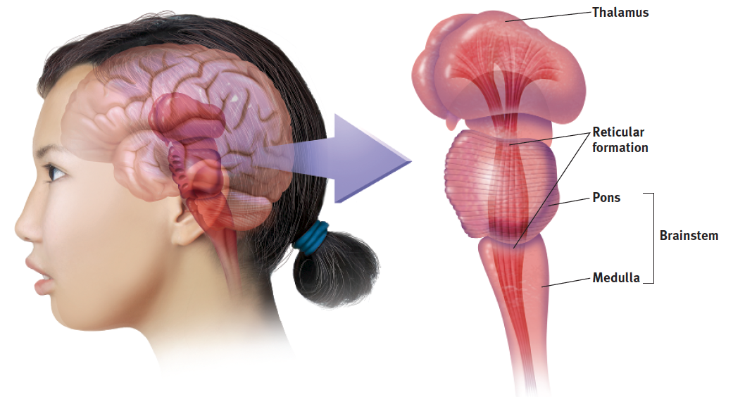
The Brainstem and Thalamus

Slide 11
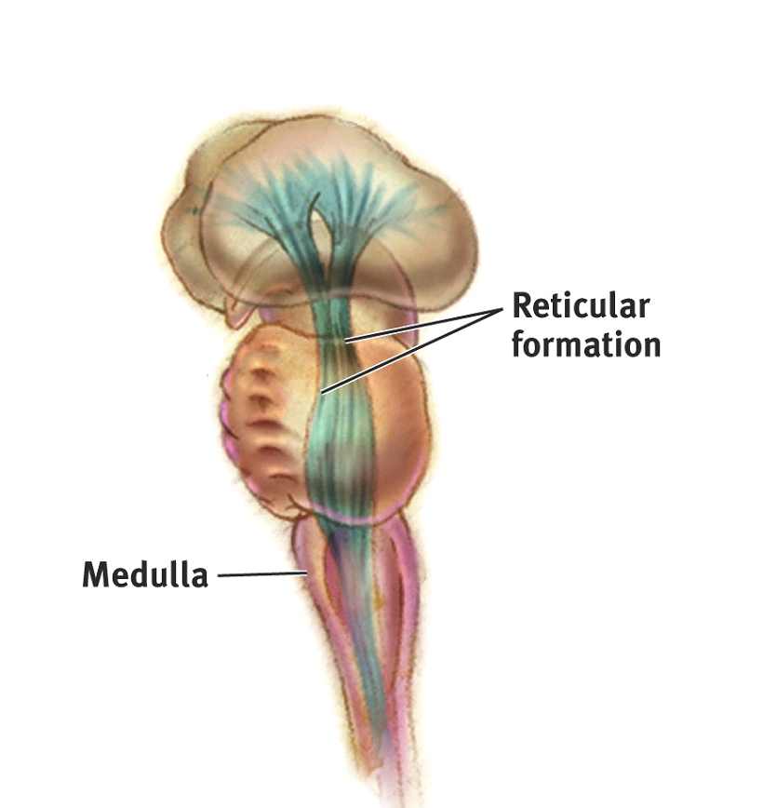
The Brainstem
Medulla
controls heartbeat and breathing
Reticular Formation
Controls arousal
3. Pons
Controls sleep, breathing, swallowing
Pons---------→

Slide 12
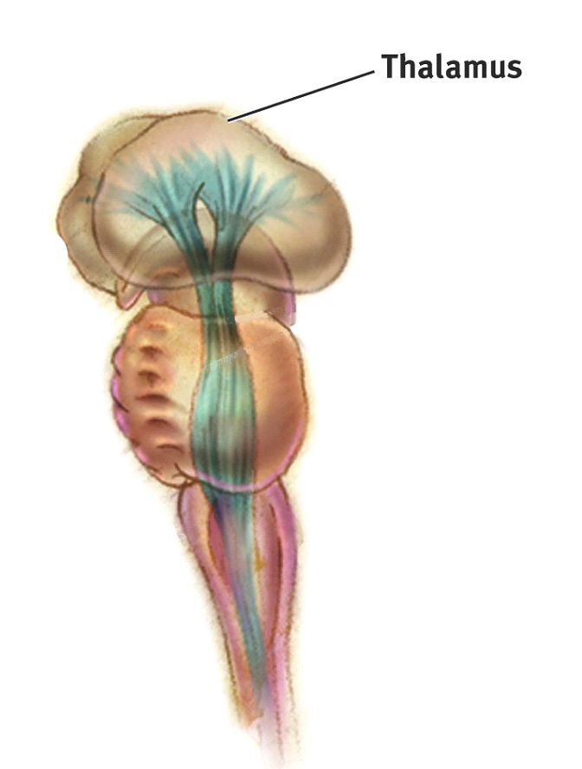
Thalamus
Thalamus
“The brain’s sensory switchboard”
Sends messages from sensory nerves to different parts of the cerebral cortex

Slide 13
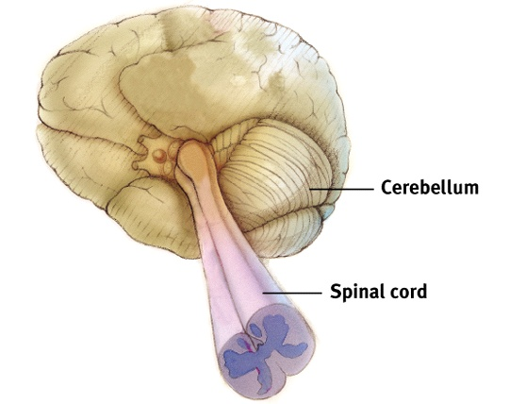
Cerebellum
Cerebellum “Little Brain” -- rear of the brainstem
Helps coordinate voluntary movement and balance

