Slide 1
Neuroscience
Neurons and Neurotransmitters

Slide 2
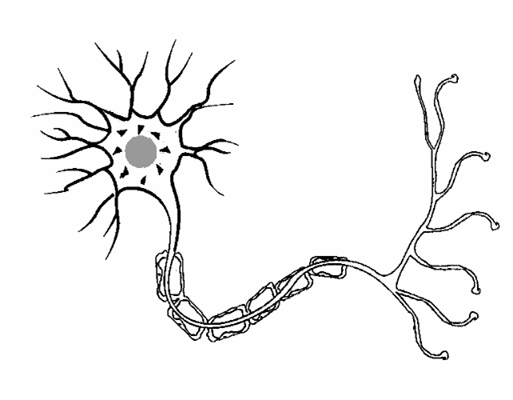

Slide 3
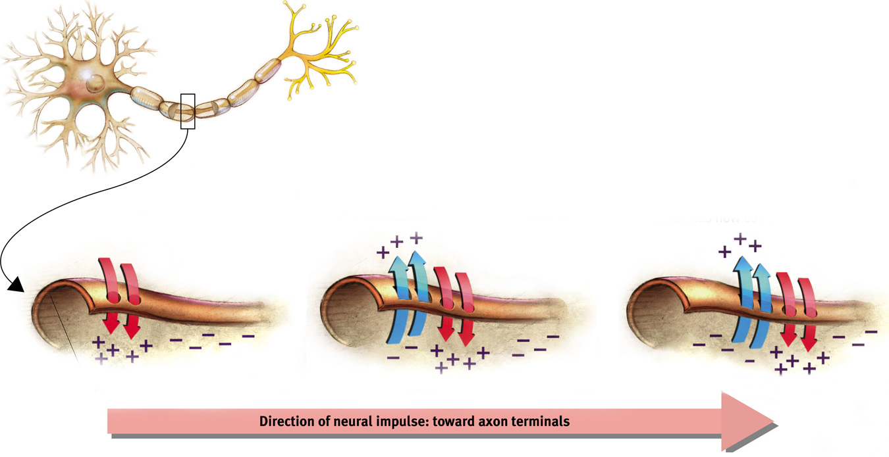
Action Potential and Threshold
Action Potential (A.K.A. Neural Impulse): An electrical charge that travels down an axon.

Slide 4
Key Terms for Action Potentials
Resting Membrane Potential – normal voltage of neural membrane
Threshold (Potential) – voltage needed to send an action potential
Depolarization – when axon is flooded by positive sodium ions (Na+)

Slide 5
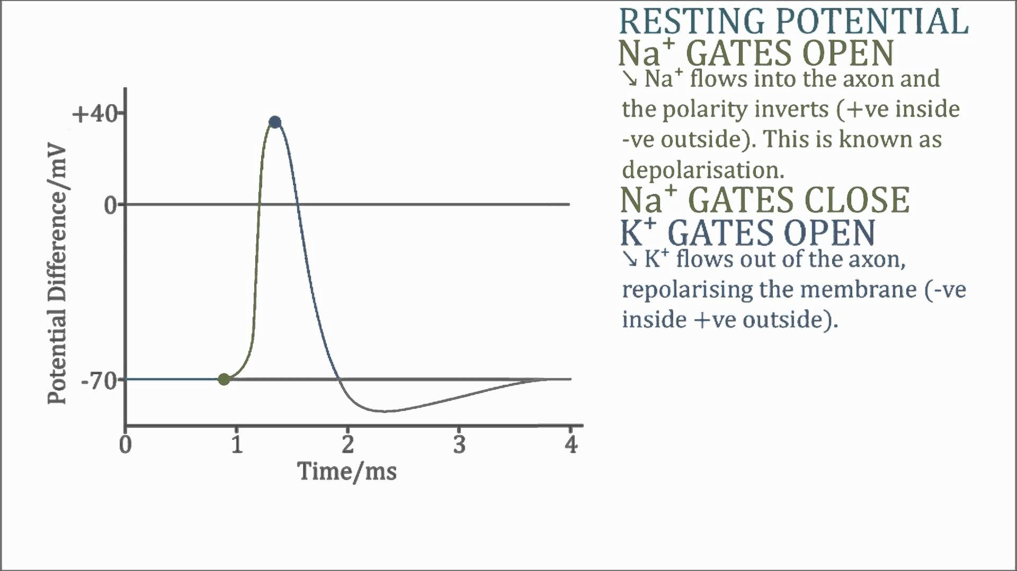
*

Slide 6
More Key Terms for Action Potentials
Repolarization – when the axon returns to its negative voltage (loses Na+ and K+ ions)
Hyperpolarization – when axon voltage is more negative than its resting membrane potential
Refractory Period – occurs during repolarization and hyperpolarization, a neuron is unable to fire another action potential

Slide 7
*

Slide 8
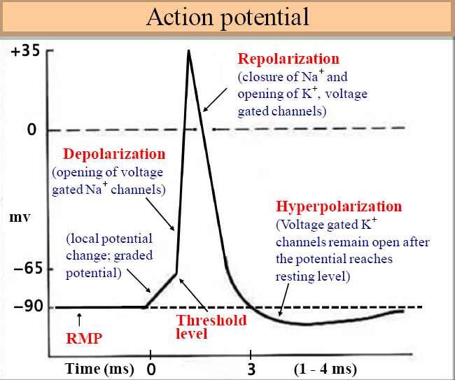

Slide 9
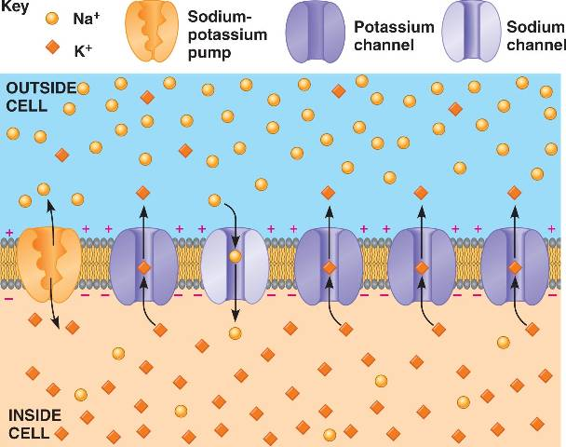
Sodium-Potassium Pumps
Sodium-Potassium Pumps: pumps positive ions out from the inside of the neuron, making them ready for another action potential.

Slide 10
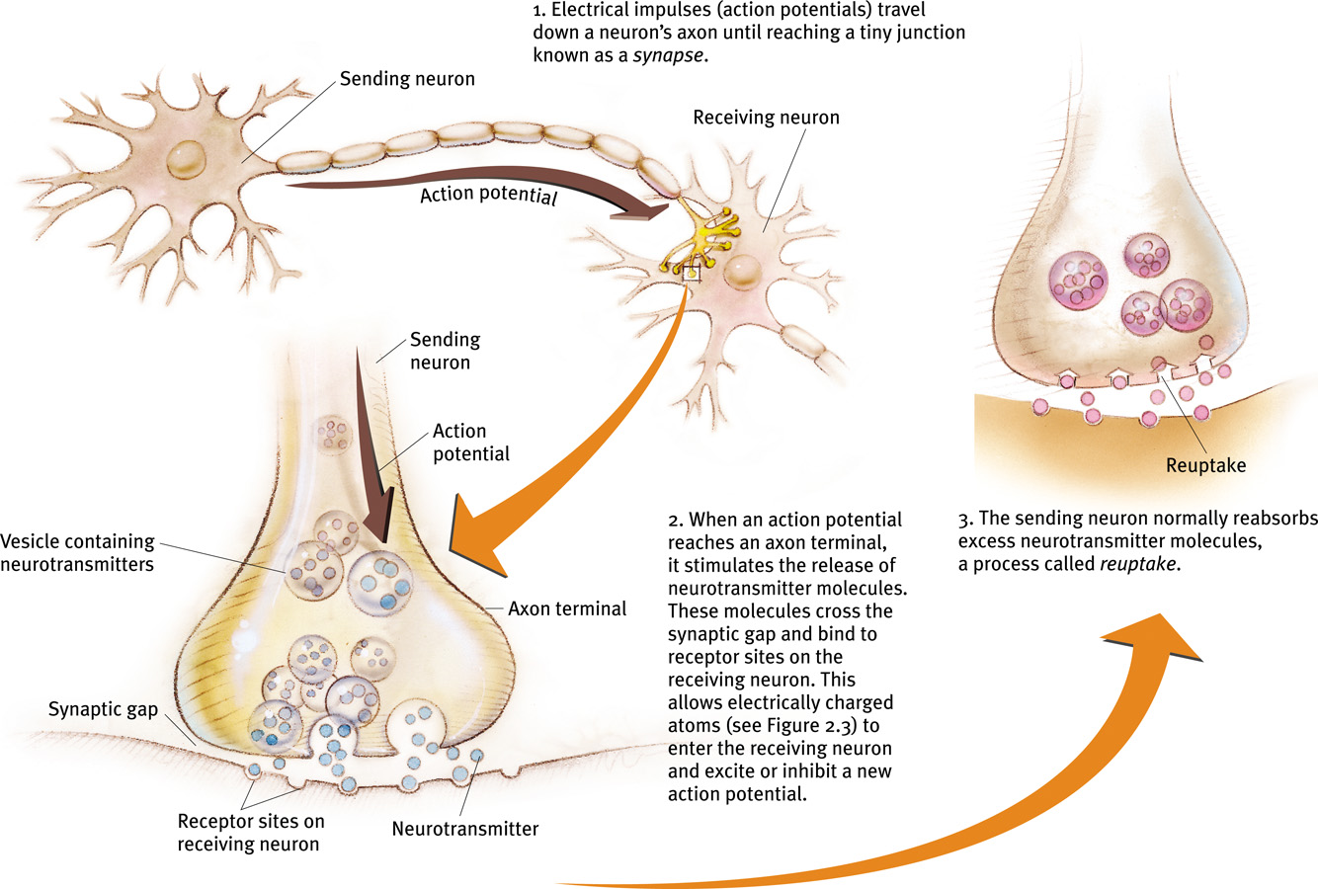
Neuron-to-Neuron Communication

Slide 11
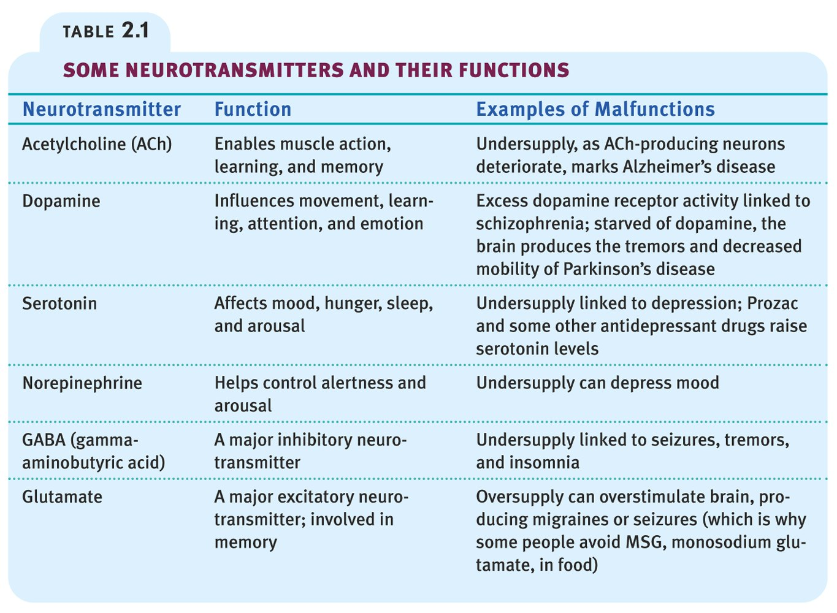
Check out this chart on page 58!

Slide 12
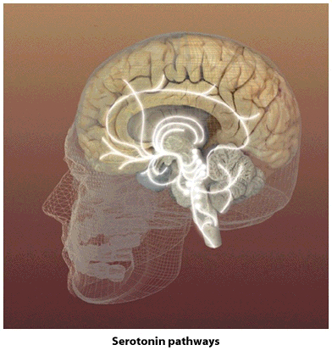
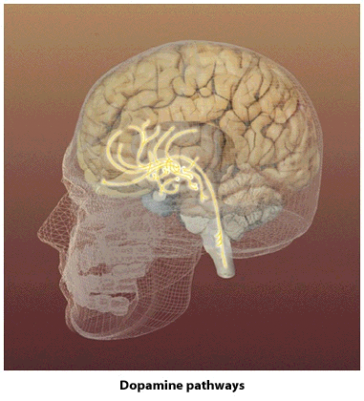
Neural Communication
Serotonin Pathways
Dopamine Pathways

Slide 13
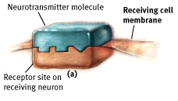
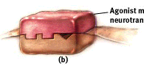
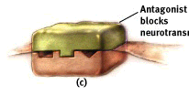
Neural Communication
Neurotransmitter
molecule
Receiving cell
membrane
Agonist mimics
neurotransmitter
Receptor site on
receiving neuron
Antagonist
blocks
neurotransmitter

Slide 14
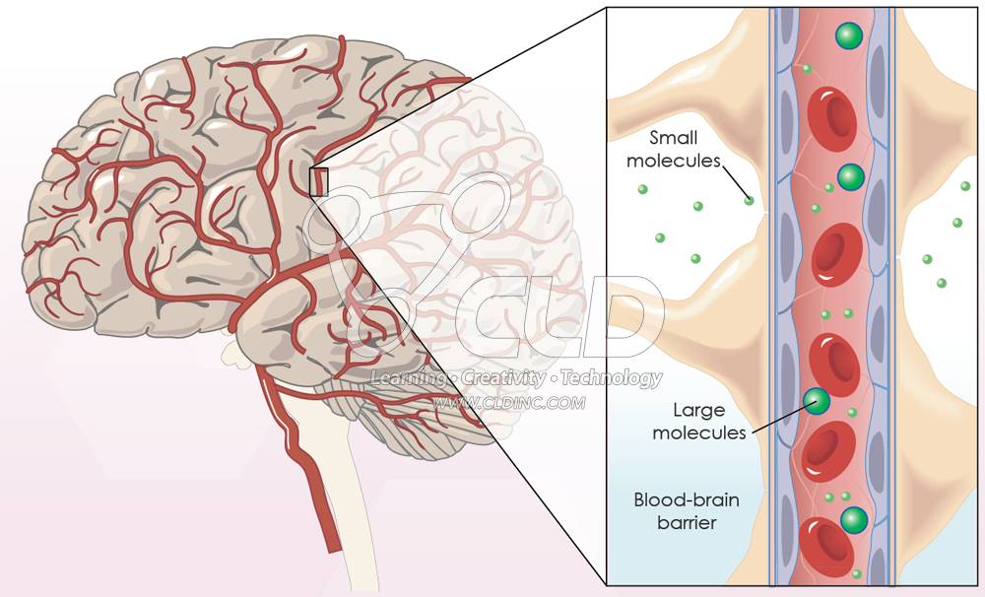
Blood-Brain Barrier
Barrier that separates blood and the brain and central nervous system.
Prevents toxic stuff from entering brain
Makes it hard to treat chemical imbalances in the brain

Slide 15
What Happens When an Action Potential is Fired
STEP 1: Stimulation from other neurons
STEP 2: Stimulation reaches threshold potential
STEP 3: Depolarization occurs when Na+ ions enter axon
STEP 4: Repolarization occurs when Na+ Channels close and K+ channels open
STEP 5: Hyperpolarization occurs when cell interior is more negative than its resting potential
STEP 6: Resting potential is reached when K+ returned to cell interior

