Slide 1
Progressivism Gets Big
From State to National Politics

Slide 2
Early Progressivism
Progressives changed local (state/city) laws 1st
Progressives later changed national laws
Considered a “grassroots” movement

Slide 3
Reforming Local Politics
Political corruption more common on local level
Attempt to eliminate political machines
Cities hired professionals to run cities
City Commissioners or City Managers
States passed Australian Ballot (secret ballot)

Slide 4
Reforming Local Politics
Progressives aimed to give people power
Initiative
Referendum
Recall
Direct Primary

Slide 5
Reforming National Politics
Corruption was less obvious in National Govt
Passed 17th Amendment
Direct election of US Senators

Slide 6
National Reforms
Meat Inspection Act (1906)
Pure Food and Drug Act (1906/1911)
Keating-Owen Act (1916) – declared unconstitutional
16th Amendment
18th Amendment
19th Amendment

Slide 7
National Reforms of Business
Elkins Act (1903)
Hepburn Act (1906)
Underwood-Simmons Tariff Act (1913)
Federal Reserve Act (1913)
Clayton Anti-Trust Act (1914)
Federal Trade Act (1914)

Slide 8
Roosevelt as Prez
Teddy Roosevelt = Prez after McKinley Assassination (1901)
Republican
Youngest president to serve…ever
TR was more active president than ever before
Wanted to fix problems

Slide 9
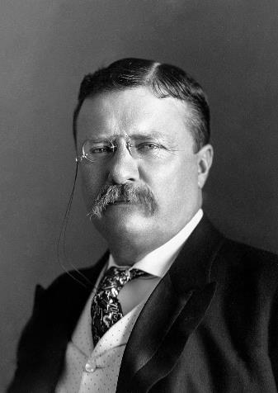
TR

Slide 10
Anthracite Coal Strike and the Square Deal
Coal miners went on strike in 1902
TR proposed a “square deal”
Compromise on demands of everyone
Seen as a big success for coal workers

Slide 11
Trustbusting Teddy
TR fought against “bad trusts”
“Bad Trusts” =
Exploited workers and consumers
“Good Trusts” =
Efficient
1st to enforce Sherman Anti-Trust Act

Slide 12
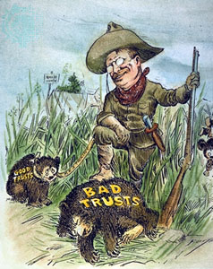

Slide 13
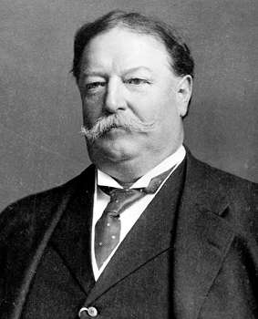
William Howard Taft
Republican William Howard Taft won
Not as skilled a politician
Republican Party splits between hard core reformers (Roosevelt) and moderates/conservatives (Taft)

Slide 14
Election of 1912
Republicans nominate Taft
Reformers form their own party, The Progressive Party
Progressives Nominate Roosevelt
Democrats nominate Woodrow Wilson
Split causes Wilson to win

Slide 15
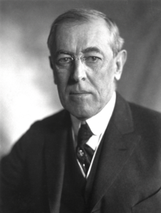
Woodrow Wilson
1st president from the South after Civil War
Progressive Democrat
Passed many progressive laws
President during WWI

