Slide 1
Reaganomics
Intro to Economics and Intro to Reagan’s Economics

Slide 2
Basic Econ Terms
Revenue = amount of $$ you make
For govts. taxes = revenue
Expenditures = amount of $$ you spend
For govts. expenditures = services (roads, welfare, law enforcement, military, etc.)
Budget = amount of money you intend to spend on things
What happens when your expenditures are bigger than your revenue?

Slide 3
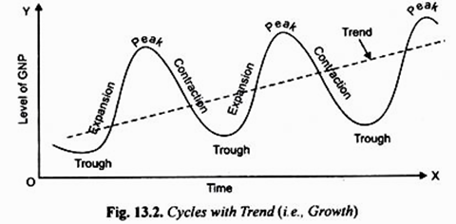
Remember Keynesian Economics?
Govt. borrows money to spend during economic crisis
Pros = adds jobs to the economy
Cons = adds to the national debt
Liberals supported this thinking
Conservatives opposed this thinking

Slide 4
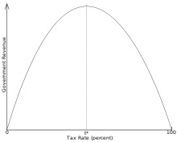
Supply Side Economics – Conservative Economics
Cutting taxes leads to economic boom
Cutting regulations (deregulation) leads to economic boom
Pros = decreases govt interference and increases personal wealth
Cons = ppl/businesses don’t always invest $$ and bad effects from degregulation

Slide 5
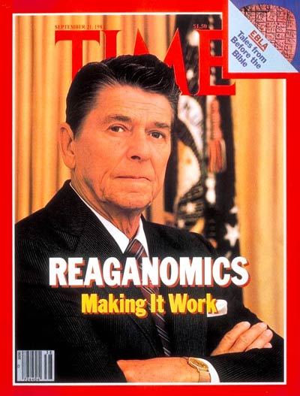
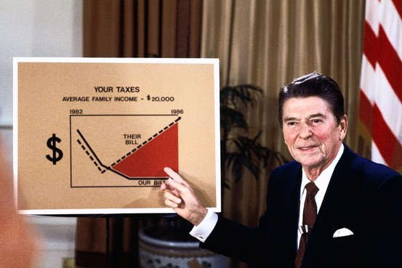
So what did Reagan do? Reaganomics
“Reaganomics”
Cut taxes
Cut federal govt spending
Cut govt regulations
Contract $$ supply

