Slide 1
Redlining

Slide 2
What is the practice of redlining
A form of housing discrimination where a person is denied a loan or home insurance based on their race and where they try to live.

Slide 3
What are the different Color Codes in redlining?
Green = Best/Most Desirable
Blue = Good/Still Desirable
Yellow = Declining/Risky
Red = Hazardous/Riskiest

Slide 4
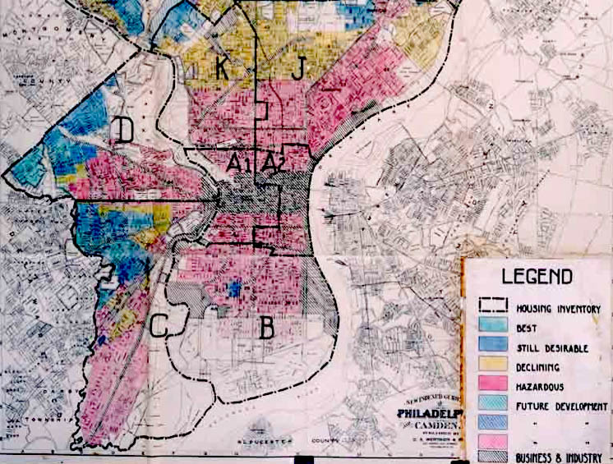

Slide 5
How did it lead to distinctly poor or wealthy neighborhoods?
Banks or insurance companies denied services to homes in red sectors
Banks or insurance companies denied minorities services in Blue or Green sectors
Made Red and Yellow sectors “rent only”

