Slide 1
Doing Research
Why do we do it in psychology?
What does research look like in psychology?

Slide 2
Are there any questions from Tuesday and Wednesday nights’ readings?

Slide 3
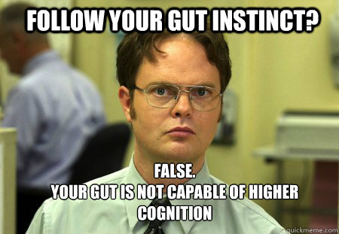
Intuition has its limits

Slide 4
Hindsight bias
What do you think most polls said the chances of Donald Trump becoming president on election night in 2016 (give your answer in %)?
What do you think you will score on tomorrow’s quiz?
How confident are you that you’ll get this score?

Slide 5
Hindsight Bias
Hindsight Bias a.k.a “I-knew-it-all-along” phenomenon.
Famous Examples:
Any economic crash (Great Depression and Recession)
NBA Draft Busts (Sam Bowie)
Elections…
Notes:
OBJECTIVE 1| Describe hindsight bias and explain how it can make research findings seem like mere common sense.
“Anything seems commonplace, once explained.” Dr. Watson to Sherlock Holmes.
Two phenomena – hindsight bias and judgmental overconfidence – illustrate why we cannot rely solely on intuition and common sense.

Slide 6
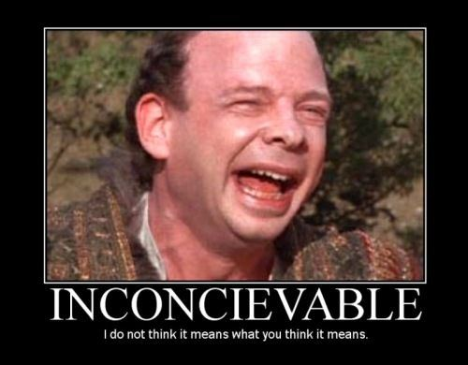
Everyone is susceptible to overconfidence
Anagram
WREAT
WATER
ETYRN
ENTRY
GRABE
BARGE
Notes:
OBJECTIVE 2| Describe how overconfidence contaminates our everyday judgments.

Slide 7
Research: Important Things to Remember
Eliminate any and all biases
Must create operational definitions
ODs = clear definitions of research variables
EX: Intelligence operationally defined as 4.0 GPA…

Slide 8
3 Forms of Research
RESEARCH | PURPOSE
Descriptive Research | Describes info via observation
Correlational Research | Finds associations between variables
Experimentation | Finds cause and effect between variables

Slide 9
Methods of Descriptive Research
Case Studies or Clinical Studies
Surveys
Naturalistic Observations

Slide 10
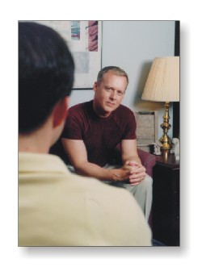
Case Studies
One individual is studied in depth
Clinical Study: Same method but with a psychotherapist and their patient
Pros?
Cons?
Do all patients respond similarly to psychotherapy?

Slide 11
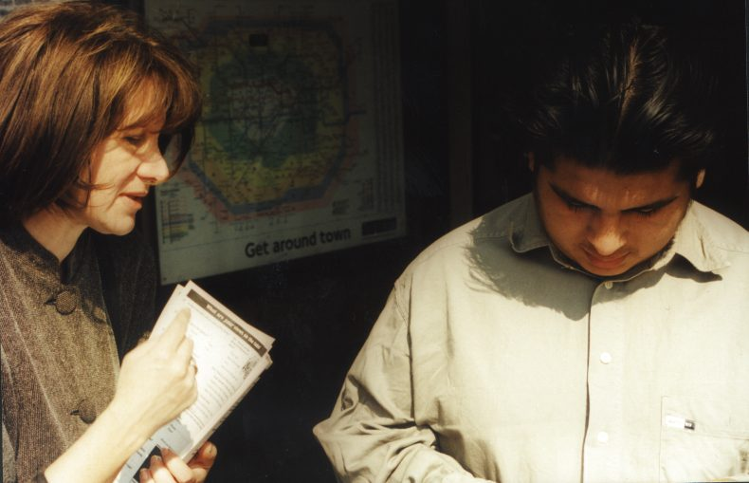
Surveys
People self-report attitudes, opinions or behaviors
Pros?

Slide 12
Sampling
Must be random and representative sample of the population
Population = everyone in the group being studied
False Consensus Effect

Slide 13
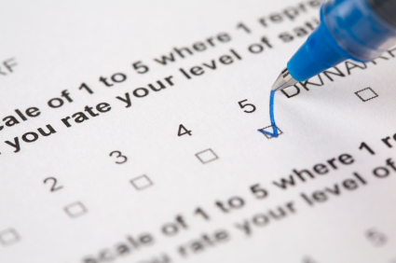
Words are Hard: Problems w/Framing
Wording can change the results of a survey.
Example:
“Should people be allowed to own guns?” OR “Should people be forbidden from owning guns?”

Slide 14
Can you think of any other challenges with surveys?

Slide 15
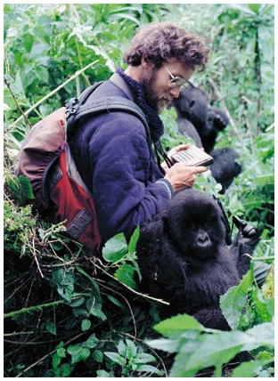
Naturalistic Observation
Observing and recording behavior in naturally occurring situations
Pros?
Cons?

Slide 16
Review Activity
You are a researcher trying to study and collect data about adolescent (12-20 yr. olds) vaping behavior.
For your assigned form of descriptive research, explain what you would do (how would you choose a population, what information you would try to collect, procedures, etc.) and the pitfalls of your assigned research method with this particular topic.
Desk # 1-7 = Survey
Desk # 8-14 = Case study
Desk # >14 = Naturalistic observation

Slide 17
Correlational Research
Correlation = When variables have a relationship
Direct/Positive correlation
Indirect/Negative correlation
Correlation Coefficient is a numerical measure of the relationship between two variables.
Notes:
OBJECTIVE 8| Describe positive and negative correlations and explain how correlational measures can aid the process of prediction.

Slide 18
Scatterplots
Perfectly negative
correlation (-1.00)
Perfectly positive
correlation (+1.00)
No relationship (0.00)

Slide 19
Correlation DOES NOT equal causation
Notable correlations:
Positive correlation between crime rates and ice cream sales
Positive correlation between time watching tv and obesity
Pellagra outbreaks and poor sewage in the Southeast in 1800s

Slide 20
Illusory Correlation
Perceiving a relationship where no relationship actually exists.
We are willing to look at some evidence but not all
Ex:
When in doubt circle “B”
Crime rates are higher during a full moon.
Notes:
OBJECTIVE 10| Describe how people form illusory correlations.

Slide 21
Experimentation: Basic procedure
Researcher manipulates variable to observe its effect
Independent Variable (IV) = variable manipulated by researcher
Dependent variable (DV) = variable that is impacted by IV

Slide 22
Experiments must have…
A control group
Avoid confounding variables
An experimental group
Random sampling
Random assignment

Slide 23
Methods of doing a control condition
Double-Blind Procedure
Placebo
Placebos may CAUSE the placebo effect

