Slide 1
Reviewing Units 6-8
Unit 6 – Memory
Unit 7 – Thinking, Language, and Intelligence
Unit 8 – Motivation, Emotions, and Stress

Slide 2
3 Steps of Memory
Encoding → Storage → Retrieval
3 stage model (old school):

Slide 3
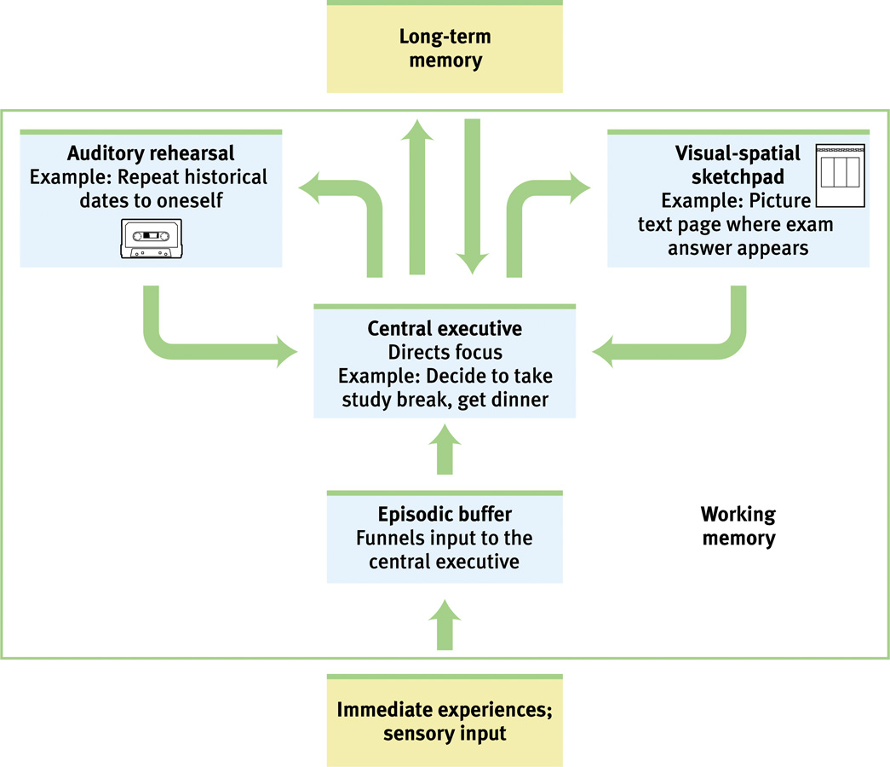
Alan Baddeley’s Working Memory Model

Slide 4
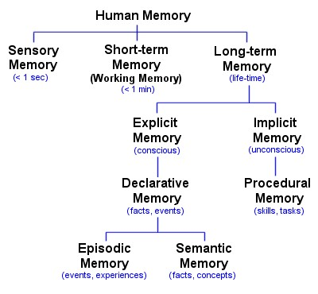
Types of Memory

Slide 5
Biological Basis of Memory
Long-term potentiation – strengthening of neural connections thru rehearsal
Declarative memories processed in hippocampus
Procedural memories processed in cerebellum

Slide 6
Types of Processing
Effortful
Ebbinghaus → Rehearsal
Automatic
Unconscious

Slide 7
Types of Encoding
Visual
Acoustic
Semantic
Which is the best one on it’s own?

Slide 8
Retrieval Tips
Chunking
Hierarchy
Mnemonic Devices
Method of Loci
Rhyming
Acronyms

Slide 9
Retrieval Tendencies
Serial Position Effect
Primacy Effect
Recency Effect
Mood-congruent memories
State-dependent memories
Recognition vs Recall

Slide 10
Retrieval Problems
Proactive Interference
Retroactive Interference
Tip-of-the-Tongue Phenomenon
Anterograde Amnesia – can’t form new memories
Retrograde Amnesia – can’t retrieve old memories

Slide 11
Fake Memories
Misinformation effect
Recovered memories
Constructed memories

Slide 12
How we think
Prototypes – mental image for each concept
Schema formation during development…
Assimilation
Accommodation

Slide 13
Problem Solving
Insight – “Eureka!” moment
Algorithm – step-by-step process
Slow
Always works…
Heuristics – a shortcut
Fast
Sometimes leads you to wrong answer

Slide 14
Heuristics
Availability heuristic – based on most recent memory
Representativeness heuristic – based on matching a prototype

Slide 15
Impediment to Problem Solving
Functional fixedness
Confirmation bias
Belief bias
Mental Set
Belief perserverance

Slide 16
Creativity and Problem Solving
Divergent thinking – multiple answers to problem
Convergent thinking – single answer to problem

Slide 17
Language Basics
Phonemes – smallest distinctive sound units
Morphemes – smallest unit of meaningful sound
Grammar
Syntax – word order
Semantics - meaning

Slide 18
Language Acquisition
Babbling stage – noise, not language
One-word stage
Two-word stage – telegraphic speech
Theories:
Noam Chomsky – innate language ability
Critical Period - Genie
Skinner – language is conditioned

Slide 19
Language and Thinking
Benjamin Whorf – linguistic relativity hypothesis
Can you think without language?
Do people who speak different languages think differently

Slide 20
Theories on Intelligence
Charles Spearman – g factor
Howard Gardner – Multiple intelligences
Robert Sternberg – Triarchic theory of intelligence
Emotional Intelligence (EQ) – is it a form of intelligence?

Slide 21
Intelligence Tests
Alfred Binet – the first one
The Stanford-Binet Test
Created by Lewis Terman’s
Used for eugenics purposes
WAIS and WISC
Weschler Adult Intelligent Scale
Wescheler Intelligence Scale for Children
Achievement vs Aptitude Tests
The Flynn Effect

Slide 22
Test Making Principles
Validity
Content validity
Predictive validity
Reliability
Split-half reliability
Test-retest reliability
Standardization

Slide 23
Theories on Emotion
James-Lange Theory
Physiological arousal comes first
Cannon-Bard Theory
Arousal and Cognitive Awareness = simultaneous
Schachter-Singer Theory (a.k.a. Two Factor Theory)
Arousal + Cognitive Label = full emotion

Slide 24
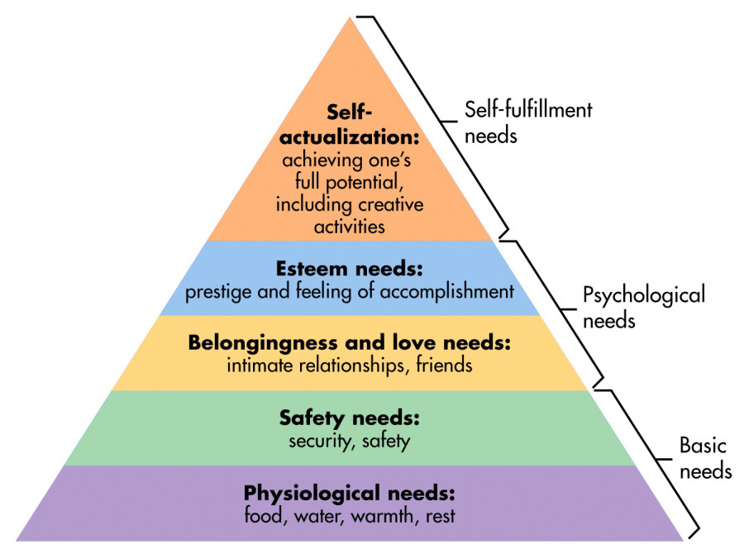
Motivation Theories
Instinct theory → more for non-human animals
Arousal theory → need optimum level of arousal
Drive Reduction Theory → based on homeostasis
Need creates drive to reduce need
Maslow’s Hierarchy of Needs

Slide 25
Hunger and Motivation – Biological Roots
Hormone | Tissue | Response
Orexin increase | Hypothalamus | Increases hunger
Ghrelin increase | Stomach | Increases hunger
Insulin increase | Pancreas | Increases hunger
Leptin increase | Fat cells | Decreases hunger
PPY increase | Digestive tract | Decreases hunger

Slide 26
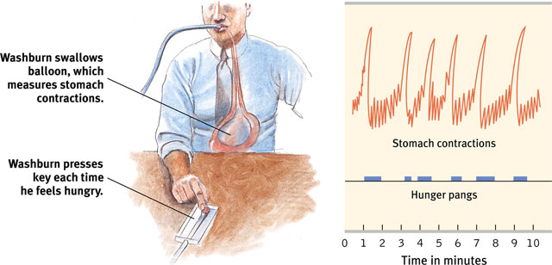
Hunger and Motivation – Biological Roots
Set Point Theory
Changes in Basal Metabolic Rate
Hunger pangs caused by stomach contractions

Slide 27
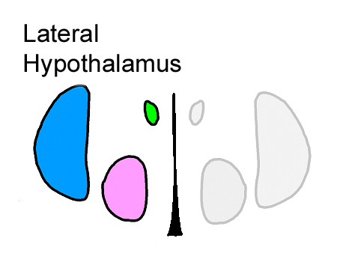
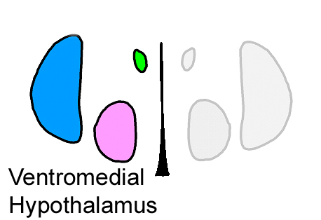
Hunger and Motivation – Biological Roots
Lateral Hypothalamus
Ventromedial Hypothalamus
Increases hunger
(when stimulated)
Decreases hunger
(when stimulated)

Slide 28
Hunger and Motivation – Psychological Roots
Eating disorders
Bulimia
Anorexia nervosa
Obesity
Eat when we’re bored (arousal theory)
Different emotional states influence hunger
Cultures influence hunger

Slide 29
Sexual Motivation – Biological Roots
Human Sexual Response Cycle – Masters and Johnson
E
P
O
R
Hormones play an incomplete role in humans.
Which ones?
Biological basis of sexual orientation
Hypothalamus structure and genetic evidence

Slide 30
Sexual Motivation – Psychological Roots
Sexual arousal caused by erotic material or thoughts
Sexual arousal leads to (not caused by) elevated sex hormones
Alfred Kinsey research…

Slide 31
Other Types of Motivation
Achievement motivation
Motivation to set goals and accomplish them.
Extrinsic motivation
Motivation caused by external rewards
Doesn’t have to be tangible rewards (social acceptance = external reward)
Intrinsic motivation
Motivated by self-satisfaction and enjoyment of task
Using rewards can eliminate intrinsic motivation

Slide 32
Management Theories
Theory X – managers believe employees only have extrinsic motivation
Rewards and punishment should be used to manage workers
Theory Y – managers believe employees have intrinsic motivation
Work policies should encourage intrinsic motivation

Slide 33
Conflicting Motivation
Approach-Approach Conflict
Choosing between 2 desirable options
Avoidance-Avoidance Conflict
Choosing between 2 undesirable options
Approach-Avoidance Conflict
When one thing has desirable AND undesirable options
Example: Choosing where to go to college…

Slide 34
Stress
Stress = life events (stressors) or your rxn to life events (“I’m stressed out”)
Hans Selye’s General Adaptation Syndrome
Deals with physiological response to stress
A
R
E
Locus of control
Internal vs External

