Slide 1
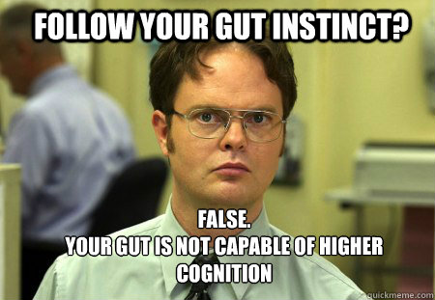
Intuition has its limits

Slide 2
Hindsight Bias
Hindsight Bias a.k.a “I-knew-it-all-along” phenomenon.
Famous Examples:
Any economic crash (Great Depression and Recession)
NBA Draft Busts (Sam Bowie)
Elections…
Notes:
OBJECTIVE 1| Describe hindsight bias and explain how it can make research findings seem like mere common sense.
“Anything seems commonplace, once explained.” Dr. Watson to Sherlock Holmes.
Two phenomena – hindsight bias and judgmental overconfidence – illustrate why we cannot rely solely on intuition and common sense.

Slide 3
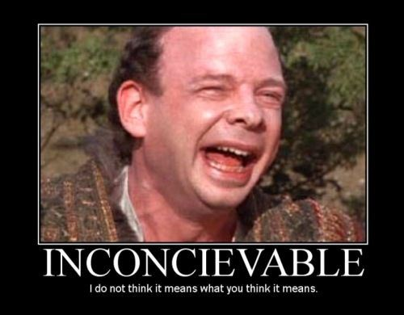
Everyone is susceptible to overconfidence
Anagram
WREAT
WATER
ETYRN
ENTRY
GRABE
BARGE
Notes:
OBJECTIVE 2| Describe how overconfidence contaminates our everyday judgments.

Slide 4
Practice
Do you remember what color tie I was wearing yesterday?
2. What percentage of the class do you think can correctly remember the color tie I was wearing yesterday?
100%
75%
50%
25%
0%
3. What color tie was I wearing yesterday?

Slide 5
Yesterday

Slide 6
The Scientific Method: Research Process

Slide 7
Operational Definition
A statement of procedures (operations) used to define research variables
Example:
Being “intelligent” may be operationally defined as having a 4.0 GPA.

Slide 8
Practice
Go through the steps of the scientific method using one of the following ideas as the “theory” (include a hypothesis, experiment, and operational definitions):
Height is the most common factor in a successful life
Attractive people have the saddest marriages
The more money you have the more friends you have
Criminals are angry people

Slide 9
Methods of Description
Case Studies
Surveys
Naturalistic Observations

Slide 10
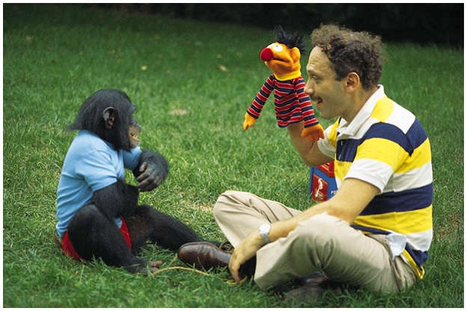
Case Study
One person is studied in depth to reveal underlying behavioral principles.
Is language uniquely human?
Notes:
OBJECTIVE 5| Identify the advantages and disadvantages of case studies in studying behavior and mental processes.

Slide 11
Case Study
Clinical Study
A clinical study is a form of case study in which the therapist investigates the problems associated with a client.

Slide 12
Survey
People self-report attitudes, opinions or behaviors
Usually done by questioning a representative, random sample of people.
Notes:
OBJECTIVE 6| Identify the advantages and disadvantages of surveys in studying behavior and mental processes, and explain the importance of wording effects and random sampling.

Slide 13
Random Sampling
Unbiased Sample = If each member of a population has an equal chance of inclusion into a sample
Biased samples make survey results invalid.
The fastest way to know about the marble color ratio is to blindly transfer a few into a smaller jar and count them.

Slide 14
Survey Challenges
Wording Effect
Wording can change the results of a survey.
Example:
“Should people be allowed to own guns?” OR “Should people be forbidden from owning guns?”
False Consensus Effect
Tendency to overestimate the extent to which others share our beliefs and behaviors

Slide 15
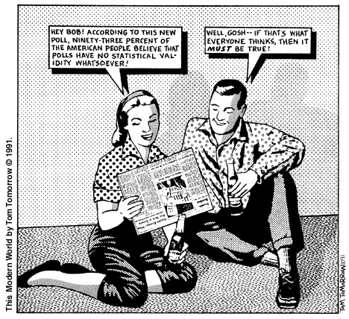

Slide 16
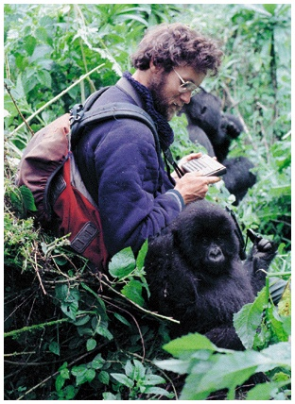
Naturalistic Observation
Observing and recording behavior in naturally occurring situations without trying to manipulate and control the situation

Slide 17
Correlation
When one trait or behavior accompanies another, we say the two correlate.
Indicates strength
of relationship
(0.00 to 1.00)
Correlation
coefficient
r =
+
0.37
Correlation Coefficient is a statistical measure of the relationship between two variables.
Indicates direction
of relationship
(positive or negative)
Notes:
OBJECTIVE 8| Describe positive and negative correlations and explain how correlational measures can aid the process of prediction.

Slide 18
Scatterplots
Perfect negative
correlation (-1.00)
No relationship (0.00)
Perfect positive
correlation (+1.00)
Scatterplot is a graph comprised of points that are generated by values of two variables.
The slope of the points depicts the direction, while the amount of scatter depicts the strength of the relationship.

Slide 19
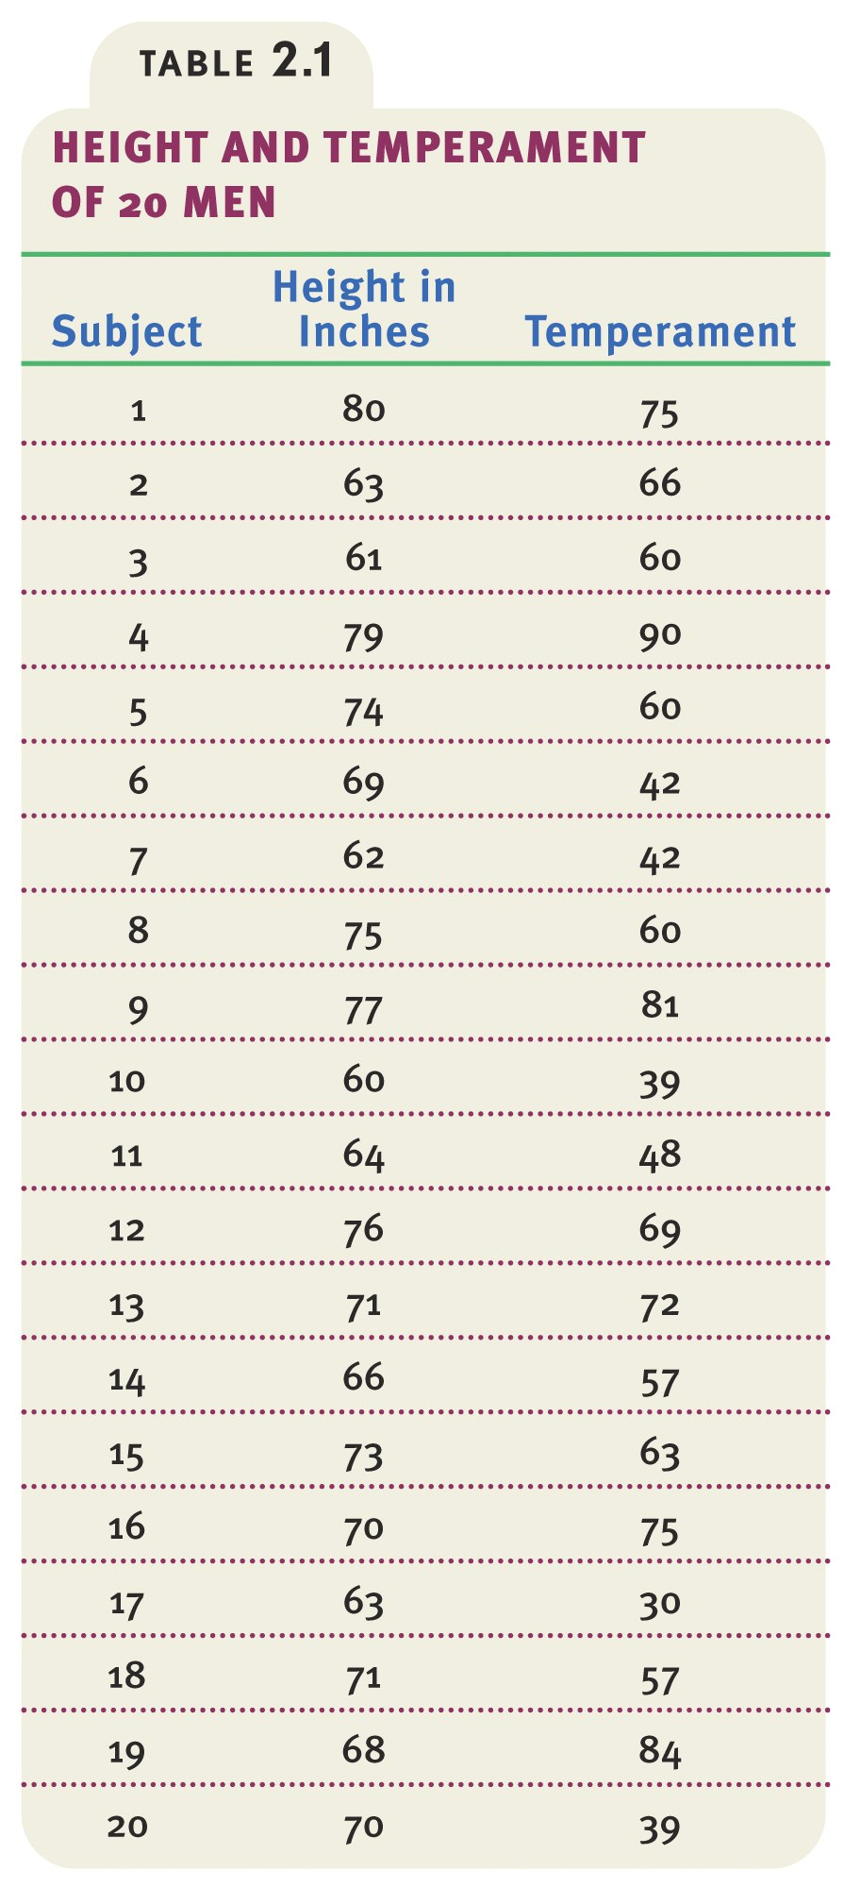
Data
Data showing height and temperament in people.

Slide 20
Scatterplot
The Scatterplot below shows the relationship between height and temperament in people. There is a moderate positive correlation of +0.63.

Slide 21
Correlation and Causation
or
Notes:
OBJECTIVE 9| Explain why correlational research fails to provide evidence of cause-effect relationships.

Slide 22
Correlation does not equal causation
Notable correlations:
Positive correlation between crime rates and ice cream sales
Positive correlation between time watching tv and obesity
Pellagra outbreaks and poor sewage in the Southeast

Slide 23
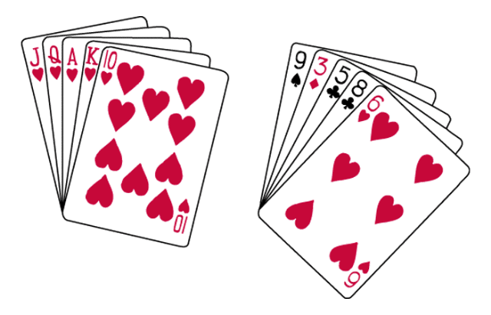
Order in Random Events
Given random data, we look for order and meaningful patterns.
Your chances of being dealt either of these hands is precisely the same: 1 in 2,598,960.

Slide 24
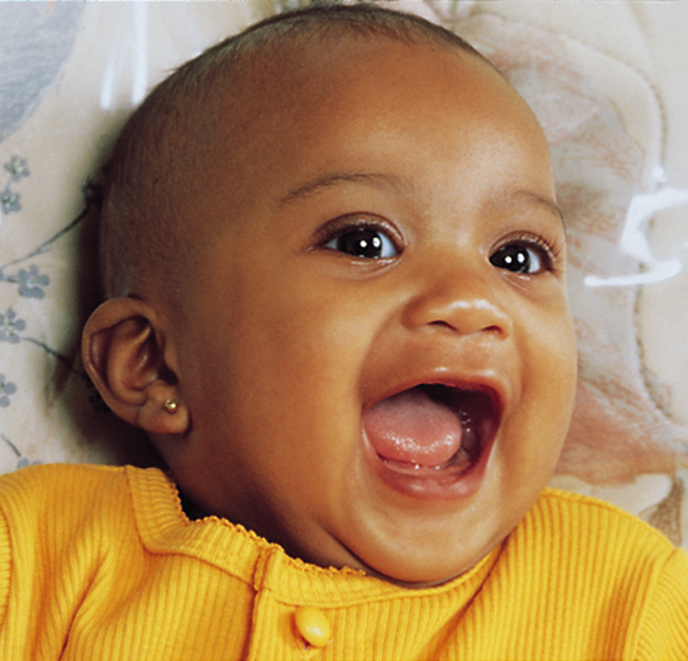
Illusory Correlation
The perception of a relationship where no relationship actually exists.
We are willing to look at some evidence but not all
Ex:
-Crime rates are higher during a full moon.
-More likely to conceive after you adopt a child
Do not conceive
Conceive
Adopt
Confirming evidence
Disconfirming evidence
Michael Newman Jr./ Photo Edit
Do not
adopt
Disconfirming evidence
Confirming evidence
Notes:
OBJECTIVE 10| Describe how people form illusory correlations.

Slide 25
Experimentation
Experiment
An investigator manipulates one or more factors (independent variables) to observe their effect on some behavior or mental process (dependent variable)
By random assignment of participants the experiment controls other relevant factors
Notes:
OBJECTIVE 12| Explain how experiments help researchers isolate cause and effect.

Slide 26
Experimentation
Experimental Condition
The condition of an experiment that exposes participants to the treatment, that is, to one version of the independent variable
Control Condition
The condition of an experiment that contrasts with the experimental treatment
Serves as a comparison for evaluating the effect of the treatment

Slide 27
Experimentation
Double-blind Procedure
Both the research participants and the research staff are ignorant (blind) about whether the research participants have received the treatment or a placebo
Commonly used in drug-evaluation studies

Slide 28
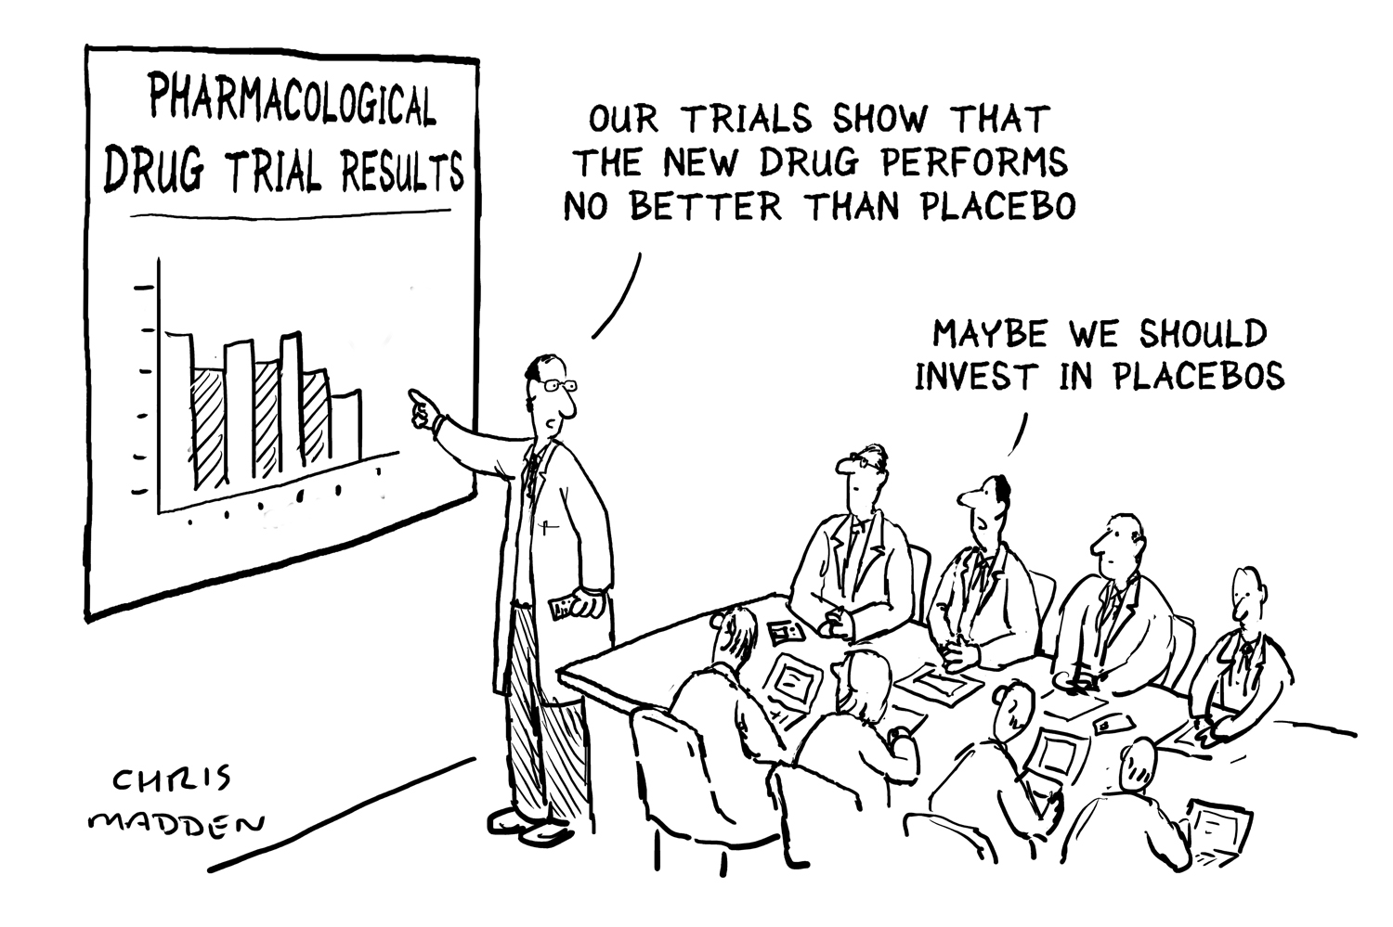
Experimentation
Placebo
An inert substance or condition that may be administered instead of a presumed active agent, such as a drug, to see if it triggers the effects believed to characterize the active agent
Notes:
Sometime research participants out of enthusiasm or personal beliefs can affect the out come of an experiment. To control for such affects, a double-blind procedure is used, in which the participants and the experimenter’s assistants are not aware of which participants got real treatment and who got placebo.

Slide 29
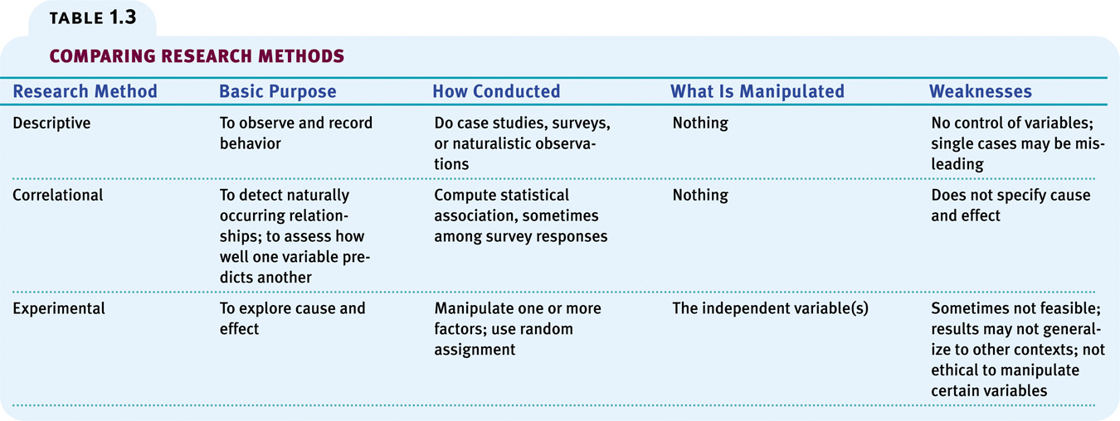

Slide 30
Statistical Reasoning
Statistical procedures analyze and interpret data allowing us to see what the unaided eye misses.
Composition of ethnicity in urban locales
Notes:
OBJECTIVE 15| Explain the importance of statistical principles, and give an example of their use in daily life.

Slide 31
Describing Data
A meaningful description of data is important in research. Misrepresentation may lead to incorrect conclusions.
Notes:
OBJECTIVE 16| Explain how graphs can misrepresent data.

Slide 32
Measures of Central Tendency
Mode: The most frequently occurring score in a distribution.
Mean: The arithmetic average of scores in a distribution obtained by adding the scores and then dividing by the number of scores that were added together.
Median: The middle score in a rank-ordered distribution.
Notes:
OBJECTIVE 17| Describe three measures of central tendency and tell which is most affected by extreme scores.

Slide 33
Measures of Central Tendency
A Skewed Distribution

Slide 34
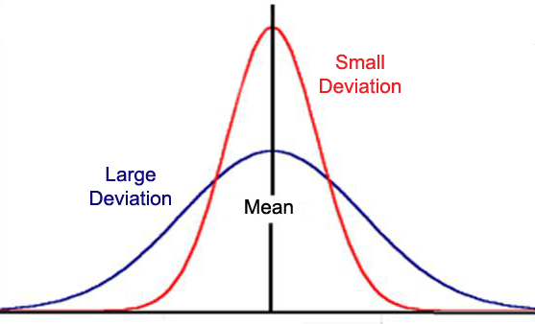
Measures of Variation
Range: The difference between the highest and lowest scores in a distribution.
Standard Deviation: A computed measure of how much scores vary around the mean.
Notes:
OBJECTIVE 18| Explain two measures of variation.

Slide 35
Making Inferences
When is an Observed Difference Reliable?
Representative samples are better than biased samples.
Less variable observations are more reliable than more variable ones.
More cases are better than fewer cases.
Notes:
OBJECTIVE 19| Identify three principles for making generalizations from samples.

Slide 36
Statistical Significance
Statistical Significance
a statistical statement of how likely it is that an obtained result occurred by chance
Differences have statistical significance when:
Sample averages are reliable
The difference between sample averages is relatively large
Notes:
OBJECTIVE 20| Explain how psychologists decide whether differences are meaningful.

Slide 37
Frequently Asked Questions about Psychology
Can laboratory experiments illuminate everyday life?

Slide 38
Frequently Asked Questions about Psychology
Does behavior depend on ones culture?
Culture--the enduring behaviors, ideas, attitudes, and traditions shared by a large group of people and transmitted from one generation to the next

Slide 39
Frequently Asked Questions about Psychology
Does behavior vary with gender?

Slide 40
Frequently Asked Questions about Psychology
Why do psychologists study animals?
Is it ethical to experiment on animals?
Is it ethical to experiment on people?

Slide 41
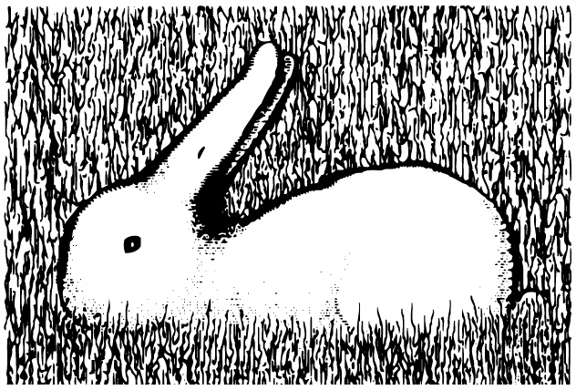
Frequently Asked Questions about Psychology
Is psychology free of value judgments?

Slide 42
Frequently Asked Questions about Psychology
Is psychology potentially dangerous?

