Slide 1
Sexual Orientation

Slide 2
Topics for Today
What is sexual orientation?
What do we know about it?
Where does sexual orientation originate?
Nature
Gay-Straight Differences

Slide 3
What is it? What do we know?
Sexual orientation – one’s preference for emotional or sexual relationships
Heterosexual, Homosexual, Bisexual
About 3-4% of males are homosexual; 1-2% of females
Homosexuality exists in non-human animals
Not a choice
Homosexual
Heterosexual
Bisexual

Slide 4
Where does sexual orientation originate?
Still unknown
Prenatal Environment?
Exposure to Sex Hormones
Mother’s immune system
Genes?
Homosexuality occurs in families with more males on maternal side

Slide 5
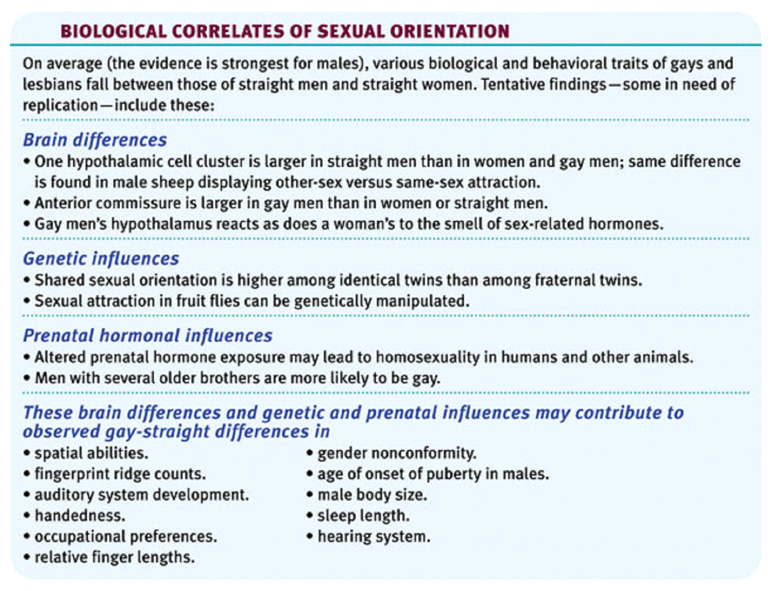
Gay-Straight Differences

