Slide 1
Sleep

Slide 2
Topics for Today
Sleep – How it works
Brain waves and sleep stages
A full night’s sleep
Why do we sleep?
Sleep deprivation
Sleep disorders
Dreams
Dream theories

Slide 3
Sleep disorders
Insomnia
Narcolepsy
Sleep apnea
Night terrors
Sleepwalking and sleeptalking

Slide 4
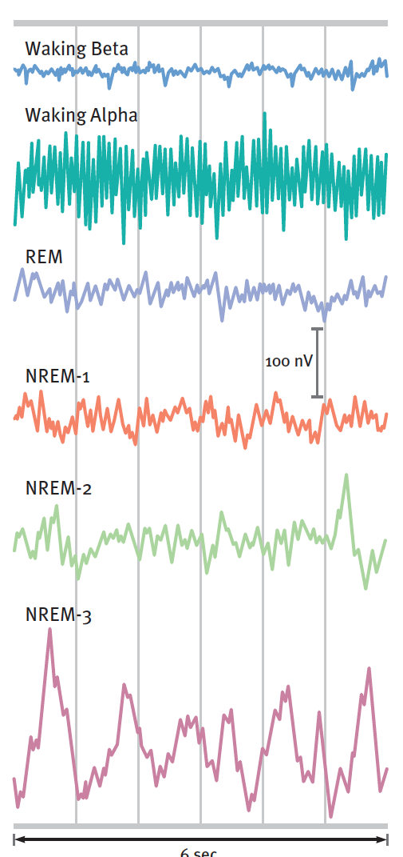
Brain waves
Beta = wide awake
Alpha = relaxed awake
Delta = deep sleep = NREM-3

Slide 5
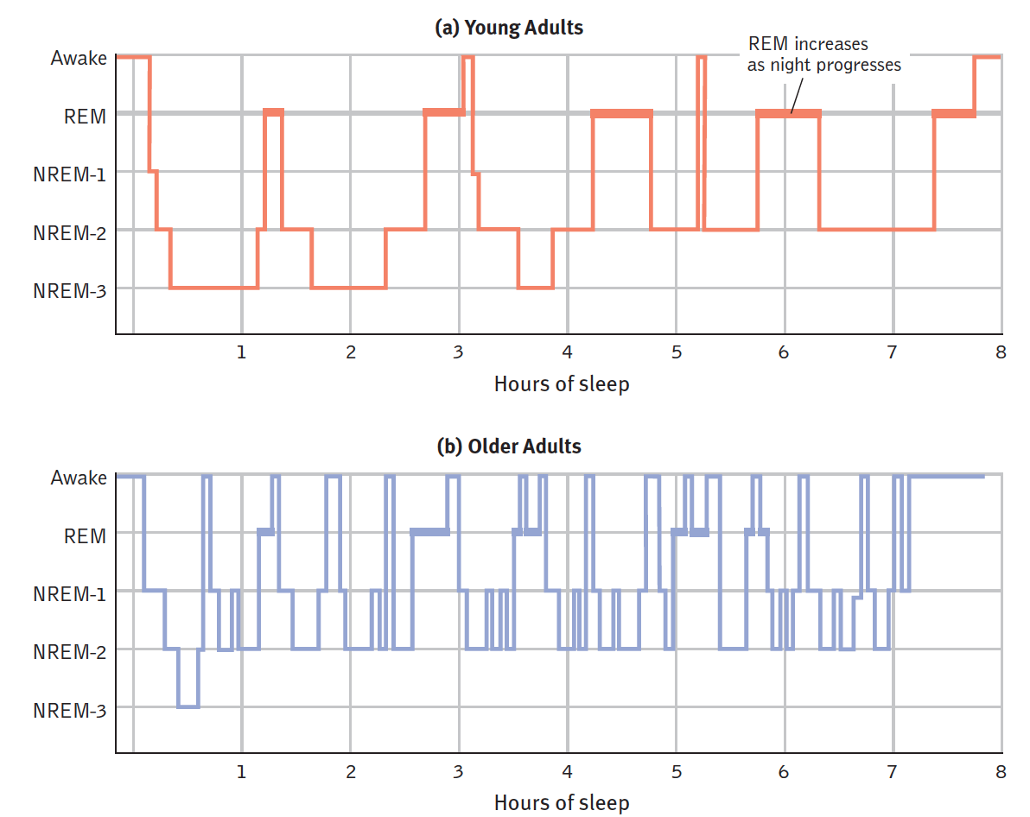
Sleep stages
What happens to stage 3?
What stage do we spend most of our sleep in?
What happens to REM as sleep continues?
What else do you notice?

Slide 6
Why do we sleep?
Evolutionary reason: protection
Restore and repair neurons
Strengthen neural connections in memory
Promotes creativity
Helps us grow…

Slide 7
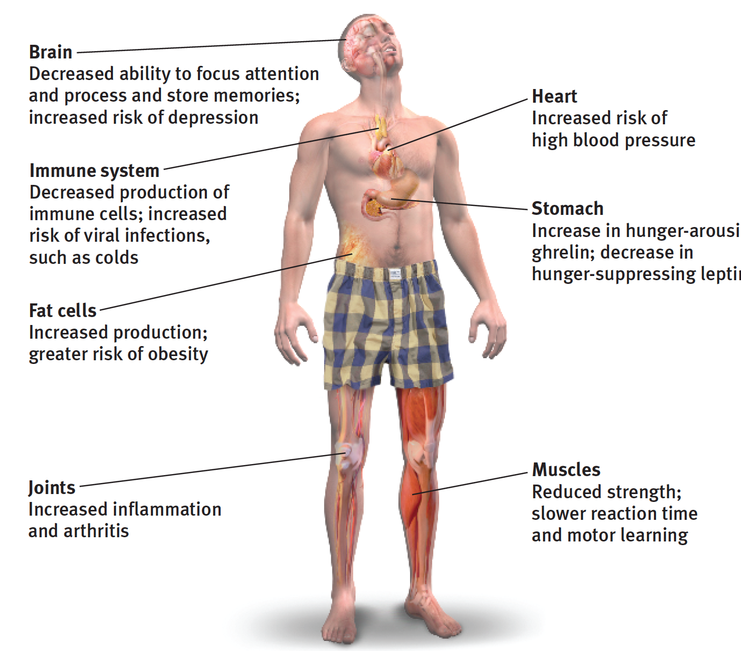
Sleep deprivation
Sleep debt → difference between needed sleep and actual sleep
Can be hard to make up
Effects of psychoactive substances
Alcohol
Sleeping pills

Slide 8
Dreams: why do we do it?
Why we dream
Wish fulfillment: To satisfy our own wishes
Information processing: To file away memories
Physiological functioning: To develop and preserve neural pathways
Neural activation: To make sense of neural static
Cognitive development: To reflect cognitive development

