Slide 1
Social-Cognitive Theory

Slide 2
Topics for today
Social-Cognitive perspective on the personality
Albert Bandura and Reciprocal determinism
Assessment and weaknesses
Odds and ends about the self

Slide 3
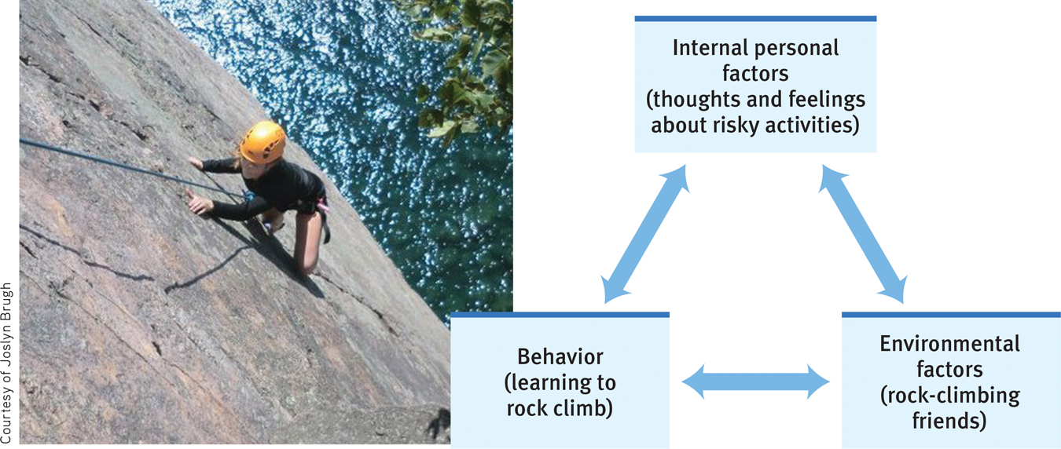
Social-Cognitive Perspective
The Bobo Doll guy…

Slide 4
Social-Cognitive Perspective
Assessing Personality
Weaknesses
Assess personality in different situations
Traits are UNDERemphasized

Slide 5
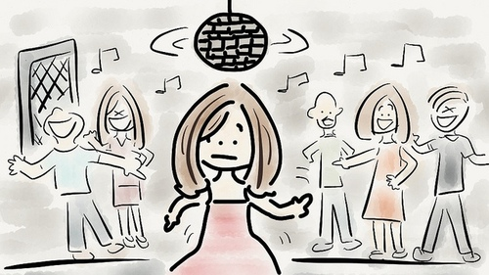
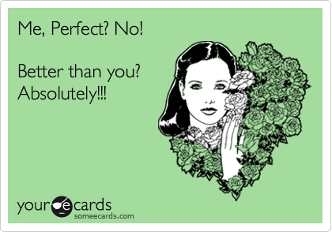
The Self
Spotlight effect
What does this say about the influence of others?
Self-serving bias
Does this mean we are predisposed to have higher self-esteem?

Slide 6
Practice with trait theories
Choose one of the 4 theories on personality that we’ve discussed (psychanalysis/psychodynamic, humanistic, trait, social-cognitive) and analyze one of the following people from that perspective:
Harry Potter
Scar from the Lion King
Donna Meagle from Parks and Rec

