Slide 1
Stress

Slide 2
Topics for Today
What is stress?
Different causes
How do we respond to stress?
General Adaptation Syndrome
Physiological changes
Impact on health
Type A, B, D Personalities
Coping with Stress

Slide 3
What is stress?
A process for responding to perceived threats

Slide 4
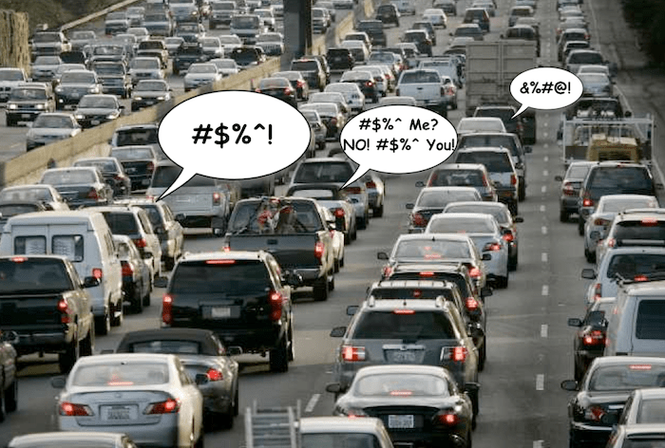
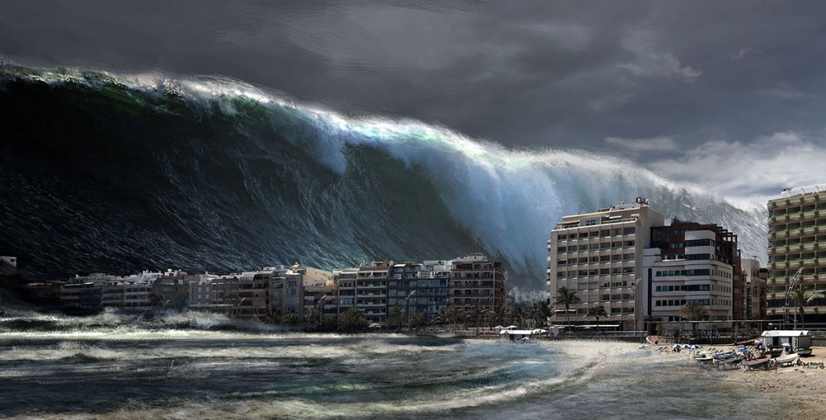
Different Causes of Stress
Catastrophic events
Life changes
Daily hassles

Slide 5
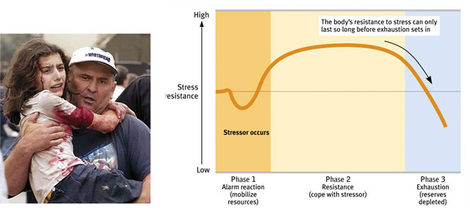
Hans Selye – General Adaptation Syndrome

Slide 6
Physiological Changes
Sympathetic Nervous System activates
Adrenal glands release stress hormones:
Adrenaline (epinephrine)
Noradrenaline (norepinephrine)
Cortisol

Slide 7
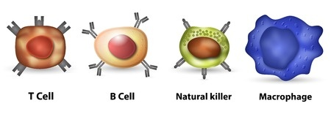
Stress and Health
Stress response suppresses immune system
People with high level of stress are more susceptible to:
Coronary Heart Disease
Colds and other illnesses
Cancer

Slide 8
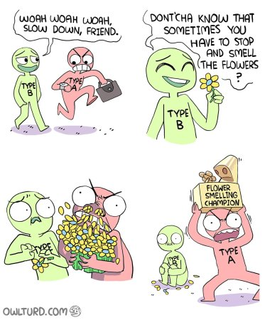
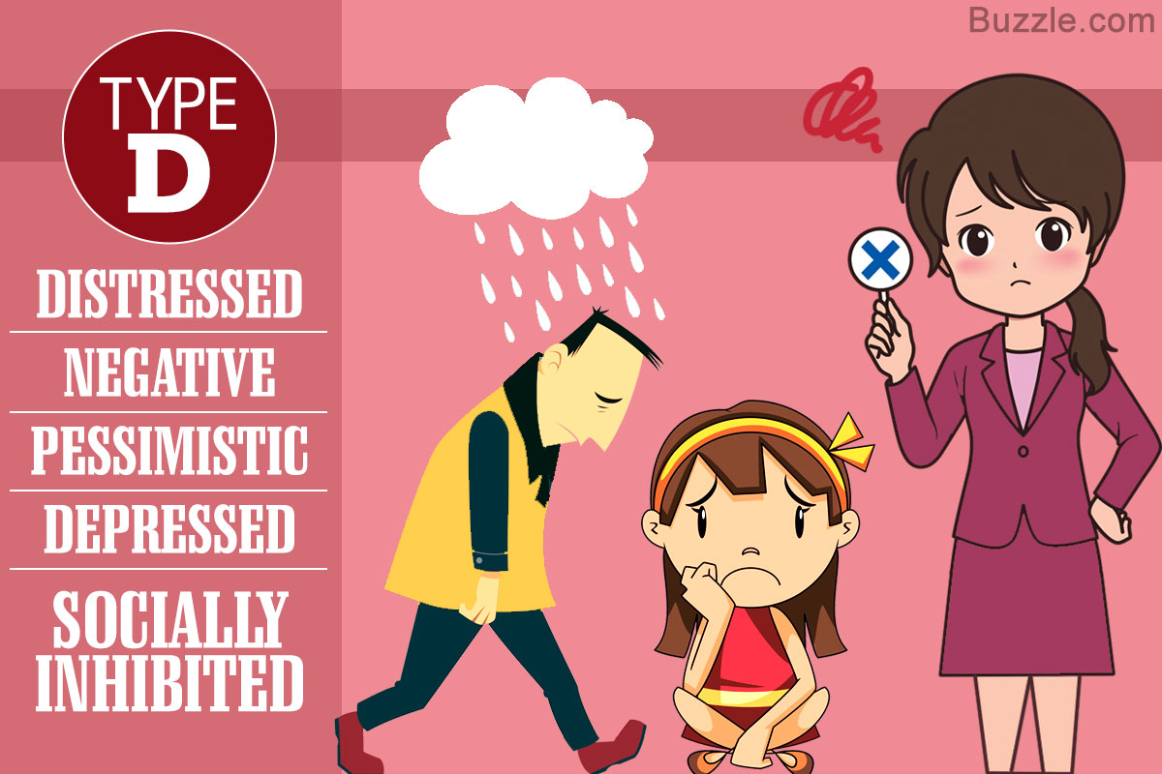
Type A, B, and D Personalities

Slide 9
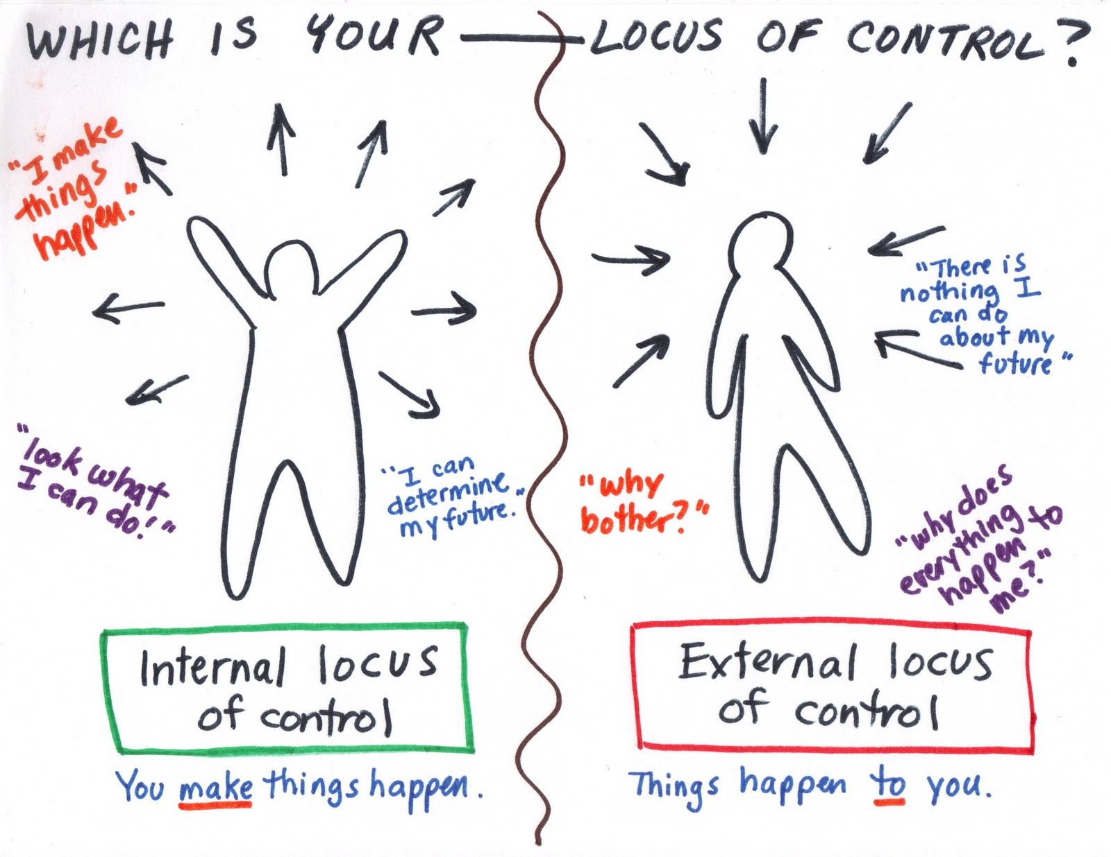
Coping with Stress
Internal vs External Locus of Control

Slide 10
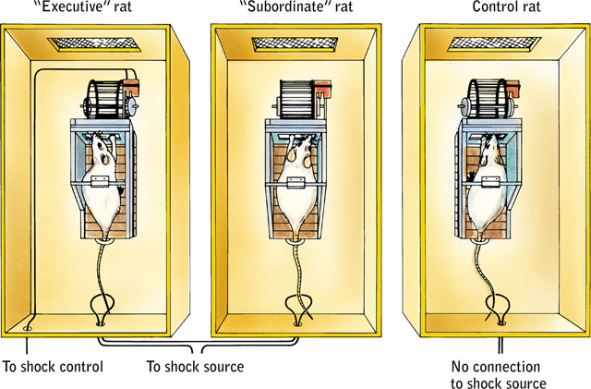
Learned Helplessness

