Slide 1
The Brain

Slide 2
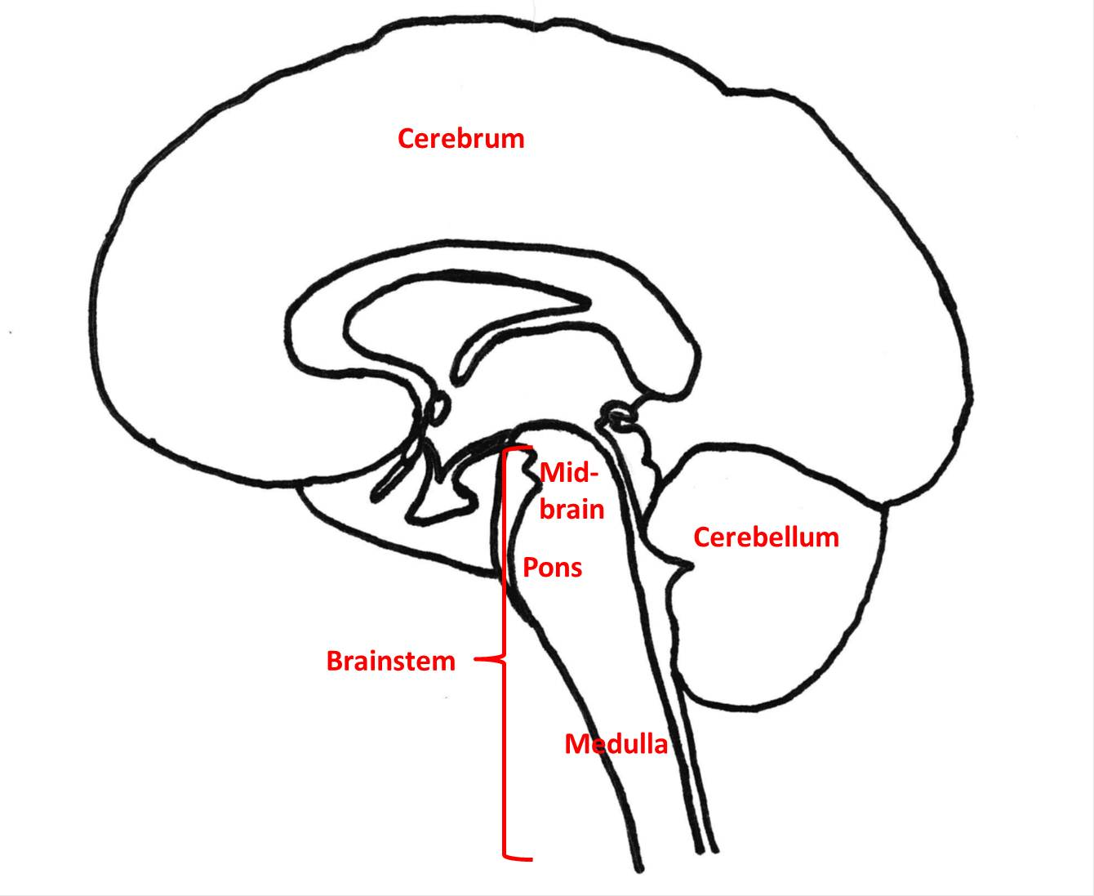
Main Brain Regions
Brainstem
Thalamus
Cerebellum
Limbic System
Cerebrum and Cerebral Cortex

Slide 3
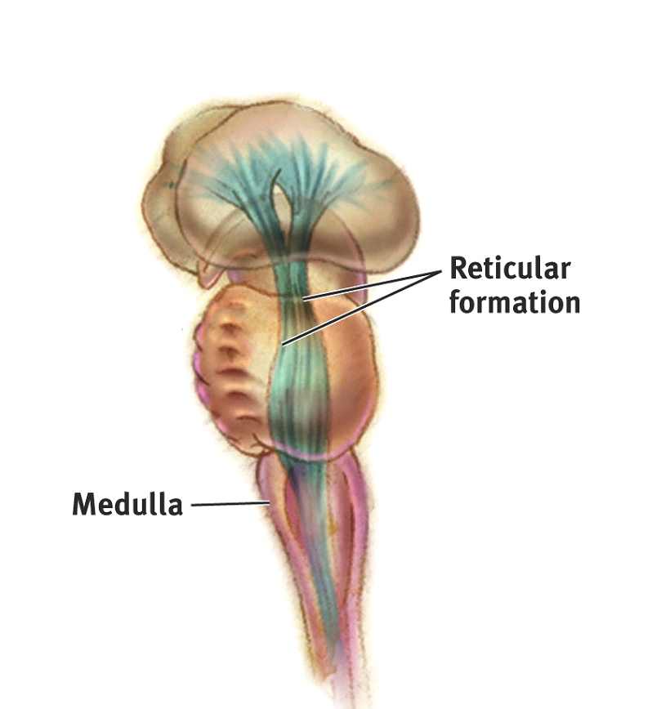
The Brainstem
Medulla
controls heartbeat and breathing
Reticular Formation
Controls arousal
3. Pons
Controls sleep, breathing, swallowing
Pons---------→

Slide 4
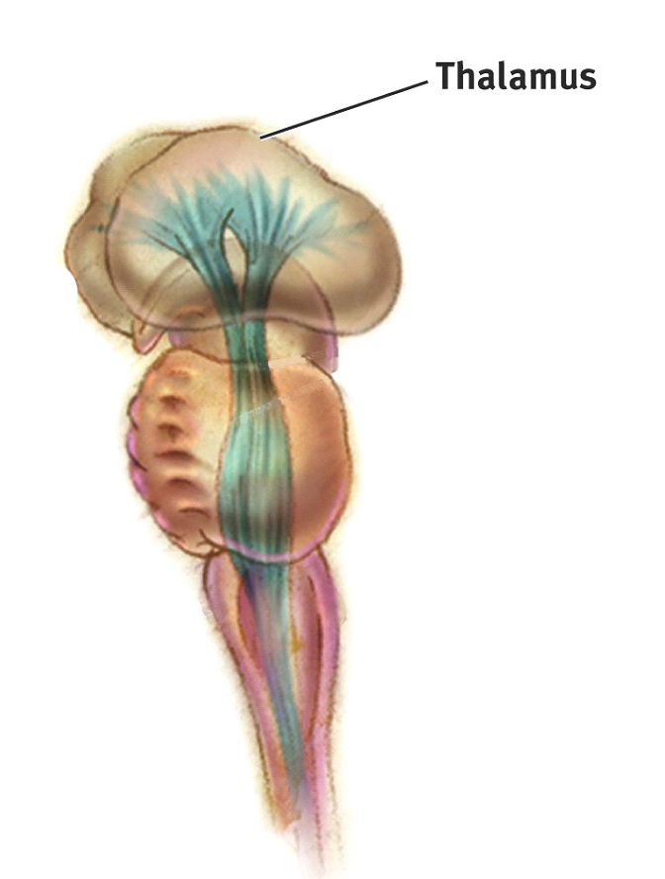
Thalamus
Thalamus [THAL-uh-muss]
“The brain’s sensory switchboard”
Sends messages from sensory nerves to different parts of the cerebral cortex

Slide 5
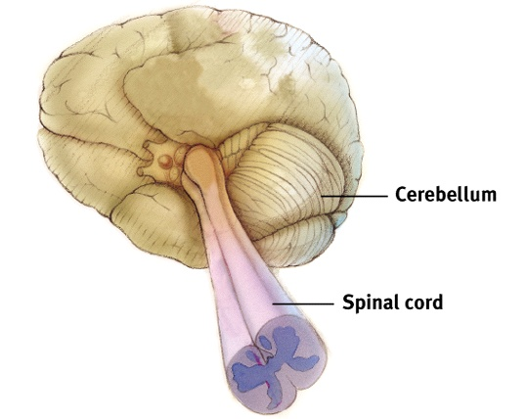
Cerebellum
Cerebellum [sehr-uh-BELL-um]
“Little Brain” -- rear of the brainstem
Helps coordinate voluntary movement and balance

Slide 6
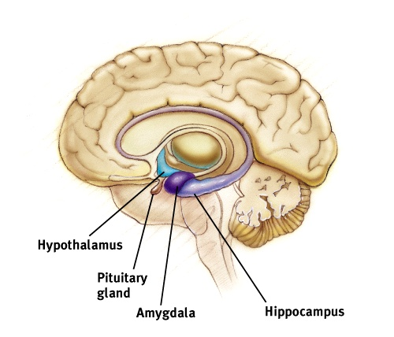
Limbic System

Slide 7
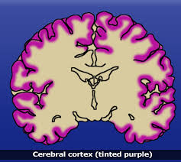
Cerebrum and Cerebral Cortex
Notes:
OBJECTIVE 14| Define cerebral cortex and explain its importance fro the human brain.

Slide 8
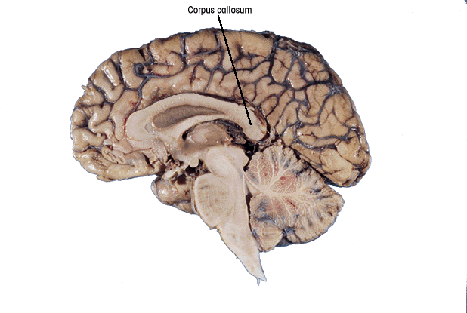
Brain is Divided into Two Hemispheres
Corpus callosum
Corpus Callosum
Band of neural fibers connecting the two brain hemispheres
Carries messages between the hemispheres

Slide 9
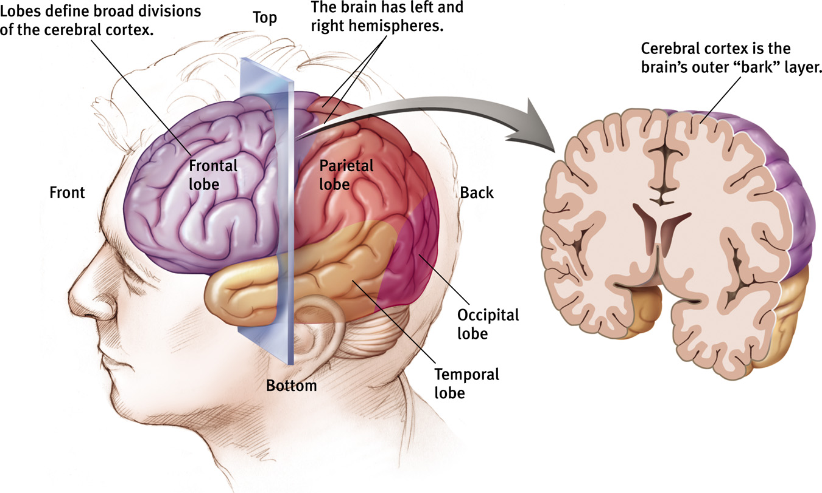

Slide 10
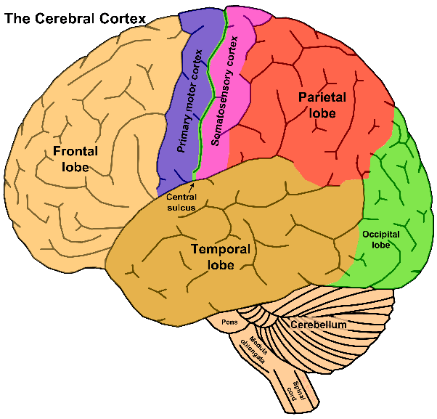

Slide 11
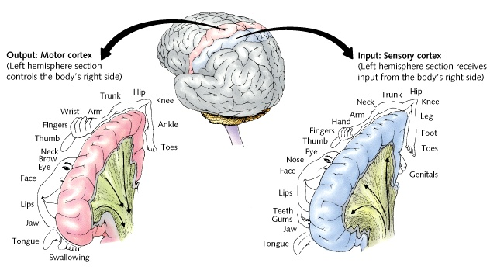

Slide 12
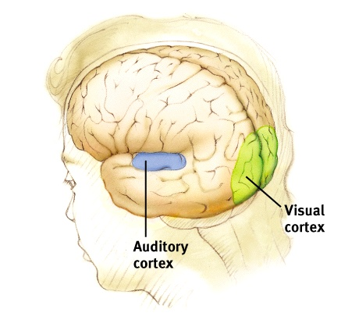
Visual and Auditory Cortices

Slide 13
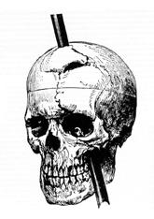
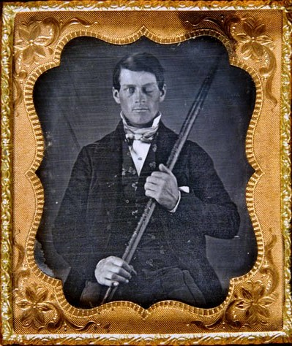
Case Study: Phineas Gage

Slide 14
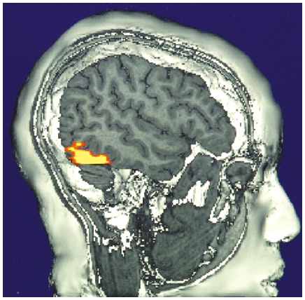
Cerebral Cortex
Functional MRI scan shows the visual cortex activated as the subject looks at faces

Slide 15
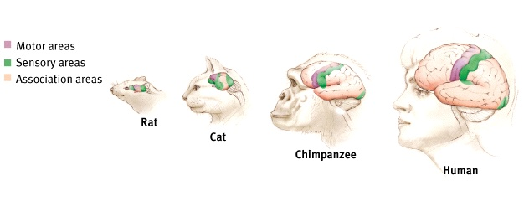
Association Areas
More intelligent animals have increased “uncommitted” or association areas of the cortex

Slide 16
Language
Aphasia
Impairment of language, usually caused by left hemisphere damage either to Broca’s area (impairing speaking) or to Wernicke’s area (impairing understanding)
Broca’s Area
An area of the left frontal lobe that directs the muscle movements involved in speech
Wernicke’s Area
An area of the left temporal lobe involved in language comprehension and expression

Slide 17
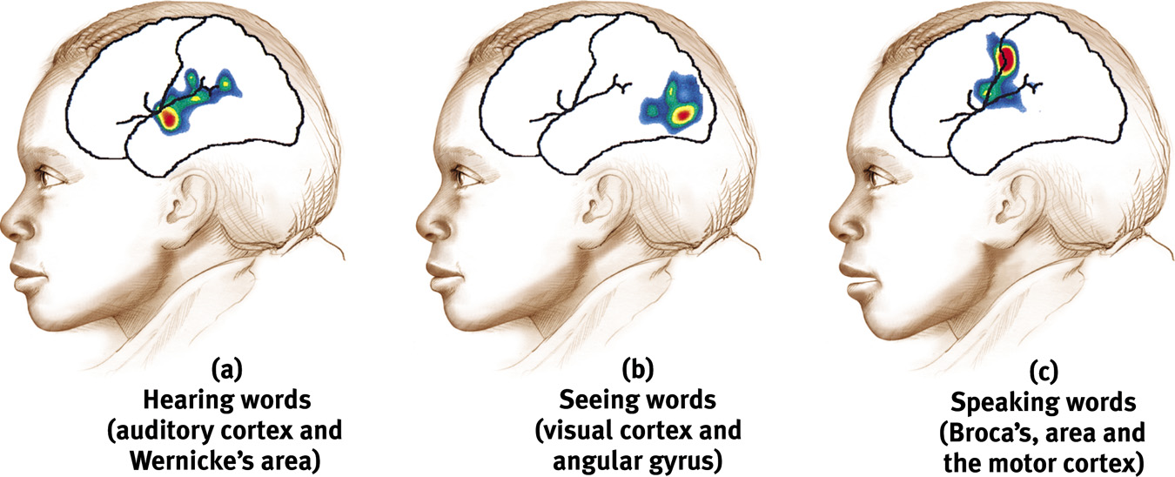
Specialization and Integration
Brain activity when hearing, seeing, and speaking words

Slide 18
Brain is Divided into Two Hemispheres
Corpus callosum
Corpus Callosum
Large band of neural fibers
Connects the two brain hemispheres
Carries messages between the hemispheres

Slide 19
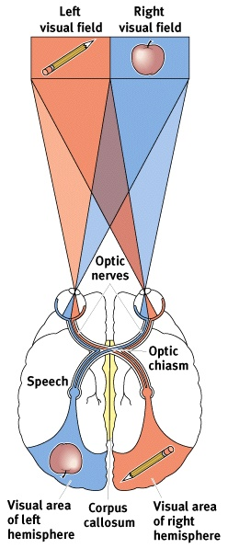
Our Divided Brain
The information highway from the eye to the brain

Slide 20
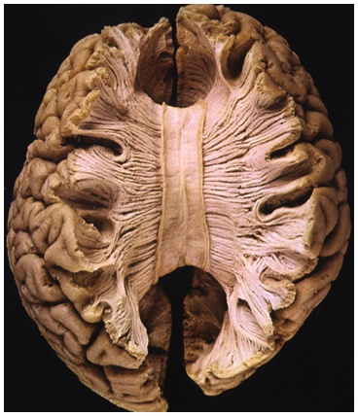
Split Brain
a condition in which the two hemispheres of the brain are isolated by cutting the connecting fibers (mainly those of the corpus callosum) between them

Slide 21
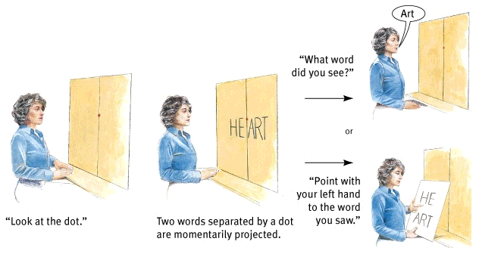
Split Brain
“What word
did you see?”
or
“Point with
your left
hand to the
word you
saw.”
“Look at the dot.”
Two words separated
by a dot are
momentarily projected.

Slide 22
Non-Split Brains
People with intact brains also show left-right hemispheric differences in mental abilities.
A number of brain scan studies show normal individuals engage their right brain when completing a perceptual task and their left brain when carrying out a linguistic task.

Slide 23
Disappearing Southpaws
The percentage of left-handers decreases sharply in samples of older people (adapted from Coren, 1993).
Percentage of
left-handedness
14%
12
10
8
6
4
2
0
The percentage of
lefties sharply
declines with age
10 20 30 40 50 60 70 80 90
Age in years

Slide 24
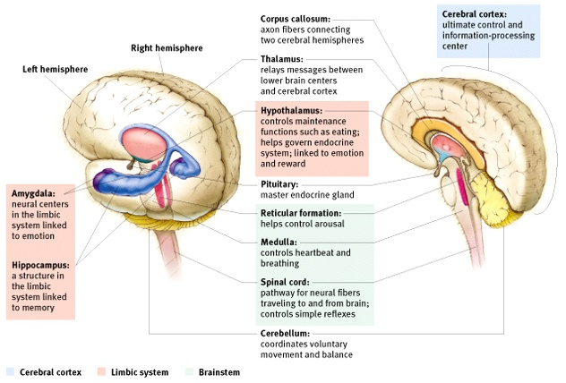
Brain Structures and their Functions

Slide 25
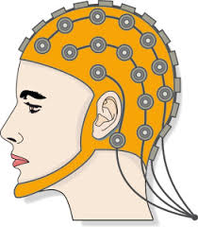
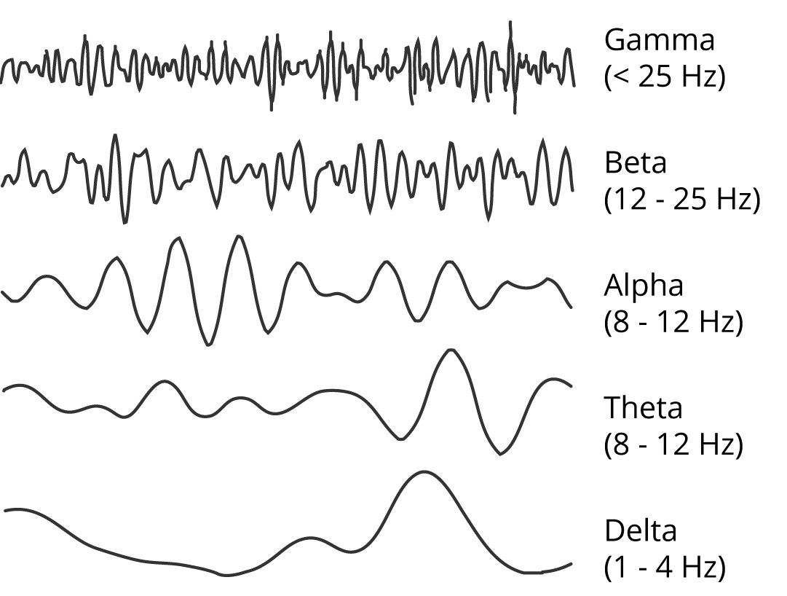
Electroencephalogram (EEG)

Slide 26
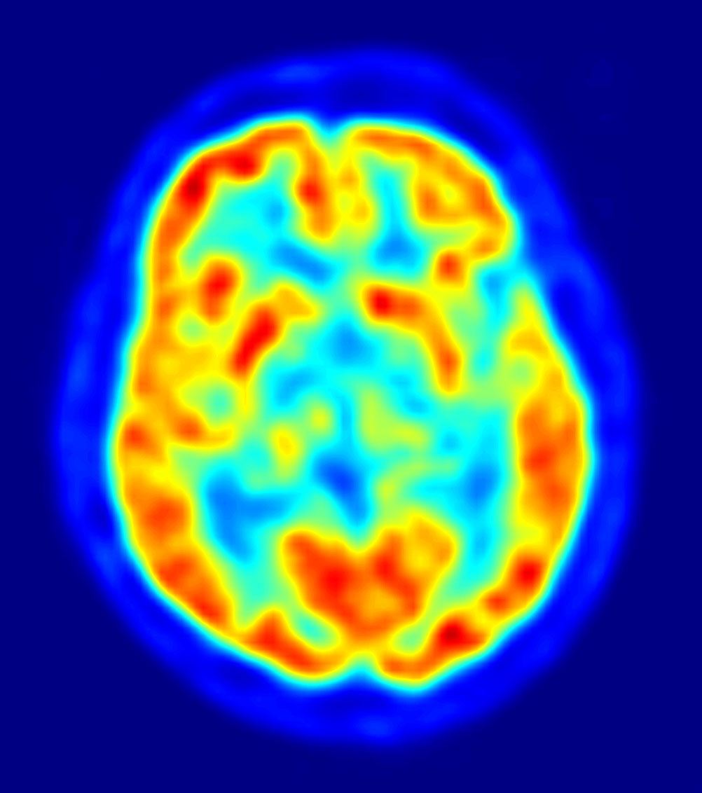
Imaging the Brain
CT (Computed Tomography) Scan
A series of x-ray photographs taken from different angles and combined by computer into a composite representation of a slice through the body
PET (Positron Emission Tomography) Scan
A visual display of brain activity that detects where a radioactive form of glucose goes while the brain performs a given task
← Image from a PET Scan

Slide 27
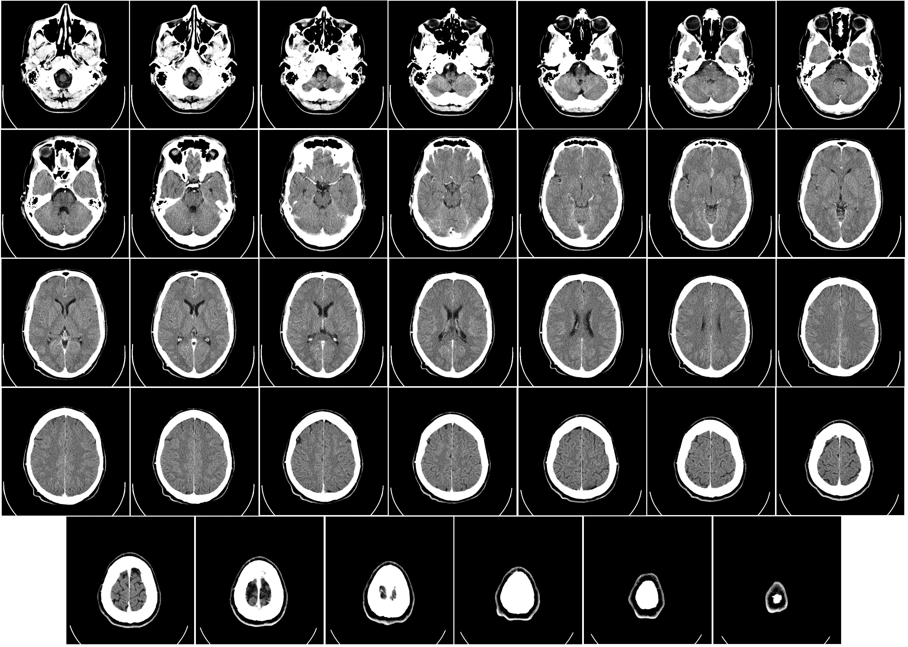
CAT Scan

Slide 28
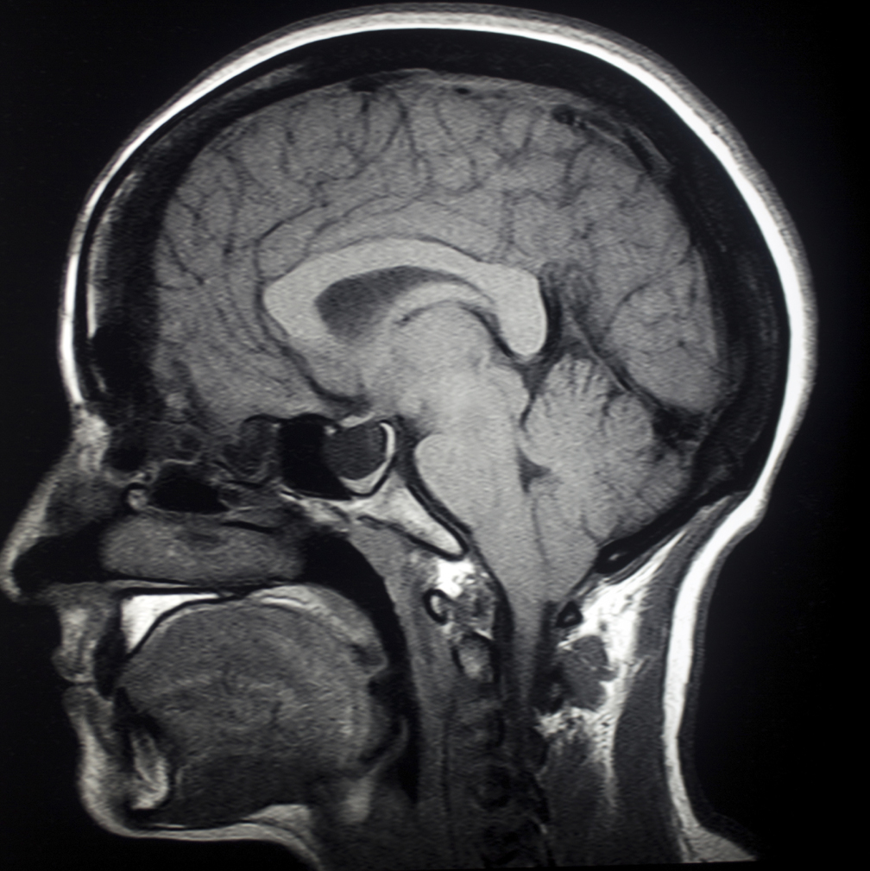
Imaging the Brain
MRI (magnetic resonance imaging)
Visual imaging technique that uses magnetic fields and radio waves to distinguish among different types of soft tissue
Functional MRI -> Shows blood flow in the brain

Slide 29
Brain Reorganization
Plasticity
The brain’s capacity for modification and reorganization following damage (especially in children) and in experiments on the effects of experience on brain development

Slide 30
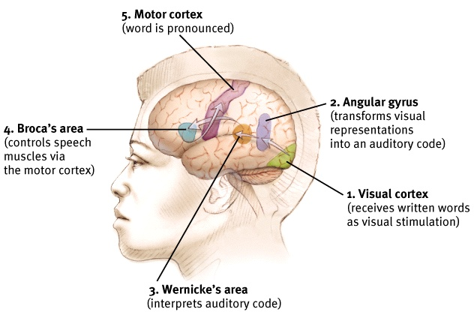
Specialization and Integration

