Slide 1
The Indian Wars
Key Conflicts and Consequences

Slide 2
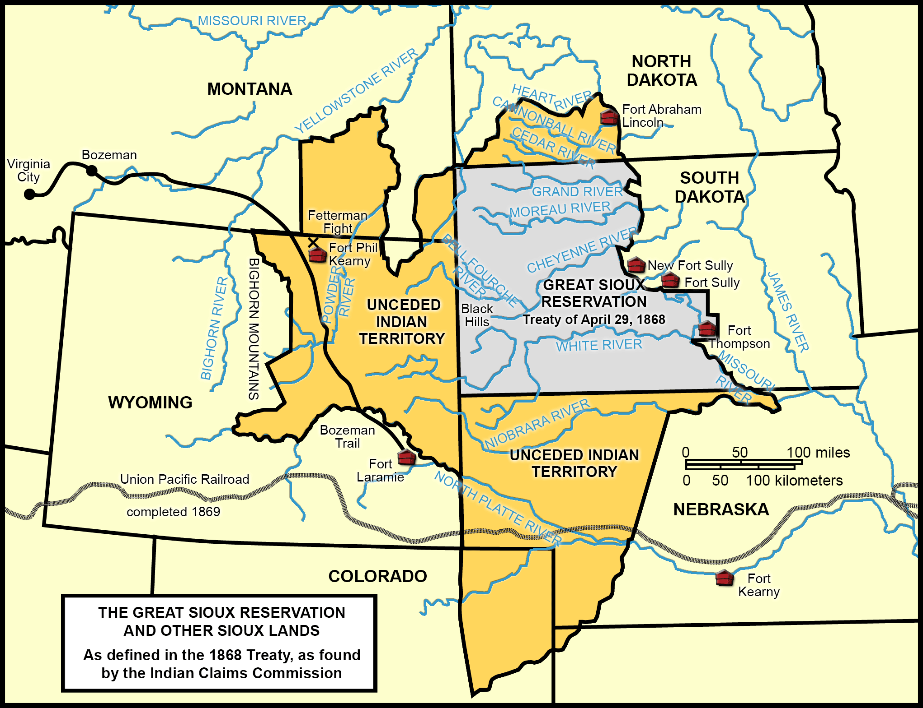
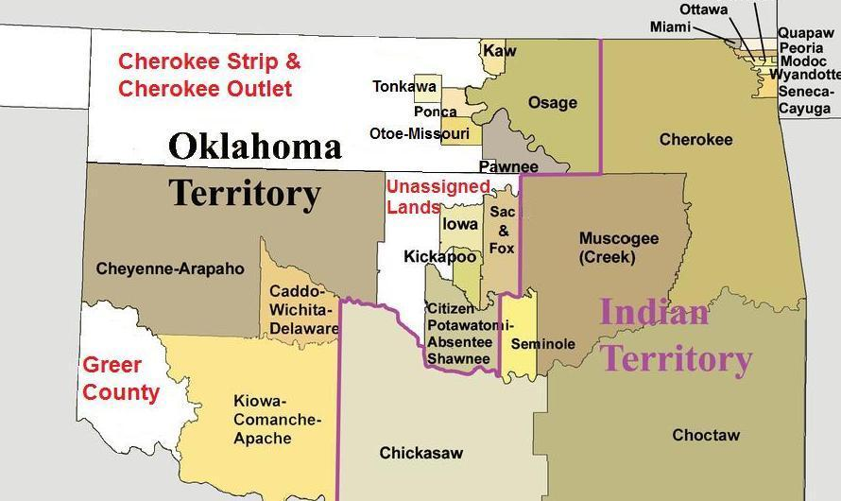
1st US Indian Policy
Move Native Americans to reservations
Separate them white settlers
Let Native Americans keep their cultures
Reservations set up by treaties
Treaties were often broken

Slide 3
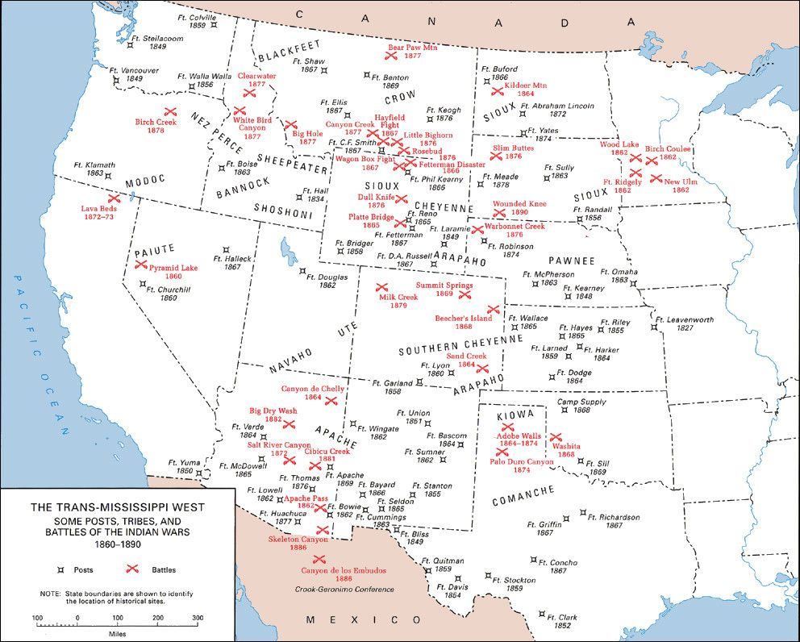

Slide 4
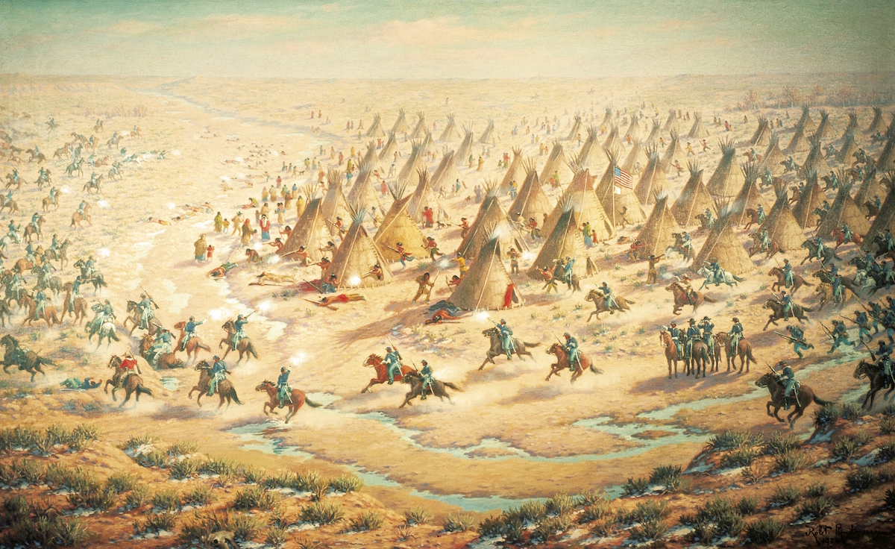
Indian Wars: Sand Creek Massacre (1864)
Peaceful Native Americans go to Sand Creek reservation
Attacked by John Chivington and Colorado militia
Causes:
Mistaken identity
Racism
Sending a message

Slide 5
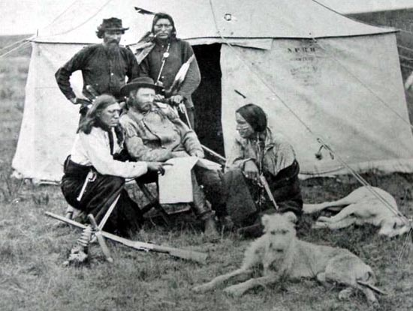
Indian Wars: Battle of Little Bighorn (1876)
Second Treaty of Ft. Laramie violated
Fighting breaks out
Sitting Bull and Sioux attack and kill George Custer and his men
Causes:
Military strategy
Sending a message to the enemy
Racism?

Slide 6
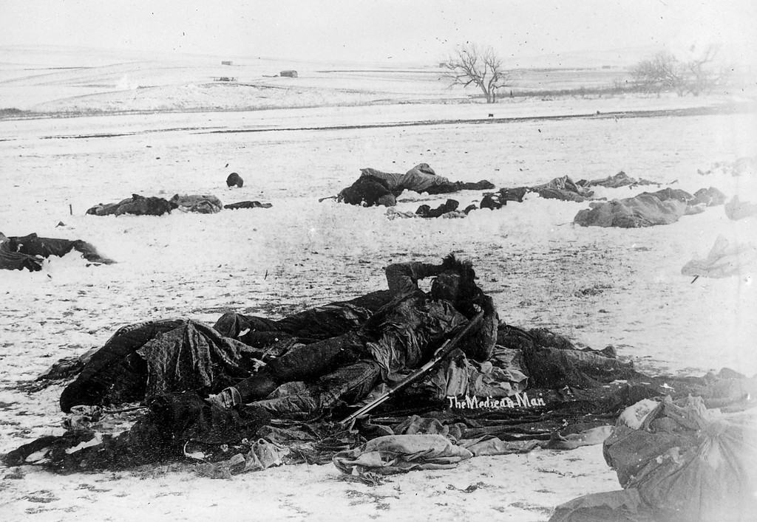
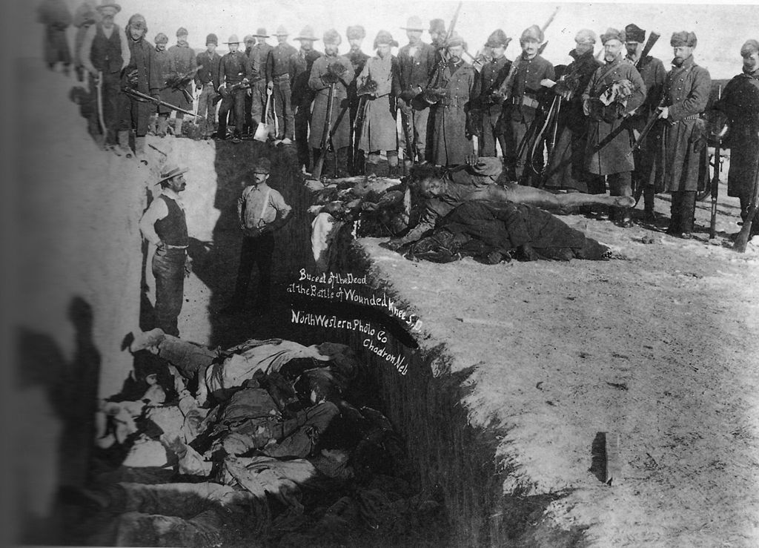
Indian Wars: Massacre at Wounded Knee (1890)
Ghost Dance scares whites
Feared Native American uprising
Sioux off-reservation rounded up
Dispute occurs and Native Americans are killed
Causes:
Military strategy
Sending a message
Racism?

Slide 7
New US Indian Policy
US govt tries to “Americanize” Native Americans
Eliminate Native culture, replace w/American culture
Chester Arthur reading
How did he want to Americanize Native Americans?
Make them landowning farmers
Send them to boarding schools

Slide 8
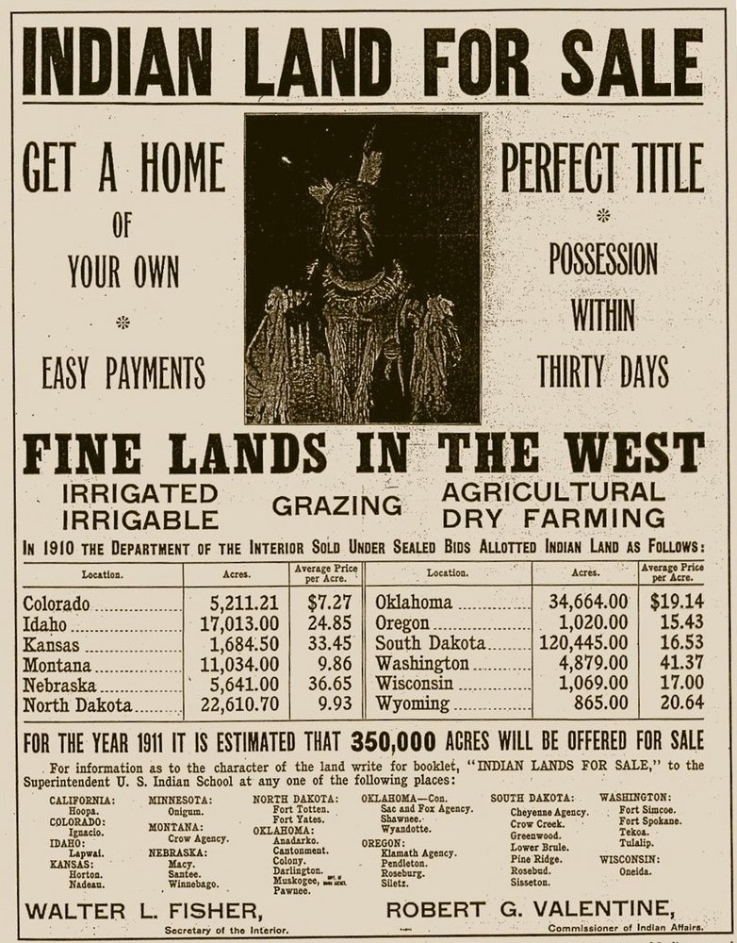
Dawes Act (1887)
Gave NAs 160 acres of land to head of household
Had to farm it
It didn’t go well
Land was bad for farming
Native Americans weren’t taught to farm
Many sold their land

Slide 9
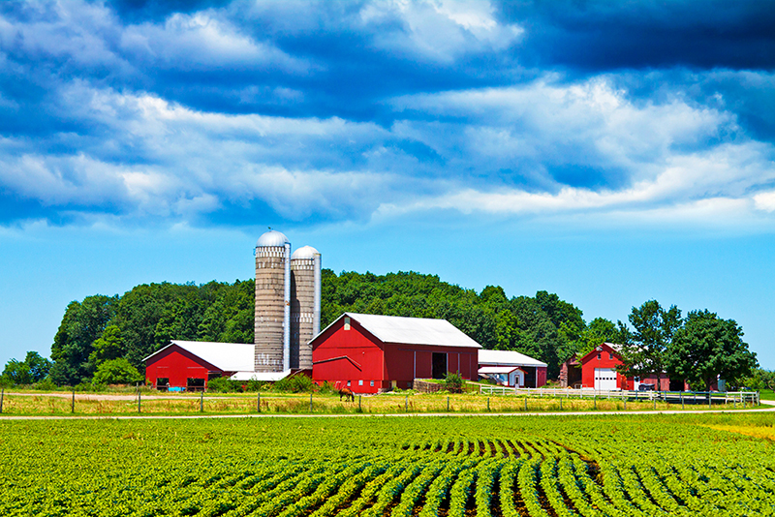
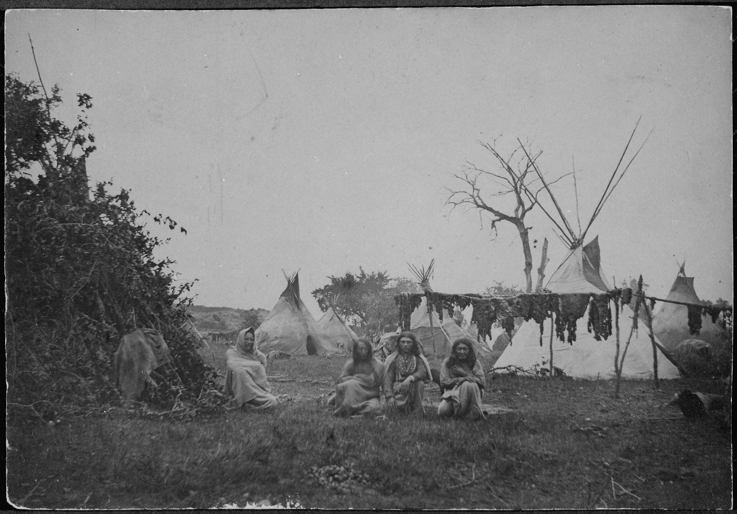
This is America
This is NOT America

Slide 10
This is America
This is NOT America

