Slide 1
The Great Depression and New Deal(s)

Slide 2
Effects of the Depression
Unemployment peaked at 25%
Greater among minorities
Millions lost savings
Homelessness increases drastically
“Hoovervilles”

Slide 3
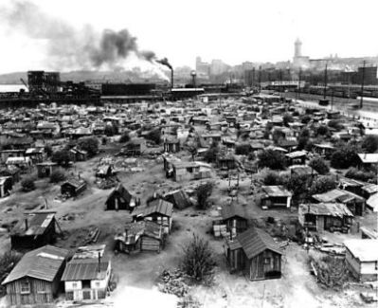

Slide 4
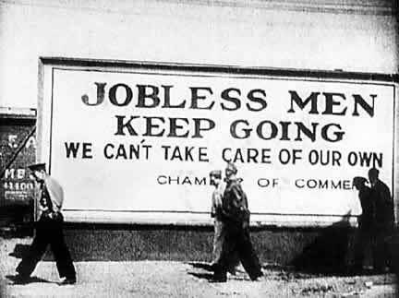

Slide 5
Hoover’s Approach
Hoover promoted volunteerism
Private charities should help, not govt.
Only a small number of public works projects
Created Reconstruction Finance Corporation (RFC) to help start public works projects

Slide 6
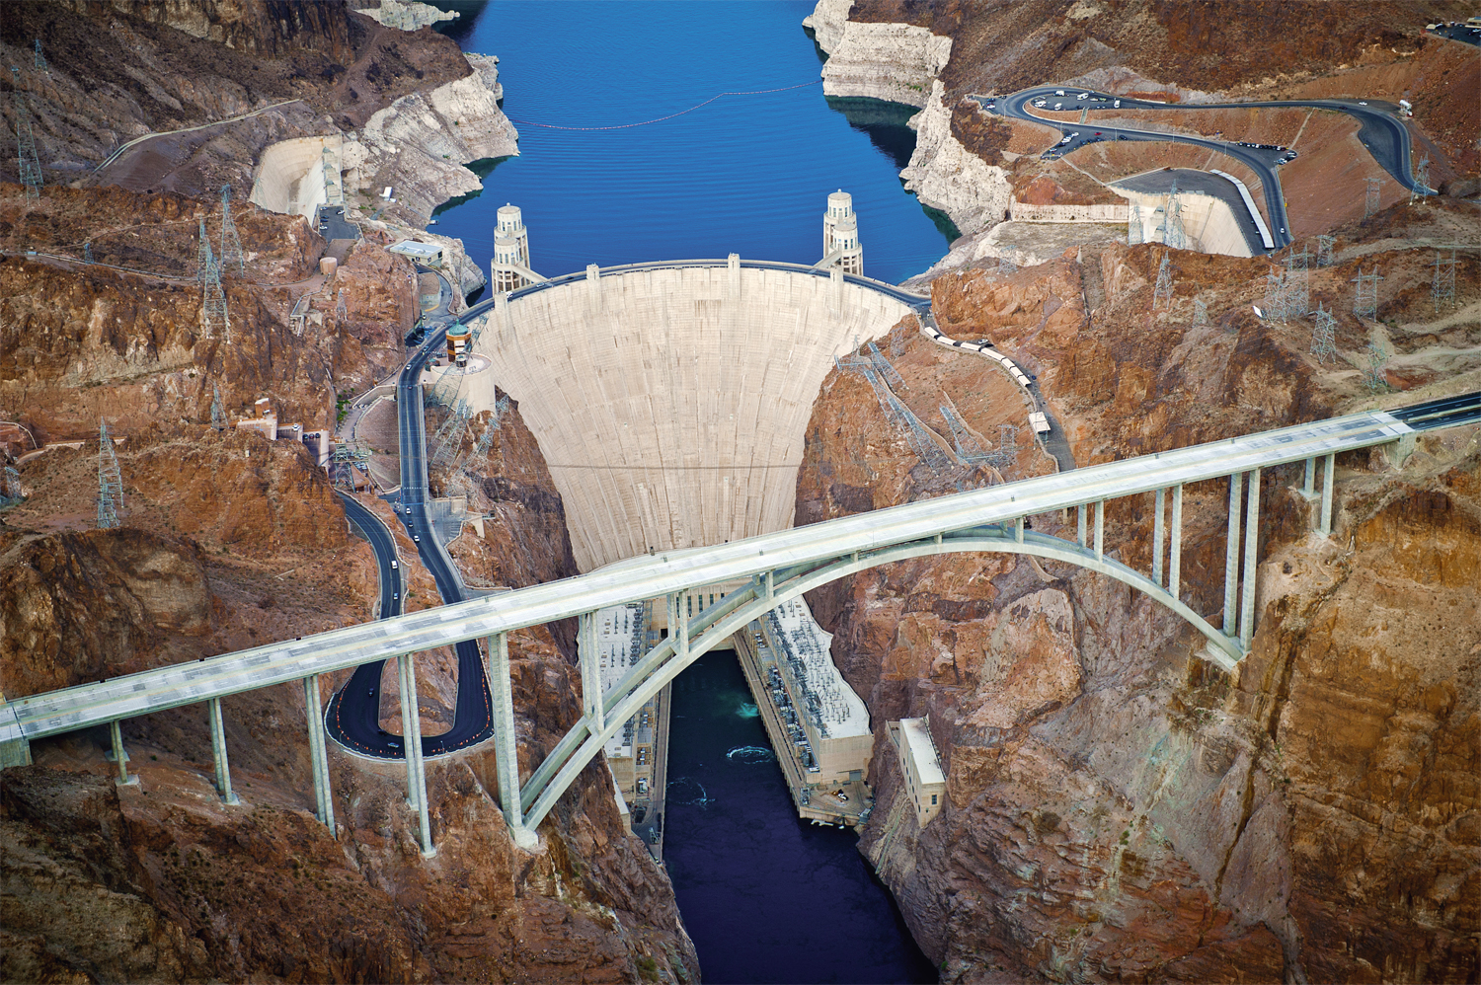

Slide 7
The Dust Bowl
Environmental catastrophe in the Plains caused by drought, overgrazing, and over-farming
Caused economic catastrophe for farmers
Basis of the book, The Grapes of Wrath
John Steinbeck

Slide 8
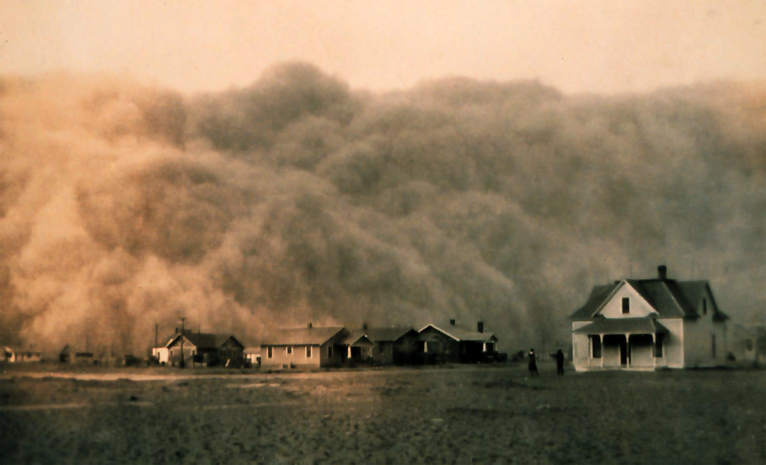

Slide 9
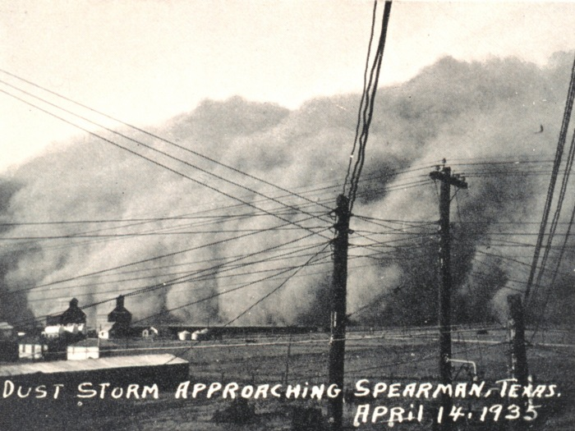

Slide 10
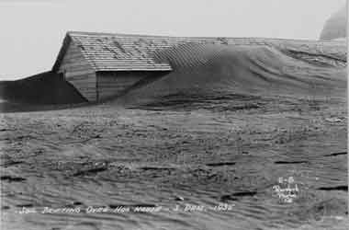

Slide 11
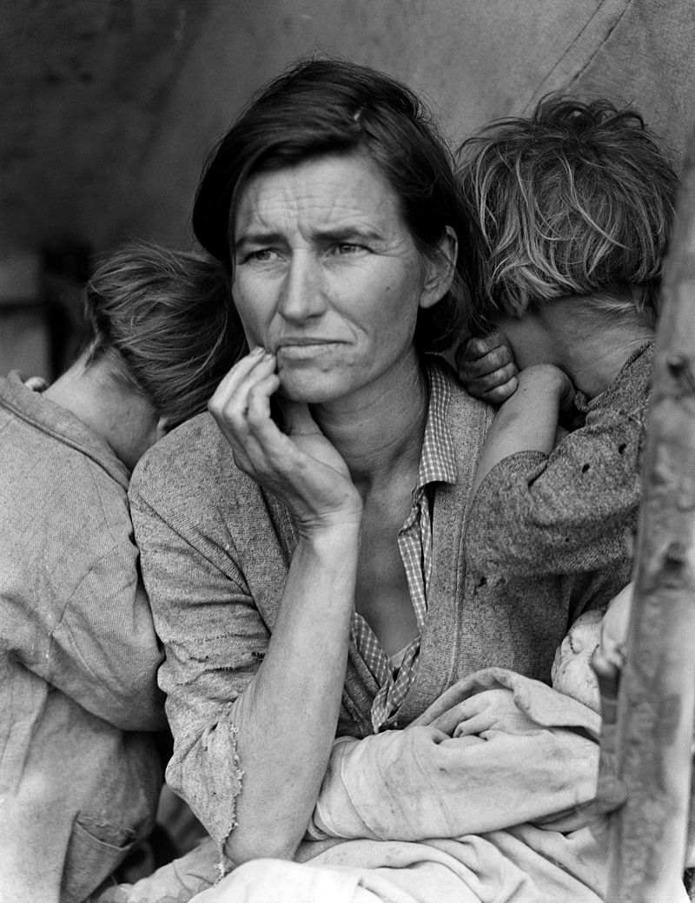

Slide 12
Bonus Army Fiasco – June 1932
Unemployed WWI Vets tried to collect bonuses earlier than 1945
Marched on Washington and set up camp
Hoover uses army to have them moved
Violence breaks out

Slide 13
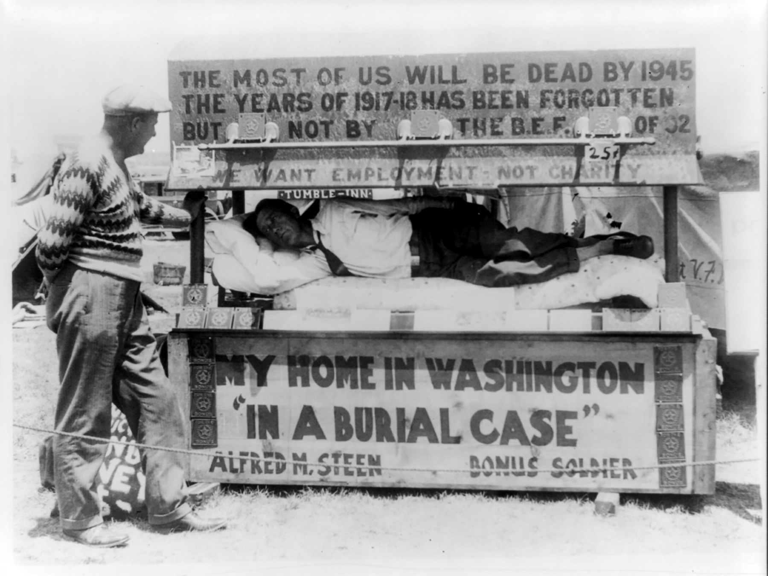

Slide 14
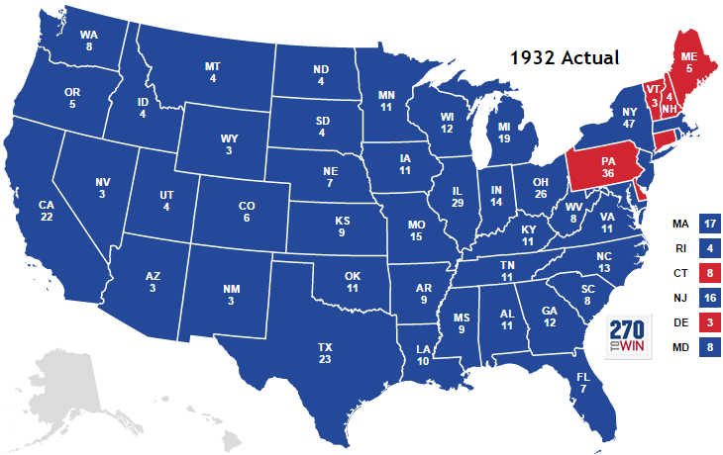
Hoover Out, FDR In
Election of 1932
Public blames Hoover for the Depression
FDR crushes -> 472 to 59 (Electoral Votes)

Slide 15
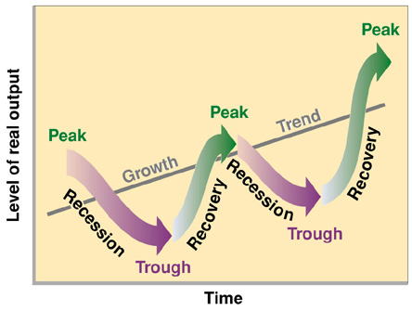
Keynesian Economics
Main Aspects of Keynesian Economic Theory:
Business cycle naturally booms and busts
During recession govt. should take on debt to provide jobs and income = Deficit Spending

Slide 16
1st 100 Days
FDR promised to try new things, like Keynesian Economics
FDR takes significant action during his 1st 100 days in office:
Passes Emergency Banking Relief Act to start “bank holiday”

Slide 17
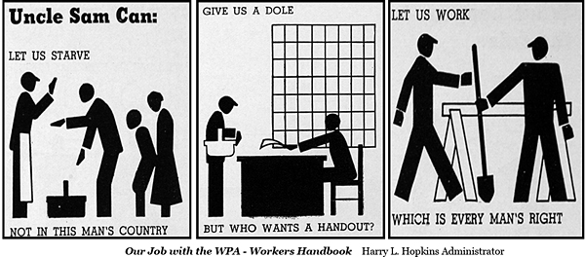
The New Deal
The New Deal = FDR’s series of laws that were meant to help society during the GD
Most provided jobs, not handouts

Slide 18
Alphabet Soup
Passed in the 1st 100 Days
Other New Deal Programs
FERA - Federal Emergency Relief Admin.
HOLC - Homeowners Loan Corporation
AAA - Agricultural Adjustment Admin.
NIRA - National Industrial Recovery Admin.
TVA - Tennessee Valley Authority
FDIC - Federal Deposit Insurance Corporation
CWA – Civil Works Admin.
PWA – Public Works Admin.
CCC – Civilian Conservation Corps
FHA – Federal Housing Admin.

Slide 19
FDIC - Federal Deposit Insurance Corporation
Goal: Guaranteed bank deposits up to $2,500
(Now it’s $250,000)
Consequences: restored confidence to banks

Slide 20
AAA - Agriculture Adjustment Act
Goal: support farmers
Paid farmers to grow less crops and raise fewer animals
Consequences:
Food prices rose
Farmers’ incomes rose

Slide 21
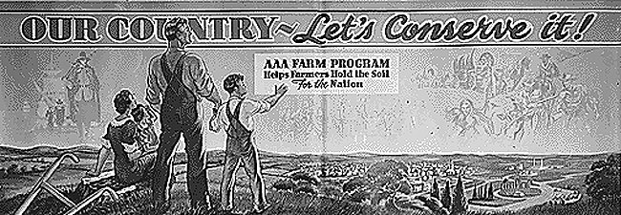
Conserve soil by not planting food…

Slide 22
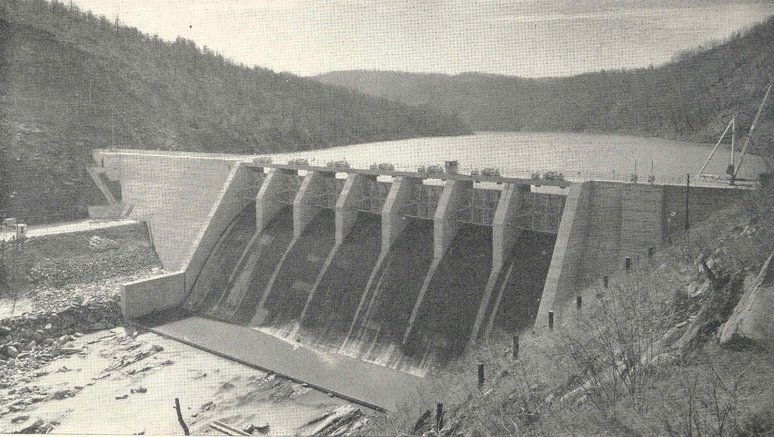
TVA - Tennessee Valley Authority
Goals: Helped people in Tenn. Valley modernize and provide jobs
Provided jobs to build dams and electricity to rural Appalachia

Slide 23
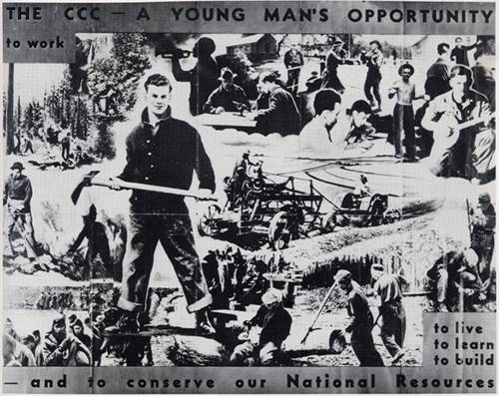
CCC - Civilian Conservation Corps
Goals: Protect natural resources and provide jobs
Created jobs to construct campgrounds, bridges, trails, planted trees
Created by Frances Perkins

Slide 24
NIRA/NRA - National Industrial Recovery Act
Goal: support industries
Passed regulations to fix prices, increase wages, and promote employment
Controversy:
Promoted monopolies
Found unconstitutional

Slide 25
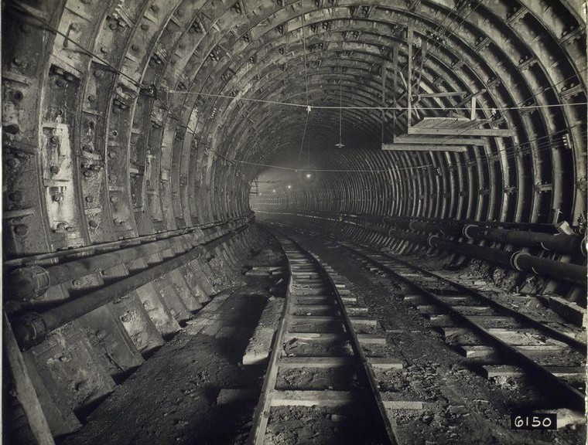
PWA - Public Works Administration
Goal: create jobs to build public works
Led by Harold Ickes

Slide 26
2nd New Deal
FDR issues 2nd New Deal in 1935
Why?
New Deal programs found unconstitutional
Public still unsatisfied
Re-election coming in 1936

Slide 27
Social Security Administration
SSA creates first ever national…
Government retirement plan
Unemployment insurance
Welfare for handicap
Legacy

Slide 28
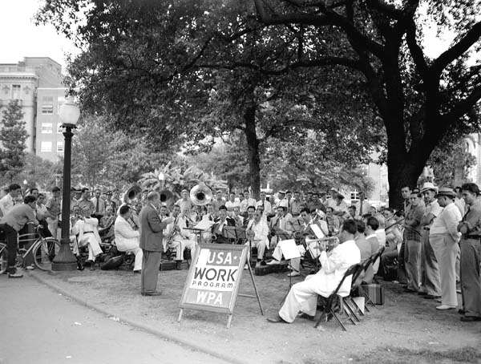
WPA - Works Progress Administration
Provided many types of jobs:
Art projects, history projects, buildings, roads
Biggest employer during Great Depression

Slide 29
Labor Union Victories
Fair Labor Standards Act
National Labor Relations Act (Wagner Act)
Created min. wage and max. work hours for most jobs.
Guaranteed the right of employees to form labor unions.

Slide 30
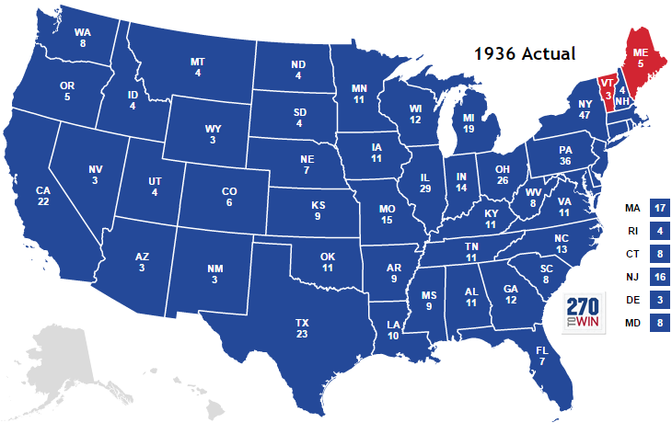
1936 Election
FDR crushes again -> 523 to 8

Slide 31
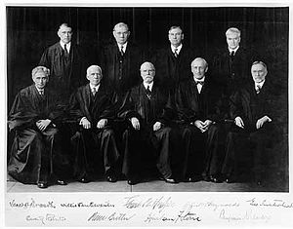
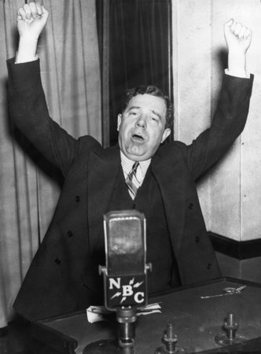
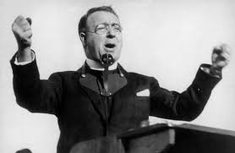
Criticisms of New Deal
Govt. was overstepping its boundaries
Govt. not doing enough to help society
Notes:
Huey Long (Share-Our-Wealth Program) and Father Charles Coughlin

Slide 32
Racial Discrimination and the New Deal
Racial discrimination in New Deal jobs
Eleanor Roosevelt = civil rights advocate
FDR eventually creates “the Black Cabinet”
Mary McLeod Bethune

