Slide 1
The Progressive Era

Slide 2
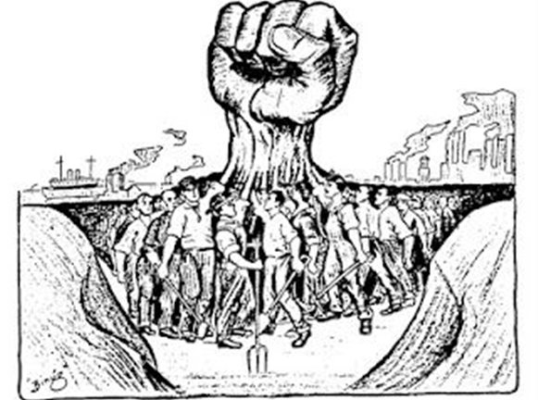
The Progressive Movement
A time when ppl wanted to fix society’s problems
It was a “grassroots” movement
Led by nobodies
Started as small, local changes
Becomes nationwide movement

Slide 3
4 Goals of the Progressive Movement
Protect social welfare – help those in need
Promote moral improvement – eliminate “evils” of society
Create economic reform – change economy to benefit everyone
Foster efficiency – end corruption in government

Slide 4
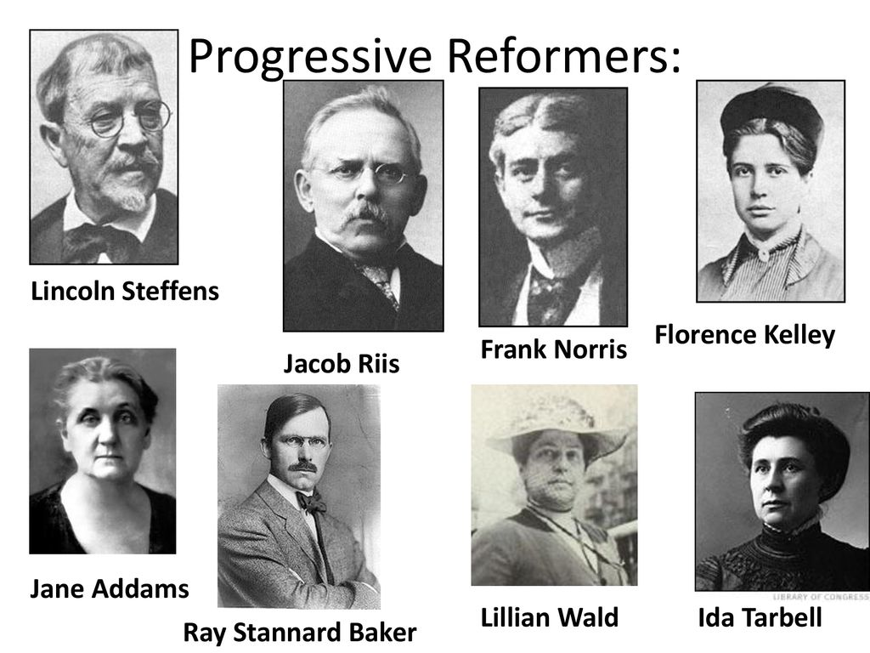
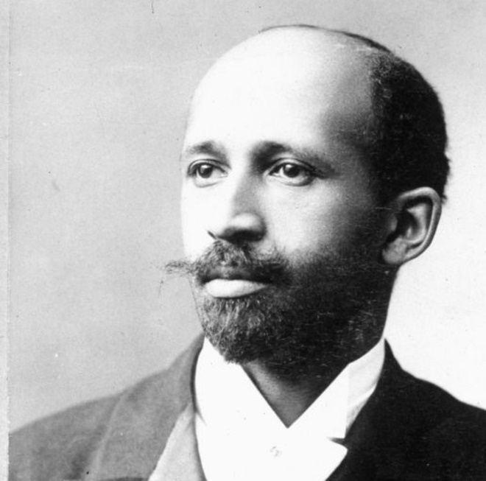
The Progressive Reformers
Most progressive reformers were…
White
Middle-class
Educated
Between 30-50 years old in 1900

Slide 5
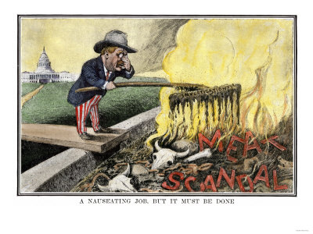
Muckrakers
Group of progressives that were investigative journalists
Tried to show society what was going wrong
A few you should know:
Ida Tarbell
Lincoln Steffens
Upton Sinclair
Jacob Riis
Ida B. Wells

