Slide 1
America in the 1920s
“The Roaring Twenties”

Slide 2
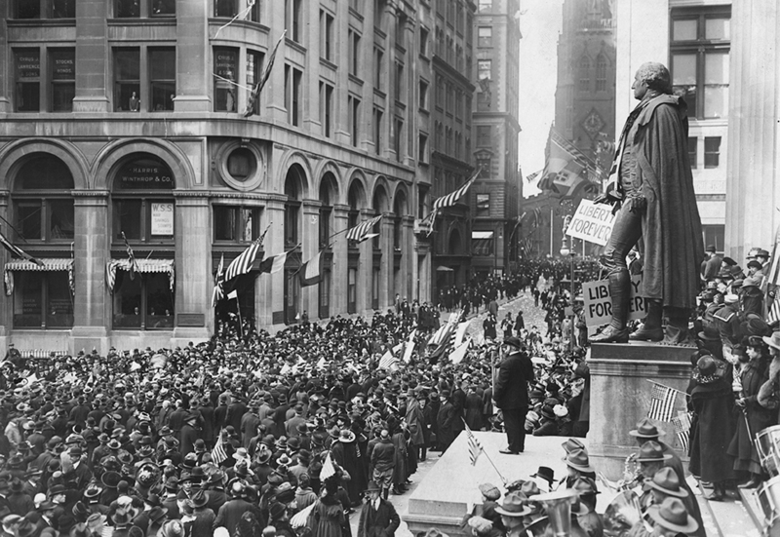
Armistice Day – Let’s Party!

Slide 3
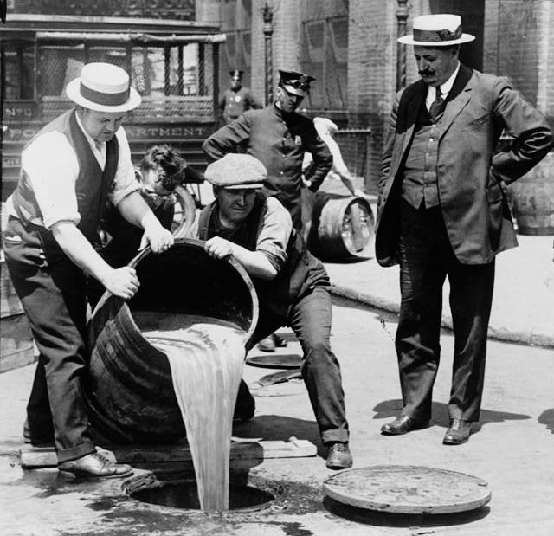
Wait!…Prohibition ratified in 1920

Slide 4
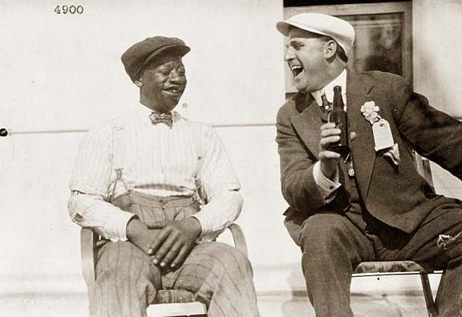
but….

Slide 5
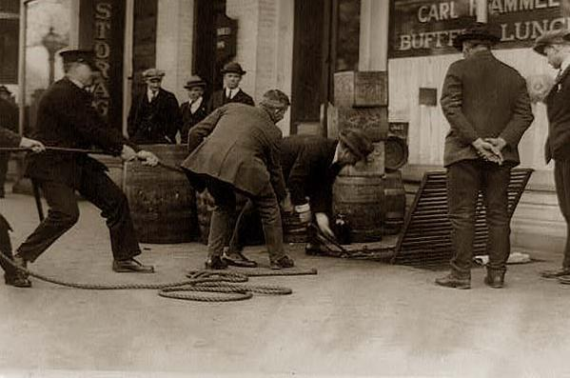
Bootleggers
Prohibition gave rise to organized crime
Police could not stop the all of the sale of illegal alcohol

Slide 6
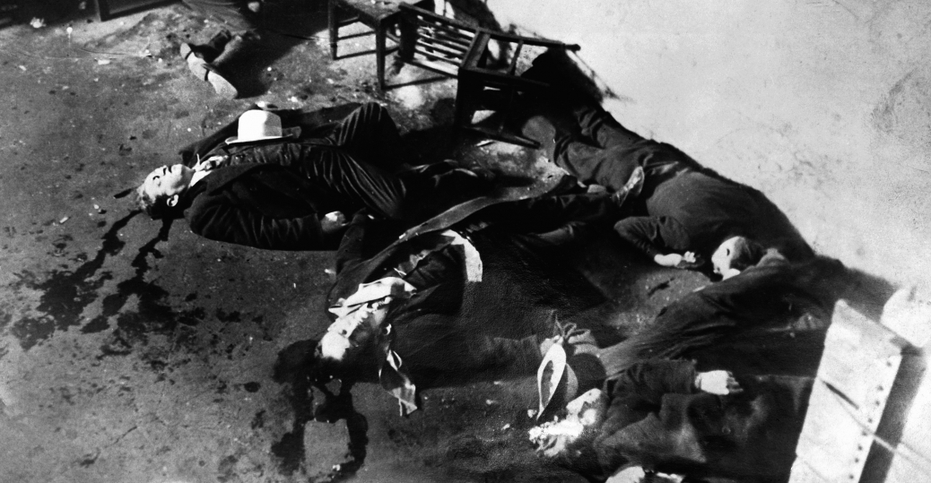
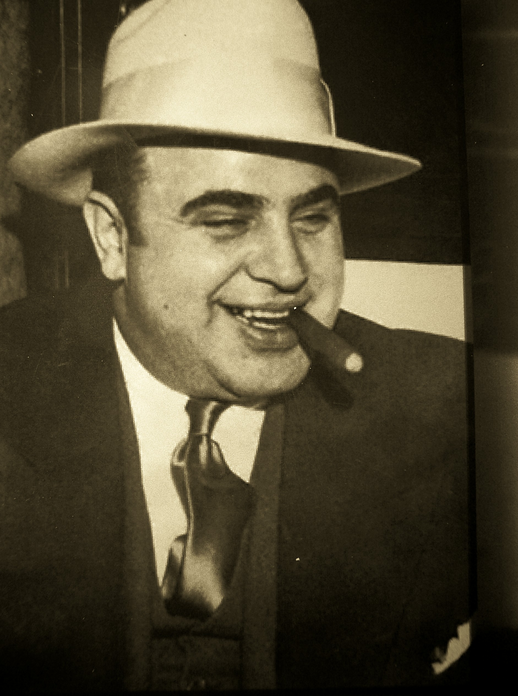
Al Capone and the Mob
Famous Chicago mobster made money from bootlegging

Slide 7
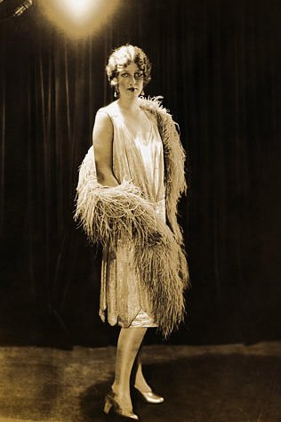
Women’s roles change
Flappers
Smoked and drank in public
Wore their hair and dresses short

Slide 8
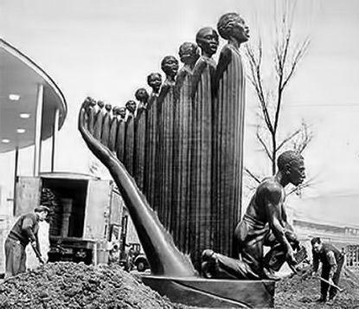
Harlem Renaissance
Movement in art, literature, music, that centered on African-American culture
Augusta Savage, Let Freedom Ring

Slide 9
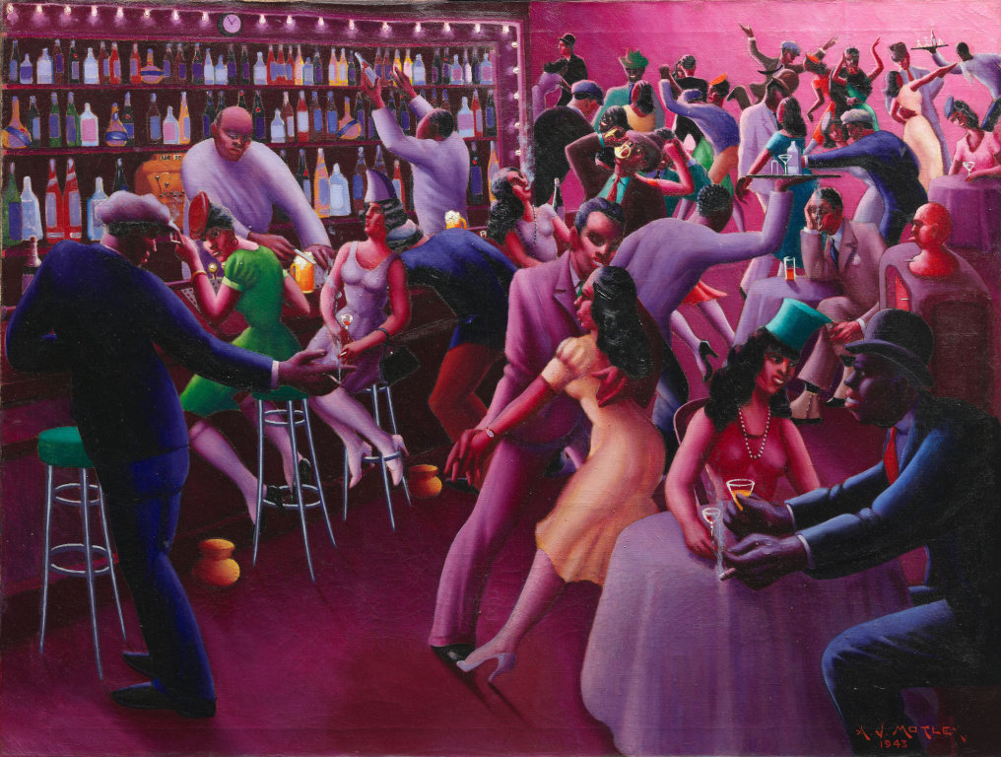
Archibald Motley Jr.
Nightlife

Slide 10
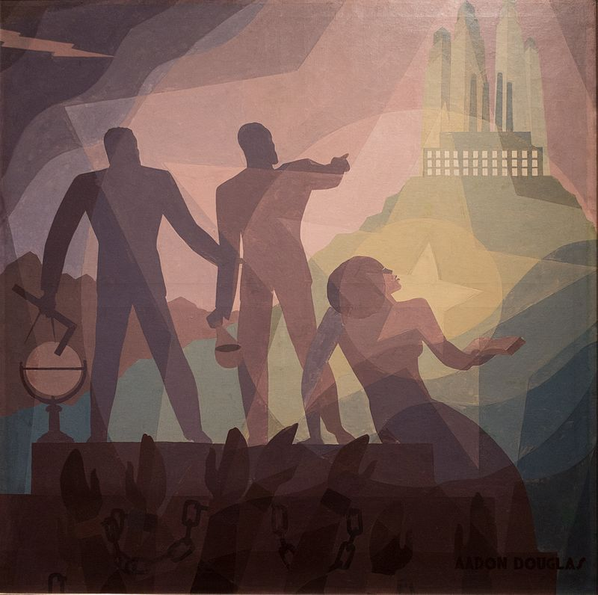
Aaron Douglas
Aspiration

Slide 11
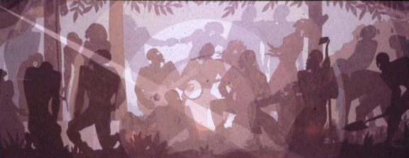
Aaron Douglas
Study for Aspects of the Negro Life: An Idyll of the Deep South

Slide 12
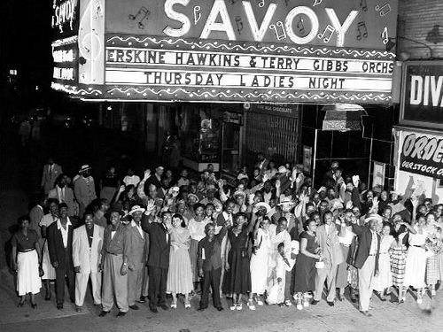
Jazz
Started in New Orleans, but became a cultural force in New York

Slide 13
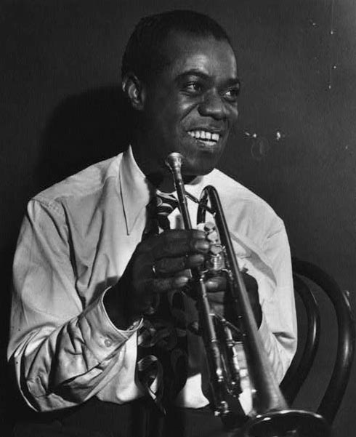
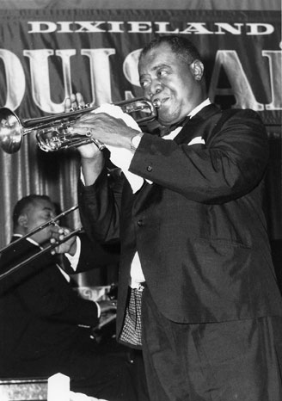
Louis Armstrong

Slide 14
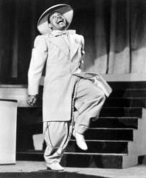
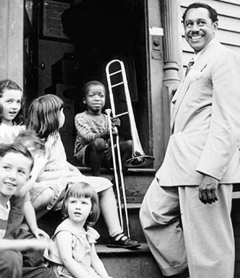
Cab Calloway

Slide 15
Bessie Smith

Slide 16
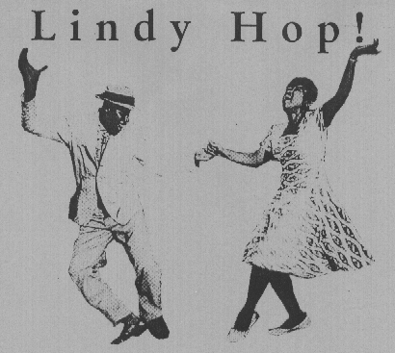
New Dances
Charleston
Black Bottom
Lindy Hop

Slide 17
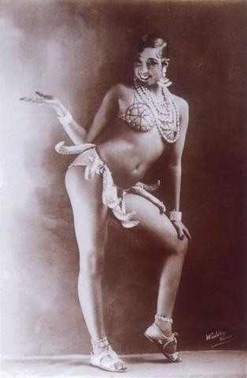
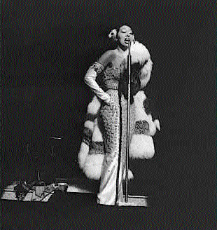
Josephine Baker

Slide 18
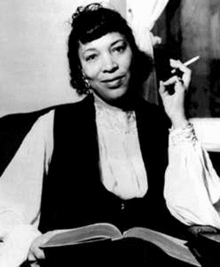
Zora Neale Hurston

Slide 19
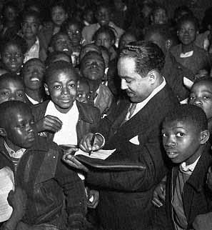
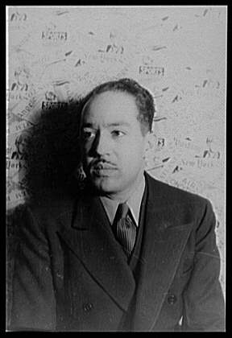
Langston Hughes

Slide 20
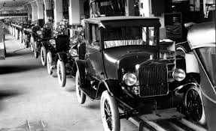
Economic Boom
Short economic downturn after WWI
Economy grew a lot after post-WWI depression

Slide 21
1920s vs the Gilded Age
Roaring 1920s
Gilded Age
Oligopolies
Pro-Business Government:
“Open Shops”
Yellow Dog Contracts
Red Scare → crackdown on unions
Monopolies
Pro-Business Government:
Govt. crackdown on unions
No enforcement of anti-trust laws

Slide 22
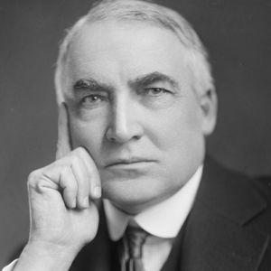
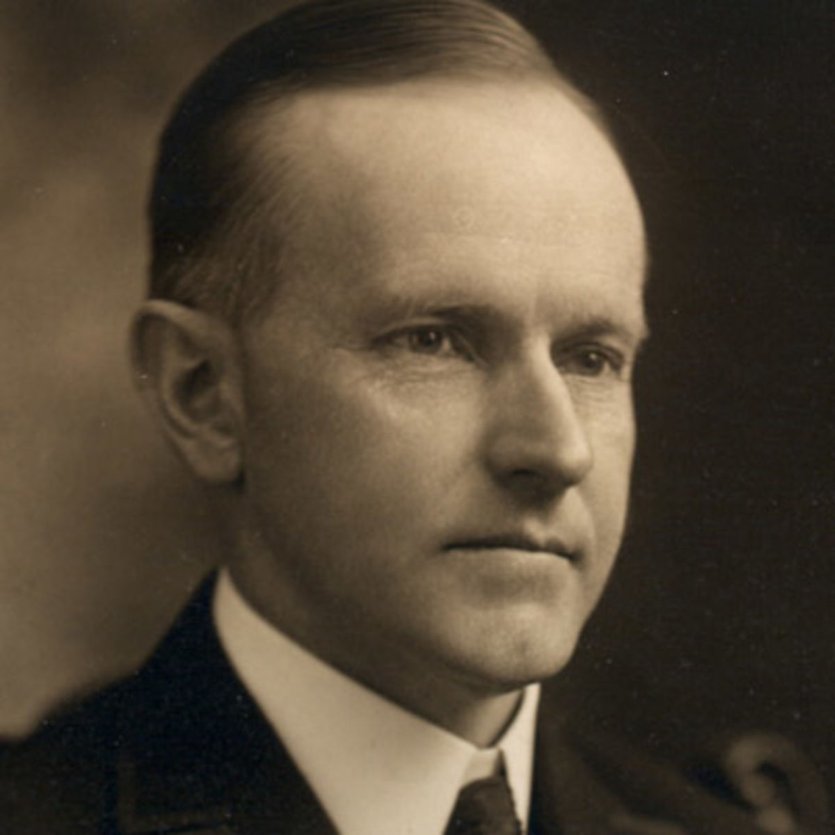
Republican Takeover
1920 - Republicans control of White House & Congress
Return to laissez faire policies
Warren G. Harding
Calvin Coolidge

Slide 23
Warren G. Harding
Campaign slogan: “Return to Normalcy”
Beliefs: Pro-Business, Pro-Civil Rights, disarmament
Achievements : Washington Naval Conference (1921-1922)
Events: Teapot Dome Scandal, his death…

Slide 24
Calvin Coolidge
In Office: 1923-1929
Campaign slogan: “Business of America is Business”
Political Beliefs: Pro-Business, pro civil rights, isolationism
Achievements: Kellogg-Briand Pact (1928)

Slide 25
The Lost Generation
A group of young writers in the 1920s
Gertrude Stein
F. Scott Fitzgerald - The Great Gatsby
Sinclair Lewis – Babbitt
Ernest Hemingway – The Sun Also Rises
Criticized American culture for being too…
Materialistic
Conservative
Self-centered

Slide 26
Urban America
By 1920, more people living in cities than rural areas
Causes a cultural shift in America
Divisions between rural and urban values

Slide 27
Culture Clashes of 1920s
Prohibition
Gender roles
Jazz
Immigration
Religion
Consumerism
African Americans

