Slide 1
The Spanish-American War

Slide 2
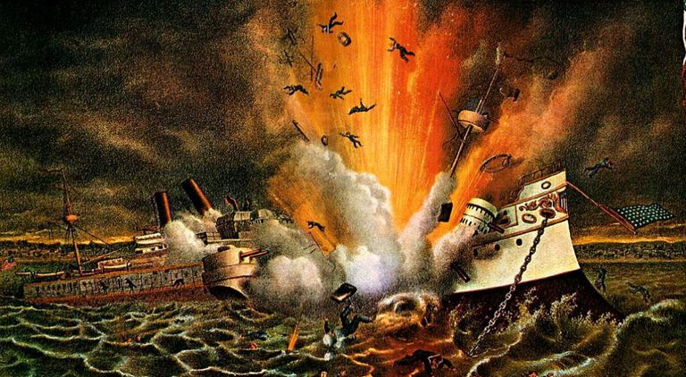
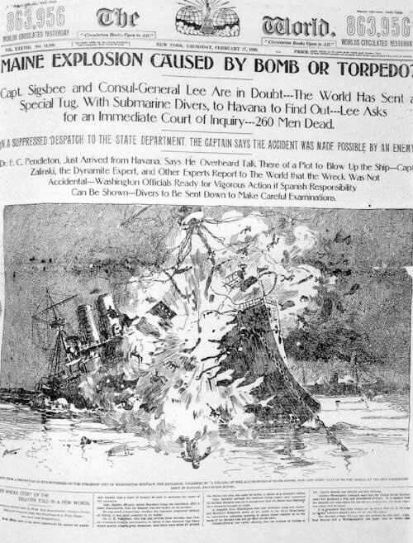
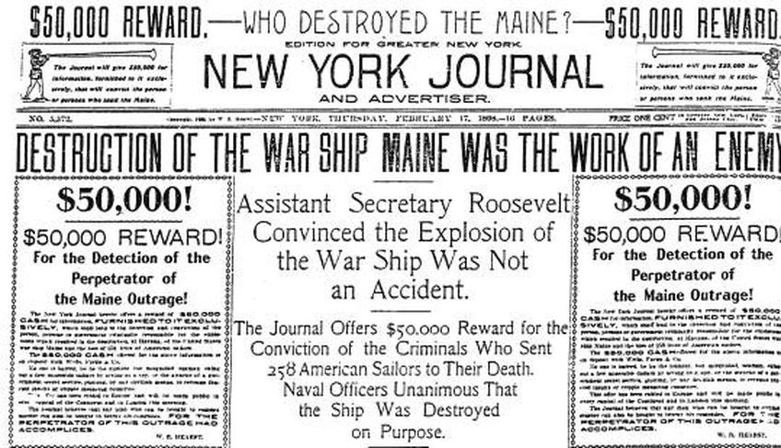
Causes
Cuban fight for independence
US business interests in Cuba
Explosion of the USS Maine
Yellow Journalism

Slide 3
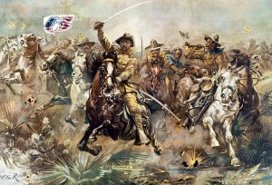
Key Events During the War
Battle of Kettle Hill
Battle of San Juan Hill
Battle of Manila

Slide 4
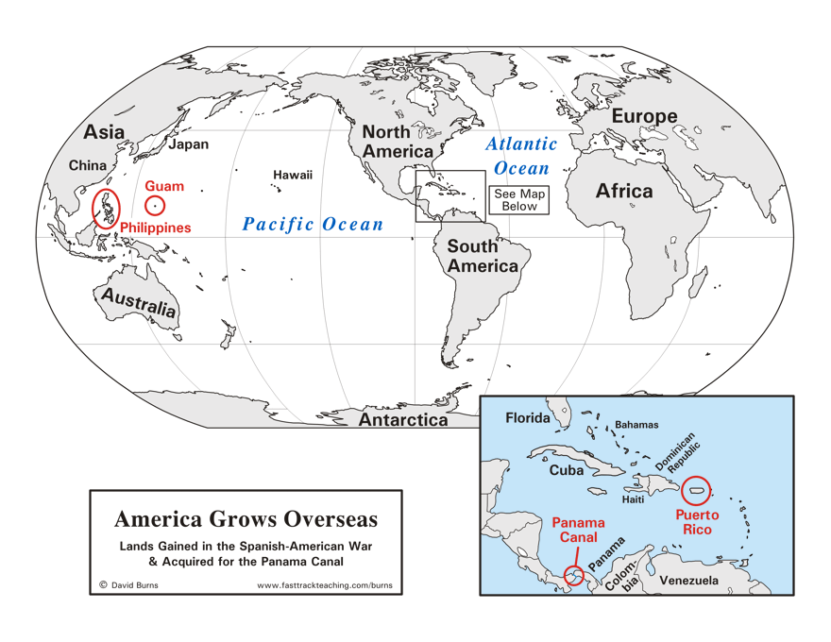
Results of the War
US Acquires:
Puerto Rico
Guam
The Philippine Islands
Cuban Independence*
Platt Amendment
Fight for Filipino Independence

Slide 5
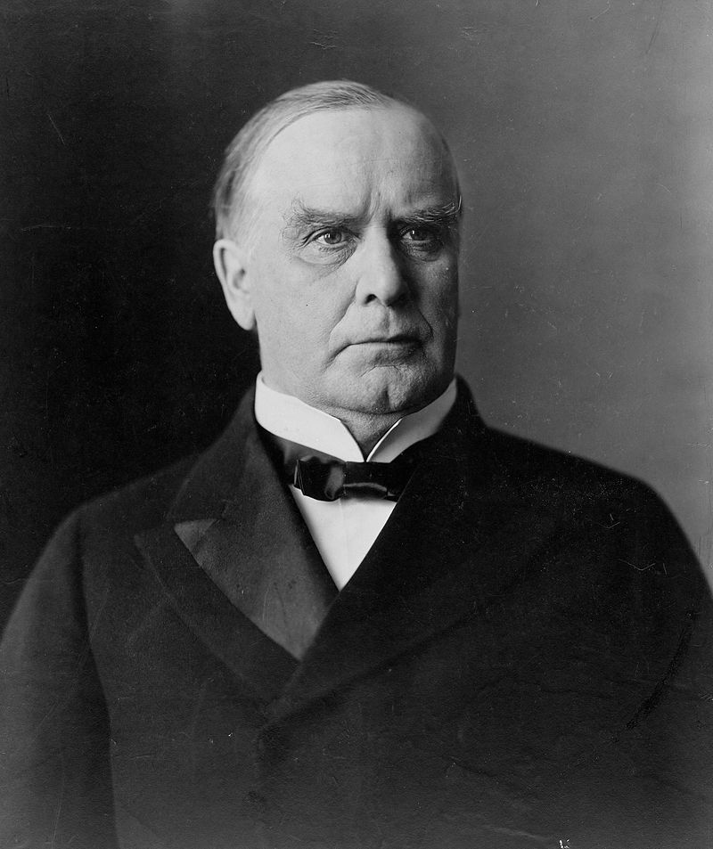
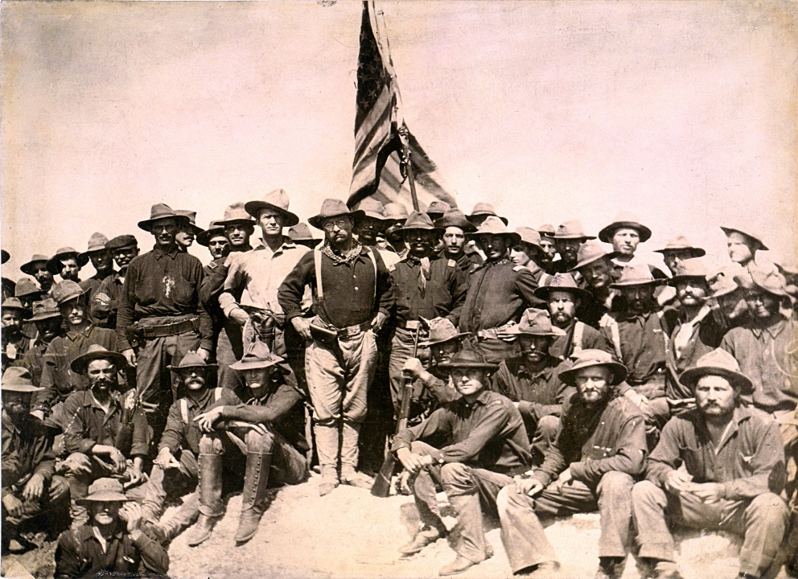
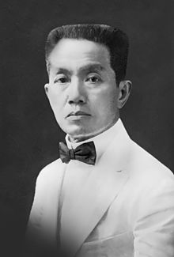
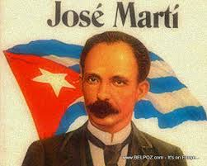
Key Peeps in the Spanish-American War
William McKinley
Jose Marti
Teddy Roosevelt
The Rough Riders
Emilio Aguinaldo

