Slide 1
Westworld
The Indian Wars

Slide 2
Western Tribes
Plains tribes used horses to move (nomadic) and hunt buffalo
Ex: Sioux (Lakota), Cheyenne
Southwestern tribes were agricultural
Ex: Navajo, Apache
Northwestern tribes farmed and fished
Ex: Nez Percé, Chinook

Slide 3
Cultural Differences
Native Americans
Little to no private property
Not all agricultural
Religion based on natural world
Western Europeans
Private property = sign of wealth
Agricultural/Mercantile economies
Christian society

Slide 4
Reasons for Conflict in 1800s
#1 = REASON LAND
White settlers and businesses moved for $$
US Govt actions
Indian Removal Acts
Violations of treaties
Destruction of Native American way of life
Destruction of the buffalo

Slide 5
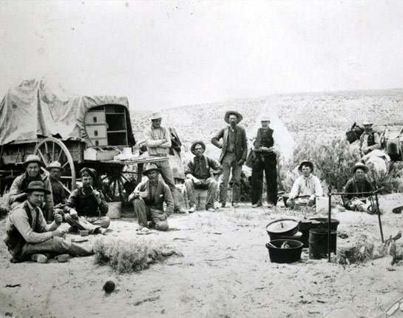
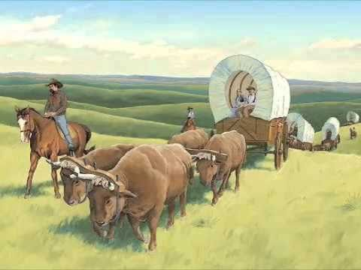
Why would you do this to yourself?

Slide 6
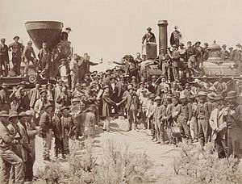
Railroad expansion
1st Transcontinental RR finished in 1869

Slide 7
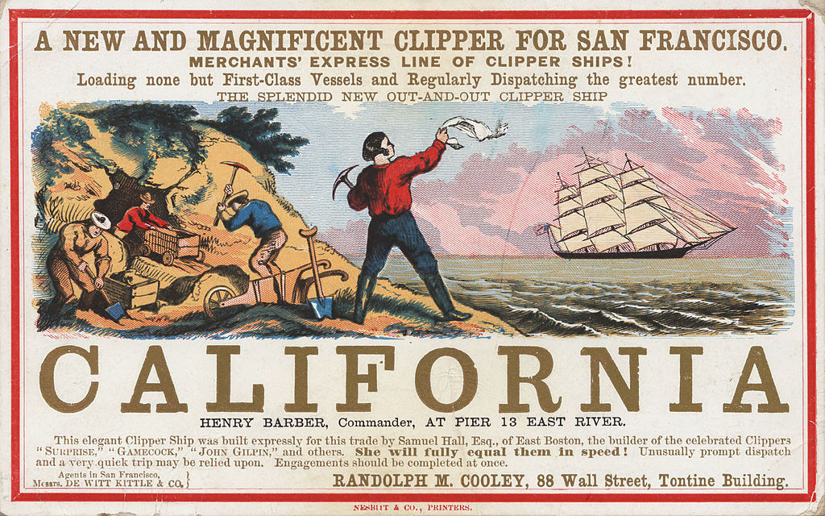
Mining Booms
Gold, silver, copper, lead mining throughout the west

Slide 8
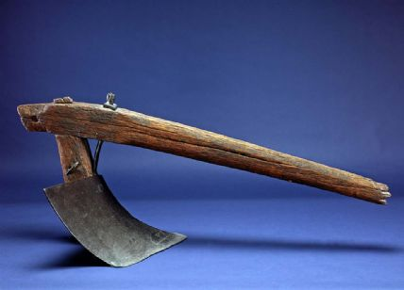
Agricultural technology advanced
The steel tip plow let farmers plant in tougher soil found on the plains

Slide 9
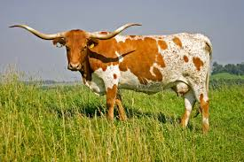
Cattle ranching boomed in Texas and the West

Slide 10
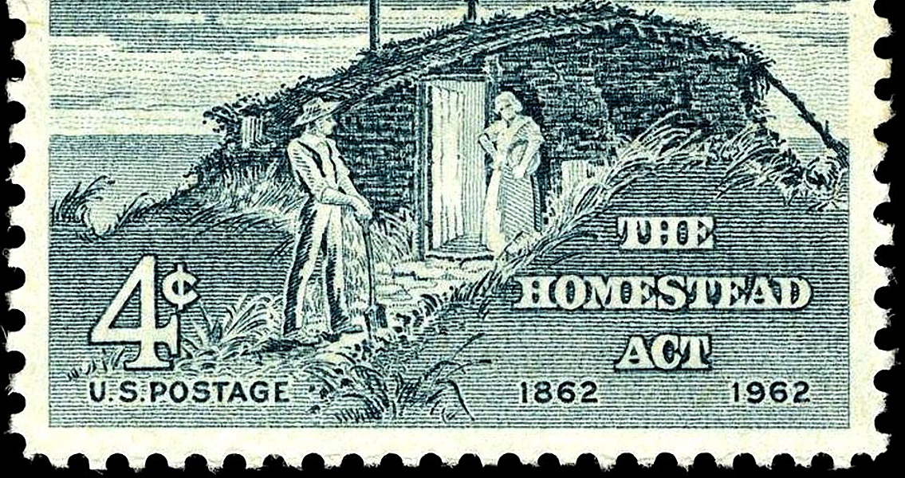
Homestead Act (1862)
Gave people 160 acres of land if they moved west and began farming for at least 5 years

Slide 11
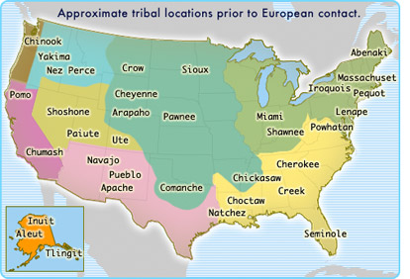

Slide 12
Federal Indian Policy
1st half of the 1800s
Remove Native Americans on to reservations
Oklahoma
2nd half of the 1800s
Assimilate Native Americans into US culture and lifestyle
Dawes Act (1887)
Indian Boarding Schools

Slide 13
Beginning of the Indian Wars
Violent conflict increased as more people moved west
The US Army got involved after the Civil War
Indian Wars = unspoken conflict between the US army and western Indian tribes

Slide 14
Major Events during Indian Wars
Sand Creek Massacre (1864)
Conflicts with the Sioux and the Massacre at Wounded Knee (1890)
Capture of Chief Joseph and Nez Percé (1877)

Slide 15
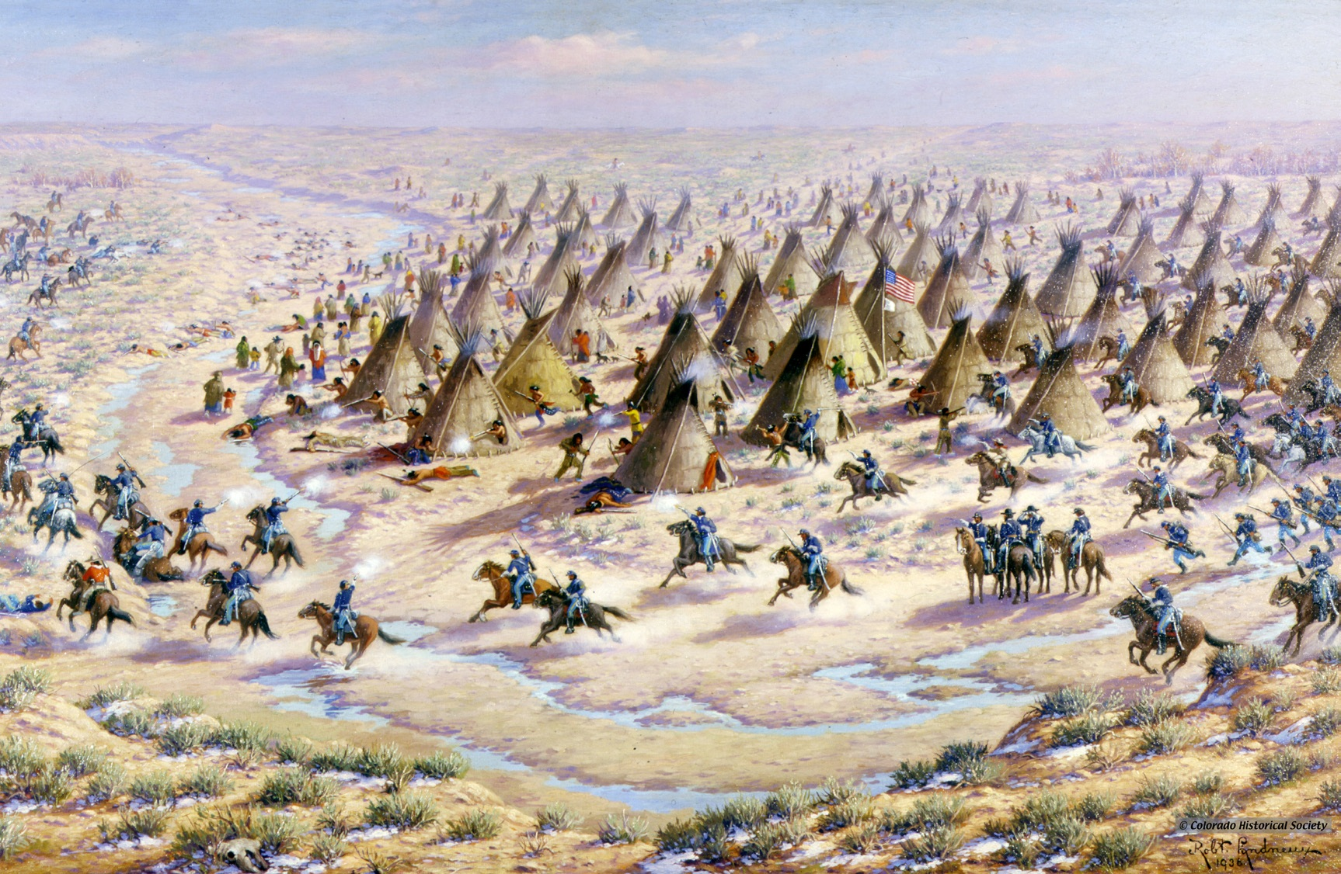
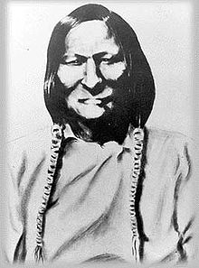
Sand Creek Massacre (1864)
John Chivington led Colorado militia attack on peaceful NA at Sand Creek reservation
Killed and mutilated mostly women and children

Slide 16
The Sioux (a.k.a. the Lakota)
Lived in the northern plains: South Dakota and Nebraska
Nomadic buffalo hunters
Famous leaders:
Red Cloud
Sitting Bull
Crazy Horse
Most successful tribe against the US

Slide 17
Red Cloud’s War (1866-68)
Sioux fought US army over land disputes
Ended when Second Treaty of Ft. Laramie (1868) was signed
Treaty:
Sioux get west SD and east WY
US abandons Bozeman Trail and outposts
Whites barred from this region

Slide 19
Great Sioux War (1876)
US violates treaty
Gold found in the Black Hills
War restarts
Battle of Little Bighorn (1876)
Custer’s unit massacred
US wants payback
Sioux eventually surrender and lose land

Slide 20
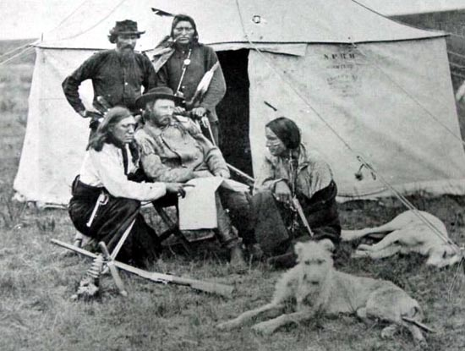

Slide 21
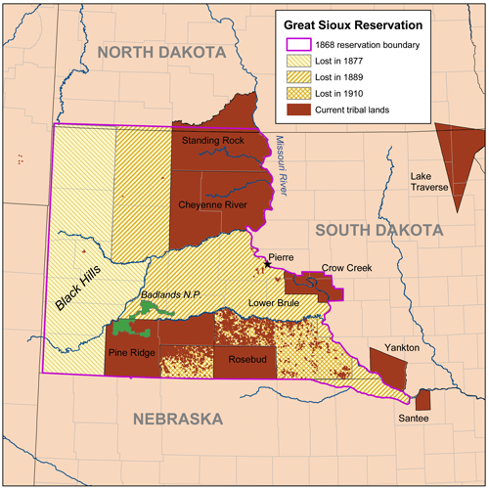

Slide 22
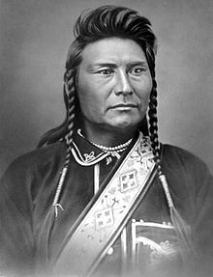
Chief Joseph and the “Nez Percé War”
US violated treaty – forced NP onto reservation in ID
Nez Percé fled, US army pursued
Almost made it to Canada before surrender
Forced to move to OK

Slide 23
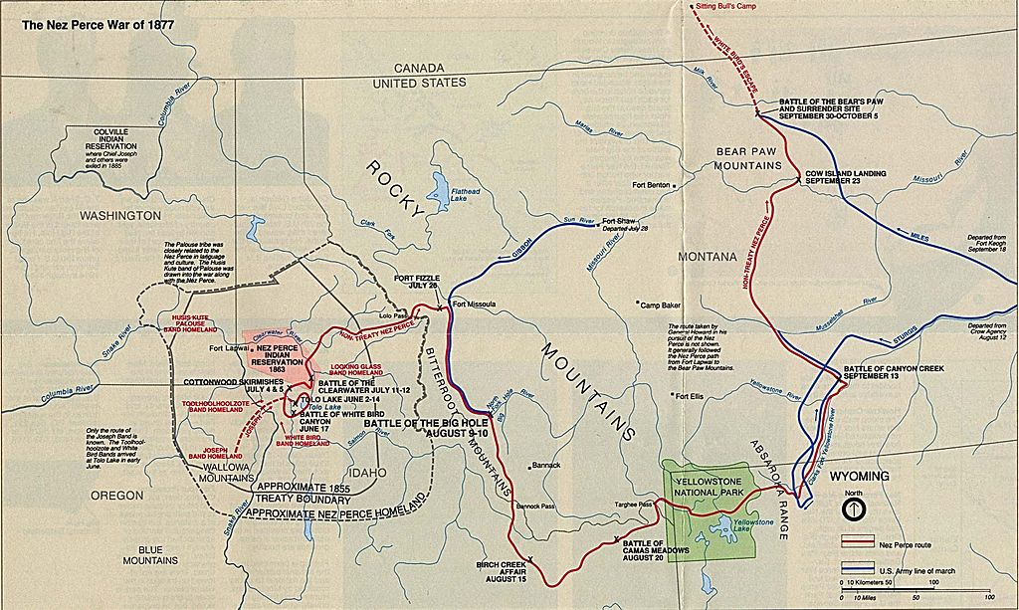

Slide 24
Ghost Dance and Wounded Knee
Ghost Dance = spiritual revival movement of 1889-1890
Spread among western tribes
Scared Whites
Some Sioux refused to go to reservations
Captured near Wounded Knee Creek
Massacre occurs next day when gun goes off
December 29, 1890

Slide 25
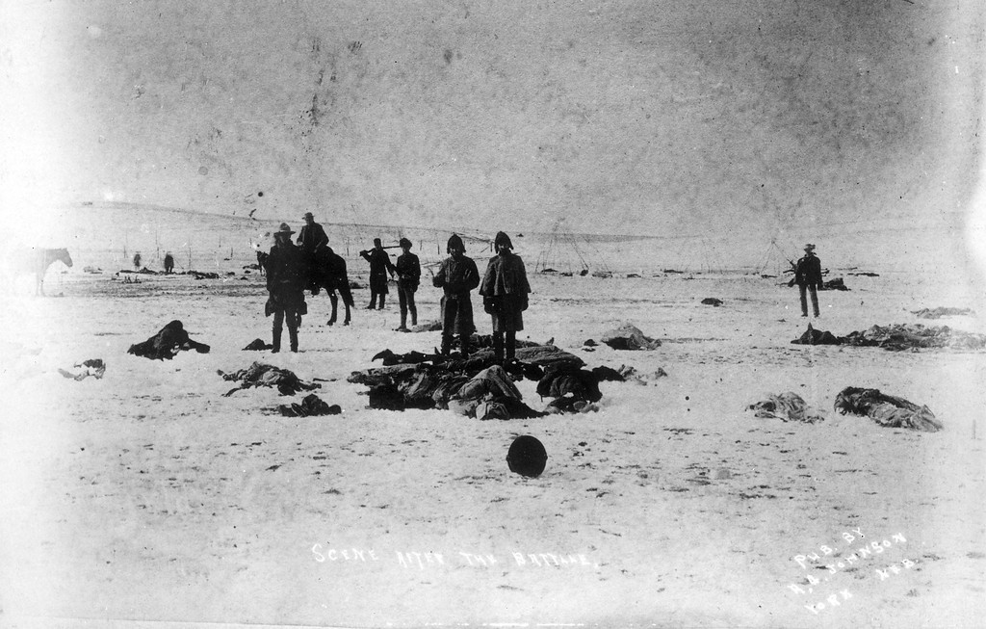

Slide 26
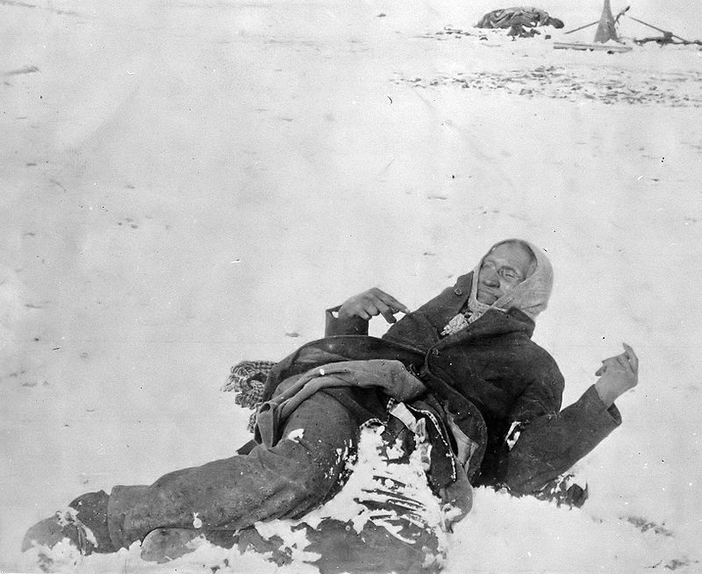

Slide 27
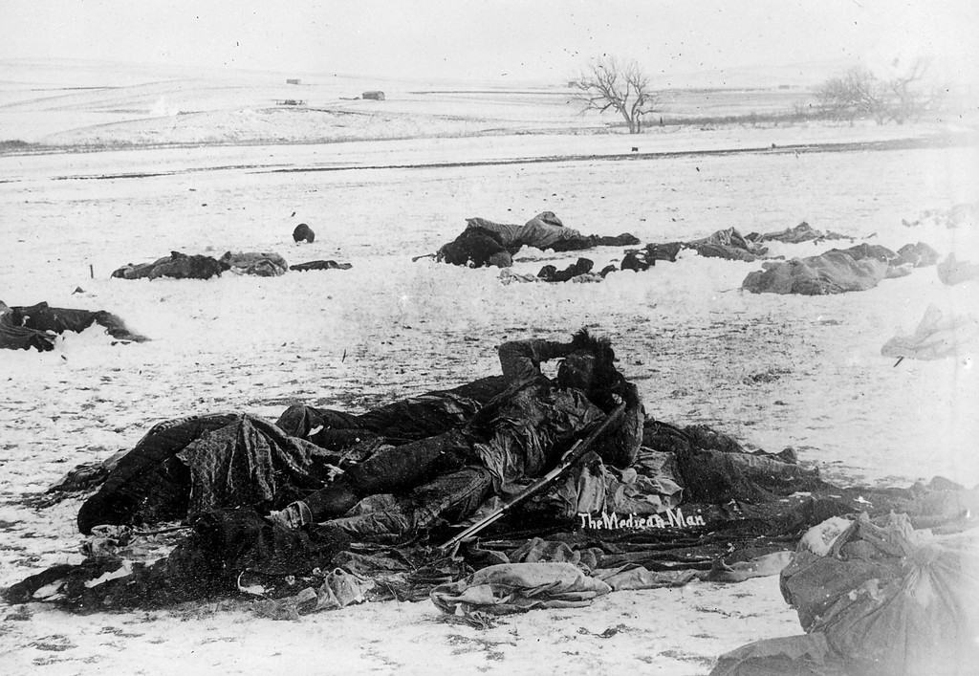

Slide 28
