Slide 1
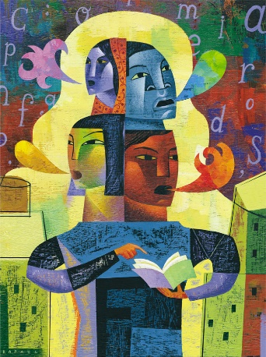
Thinking and Language Chapter 9

Slide 2
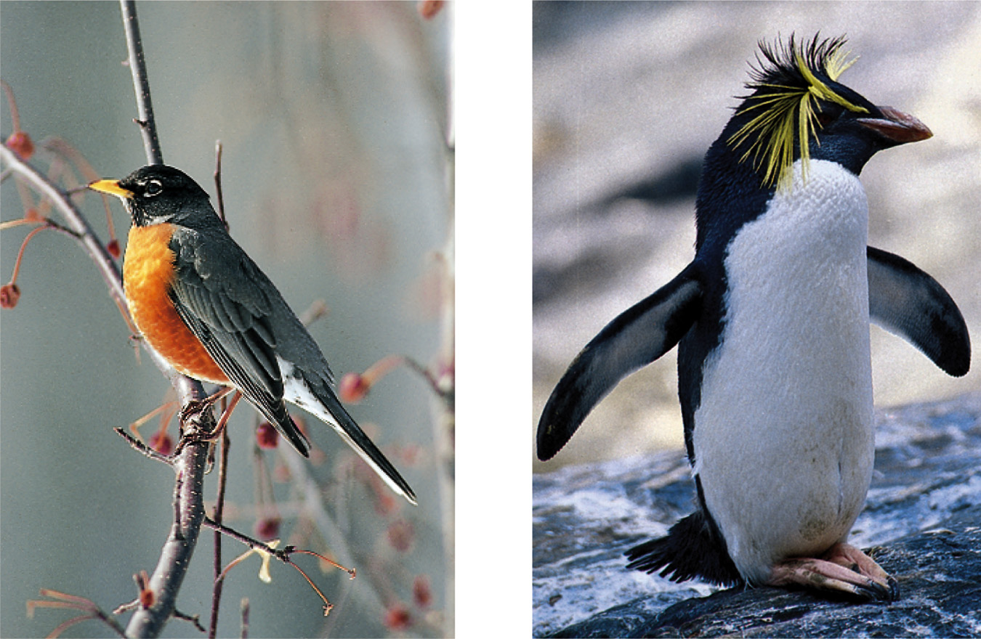
Concepts and Prototypes
For each concept we have a mental image exemplifying it (prototype).

Slide 3
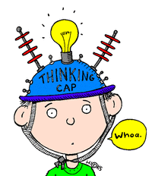
Problem Solving: Insight
Insight
Brain imaging and EEG studies suggest that when an insight strikes, it activates the right temporal cortex (Jung-Beeman, 2004).

Slide 4
Problem Solving: Representativeness Heuristic
Judging the likelihood of things or objects in terms of how well they seem to represent, or match, a particular prototype.
If you meet a slim, short, man who wears glasses and likes poetry, what do you think his profession would be?
An Ivy league professor or a truck driver?
Probability that that person is a truck driver is far greater than an ivy league professor just because there are more truck drivers than such professors.

Slide 5
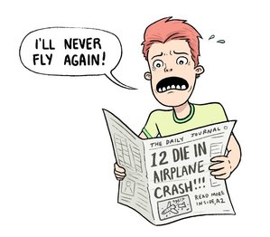
Availability Heuristic
Basing likelihood of events on the availability in memory.
Example:
Your parents read a news article about a teenager that was killed in a car accident
Then, they take away your car keys claiming that “teenagers are reckless and dangerous.”

Slide 6
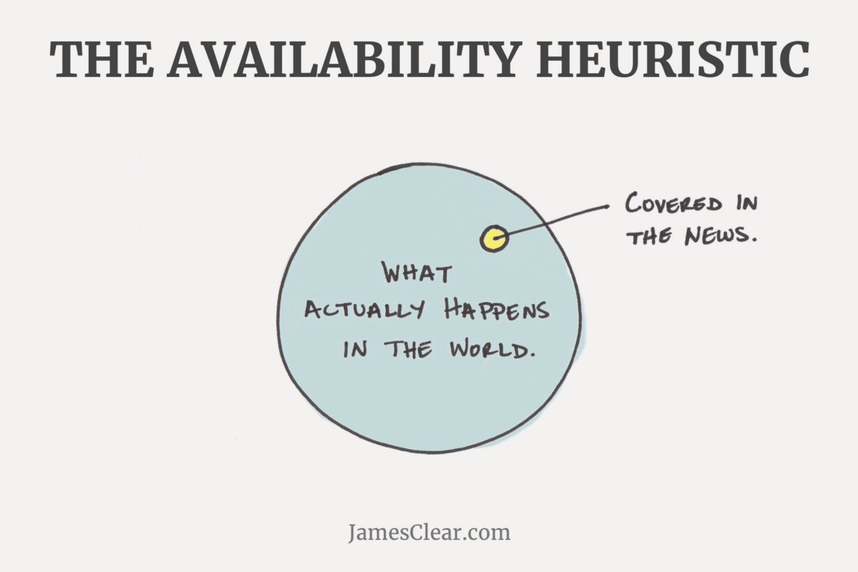

Slide 7
Problems in Solving Problems
Confirmation Bias
Example:
Liberal voters looking at liberal news sources to understand a political situation.
Notes:
OBJECTIVE 4| Contrast confirmation bias and fixation, and explain how they can interfere with effective problem solving.

Slide 8
Mo’ Problems to Problem Solving
Fixation
Mental Set
Functional Fixedness: A tendency to think only of the familiar functions of an object.

Slide 9
Rank these places by their levels of poverty (highest to lowest):
Chapel Hill
Durham (city)
New York (city)

Slide 10
Chapel Hill – 21.7%
New York (city) – 20.6%
Durham (city) – 19.6%

Slide 11
Rank these places by their median income (highest to lowest).
New York (city)
Durham (city)
Chicago
Raleigh

Slide 12
Raleigh - $54,581
New York (city) - $52,737
Durham (city) - $49,585
Chicago - $47,831

Slide 13
According to the 2010 Census
What are the racial demographics for the city of Durham (in percentages)?
White (alone)
Black (alone)
Latino/Hispanic
Asian (alone)

Slide 14
According to the 2010 Census
Durham (city)
White (alone) – 42.5%
Black (alone) – 41%
Latino/Hispanic – 14.2%
Asian – 5.1%

Slide 15
According to the 2010 Census
What are the demographics for the US (in percentages)?
White (alone)
Black (alone)
Latino/Hispanic
Asian (alone)

Slide 16
According to the 2010 Census
Amerrrrrrca
White (alone) – 72.4%
Black (alone) – 12.6%
Latino/Hispanic – 16.3%
Asian (alone) – 4.8%

Slide 17
Problems w/Intuition: Framing Decisions
Decisions and judgments may be significantly affected depending upon how an issue is framed.
Example: What is the best way to market ground beef — as 25% fat or 75% lean?
Notes:
OBJECTIVE 7| Describe how others can use framing to elicit from us the answers they want.

Slide 18
Problems w/Intuition: Belief Bias and Belief Perseverance
Belief Bias:
When one’s beliefs distort their logical reasoning.
Example:
All cops are corrupt
Frank is a cop
Frank is corrupt
Belief Perseverance
Example:
“This was the largest audience to ever witness an inauguration — period — both in person and around the globe.”
Notes:
OBJECTIVE 8| Explain how our preexisting beliefs can distort our logic.

Slide 19
Language
Language, our spoken, written, or gestured work, is the way we communicate meaning to ourselves and others.
M. & E. Bernheim/ Woodfin Camp & Associates
Language transmits culture.

Slide 20
Language Structure
Phonemes: The smallest distinct sound unit in a spoken language. For example:
bat, has three phonemes b · a · t
chat, has three phonemes ch · a · t
Notes:
OBJECTIVE 11| Describe the basic structural units of language.

Slide 21
Language Structure
Morpheme: The smallest unit that carries a meaning. It may be a word or part of a word. For example:
Milk = milk
Pumpkin = pump . kin
Unforgettable = un · for · get · table

Slide 22
Structuring Language
Phonemes
Basic sounds (about 40) … ea, sh.
Morphemes
Smallest meaningful units (100,000) … un, for.
Words
Meaningful units (290,500) … meat, pumpkin.
Phrase
Composed of two or more words (326,000) … meat eater.
Sentence
Composed of many words (infinite) … She opened the jewelry box.

Slide 23
Grammar
Grammar is the system of rules in a language that enable us to communicate with and understand others.
Grammar
Semantics
Syntax

Slide 24
Semantics
Semantics is the set of rules by which we derive meaning from morphemes, words, and sentences.
For example: Semantic rule tells us that adding –ed to the word laugh means that it happened in the past.

Slide 25
Syntax
Syntax consists of the rules for ordering words into grammatically sensible sentences.
For example: In English, syntactical rule says that adjectives come before nouns; white house. In Spanish, it is reversed; casa blanca.

Slide 26
Practice
I am a pretty, little flower.
There is no need to be rude.
I like pizza more than I like ice cream.

Slide 27
Language Development
Children learn their native languages much before learning to add 2+2.
We learn, on average (after age 1), 3,500 words a year, amassing 60,000 words by the time we graduate from high school.
Time Life Pictures/ Getty Images

Slide 28
When do we learn language?
Babbling Stage: Beginning at 4 months, the infant spontaneously utters various sounds, like ah-goo. Babbling is not imitation of adult speech.
Notes:
OBJECTIVE 12| Trace the course of language acquisition from the babbling stage through two-word stage.

Slide 29
When do we learn language?
One-Word Stage: Beginning at or around his first birthday, a child starts to speak one word at a time and is able to make family members understand him. The word doggy may mean look at the dog out there.

Slide 30
When do we learn language?
Two-Word Stage: Before the 2nd year a child starts to speak in two-word sentences. This form of speech is called telegraphic speech because the child speaks like a telegram: “Go car,” means I would like to go for a ride in the car.

Slide 31
When do we learn language?
Longer phrases: After telegraphic speech, children begin uttering longer phrases (Mommy get ball) with syntactical sense, and by early elementary school they are employing humor.
You never starve in the desert because of all the sand-which-is there.

Slide 32
When do we learn language?

Slide 33
Explaining Language Development
Operant Learning: Skinner (1957, 1985) believed that language development may be explained on the basis of learning principles such as association, imitation, and reinforcement.
Notes:
OBJECTIVE 13| Discuss Skinner’s and Chomsky’s contributions to the nature-nurture debate over how children acquire language, and explain why statistical learning and critical periods are important concepts in children’s language learning.

Slide 34
Explaining Language Development
2. Inborn Universal Grammar: Chomsky (1959, 1987) opposed Skinner’s ideas and suggested that the rate of language acquisition is so fast that it cannot be explained through learning principles, and thus most of it is inborn.

Slide 35
Explaining Language Development
Statistical Learning and Critical Periods:
Infants can determine word breaks and associated syllables thru “statistically analysis.”
These statistical analyses are learned during critical periods of child development.

Slide 36
Genes, Brain, & Language
Genes design the mechanisms for a language, and experience modifies the brain.
Michael Newman/ Photo Edit, Inc.
David Hume Kennerly/ Getty Images
Eye of Science/ Photo Researchers, Inc.

Slide 37
Language & Age
Learning new languages gets harder with age.

Slide 38
Language & Thinking
Language and thinking intricately intertwine.
Rubber Ball/ Almay

Slide 39
Language Influences Thinking
Linguistic Determinism: Whorf (1956) suggested that language determines the way we think. For example, he noted that the Hopi people do not have the past tense for verbs. Therefore, the Hopi cannot think readily about the past.
Notes:
OBJECTIVE 14| Summarize Whorf’s linguistic determinism hypothesis, and comment on its standing in contemporary psychology.

Slide 40
Linguistic Determinism Questioned
Although people from Papua New Guinea do not use our words for colors and shapes, they still perceive them as we do (Rosch, 1974).

Slide 41
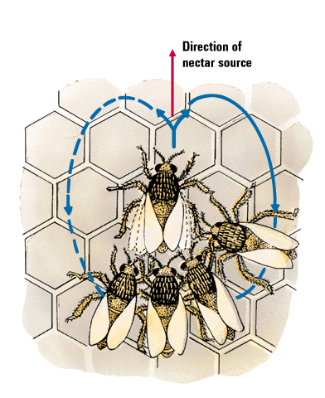
Animals & Language
Do animals have a language?
Honey bees communicate by dancing. The dance
moves clearly indicate the direction of the nectar.

Slide 42
Do Animals Think?
Common cognitive skills in humans and apes include the following:
Concept formation.
Insight
Problem Solving
Culture
Mind?
William Munoz
African grey parrot assorts red
blocks from green balls.
Notes:
OBJECTIVE 16| List five cognitive skills shared by the great apes and humans.

Slide 43
Do Animals Exhibit Language?
There is no doubt that animals communicate.
Vervet monkeys, whales and even honey bees communicate with members of their species and other species.
Copyright Baus/ Kreslowski
Rico (collie) has a
200-word vocabulary
Notes:
OBJECTIVE 17| Outline the arguments for and against the idea that animals and humans share the capacity for language.

