Slide 1
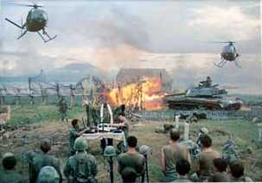
Vietnam War
Escalation in Vietnam
1965-1968

Slide 2
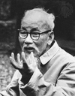
Ho Chi Minh
Leader of North Vietnam after independence from France
Communist
Fought French with Vietminh
Fought US with Vietcong

Slide 3
LBJ Gets the US More Involved
1964 – Johnson commits ground troops
1965 – Johnson starts Operation ROLLING THUNDER (3 year bombing campaign)
1966 – US troops go from 75,000 to 275,000
1967 – Over 485,000 US troops

Slide 4
US Challenges
Guerrilla Warfare
Unknown enemy
Challenging Terrain
Ho Chi Minh Trail
Vietnamese sense of independence
Unpopularity of South Vietnam regimes

Slide 5
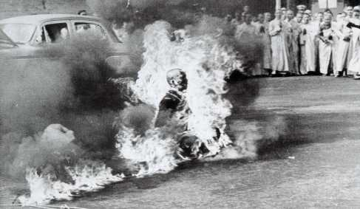
Protests

Slide 6
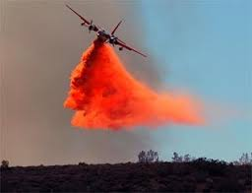
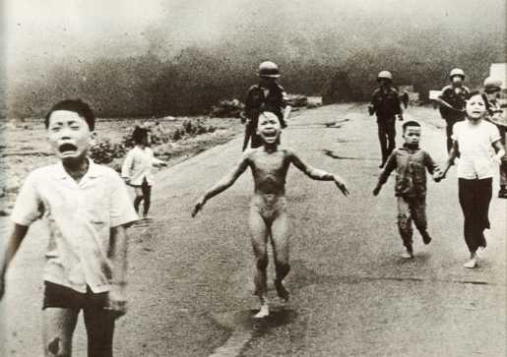
Fighting the Terrain
Napalm - Gasoline based gel explosive
Agent Orange – chemical defoliant (removes leaves from trees)

Slide 7
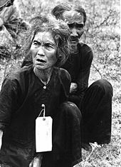
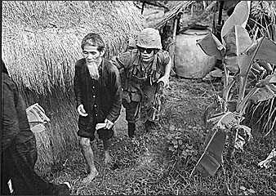
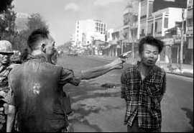
The Enemy Within?

Slide 8
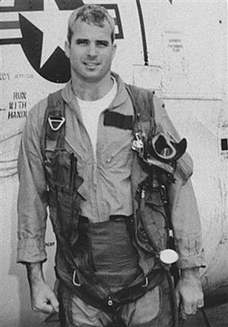
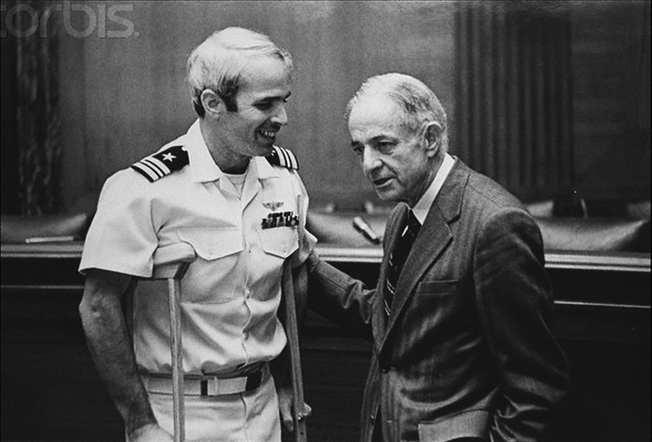
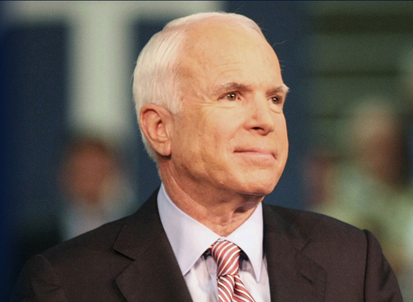
Mistreatment of POWs
Viet Cong mistreated US soldiers and South Vietnamese
US mistreated captured VC

Slide 9
Vietnam and the Credibility Gap
Credibility Gap: Difference between what the gov said was happening and what actually happened
It was growing
News agencies showed what was really happening in Vietnam

Slide 10
Tet Offensive
Surprise attack by the North Vietnamese on Vietnamese New Year (Tet).
US able to regain control but looks bad to the public

Slide 11
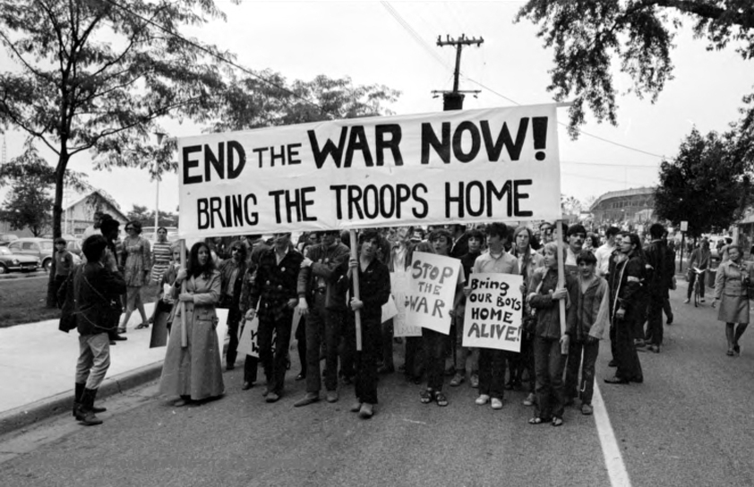
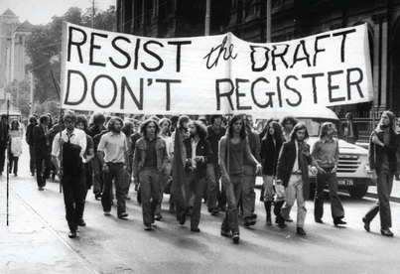
Impact of War
Great Society and Civil Rights Movement overshadowed by Vietnam War
Civil unrest and distrust of govt grows
Cost of money and lives
LBJ rep ruined

